Slide 1
Unit 09
Listen
Ecology

Slide 2
Objective 9.1
Listen
I can describe what is studied in Ecology.

Slide 3
Write
Ecology: The study of interactions between living things and the environment.

Slide 4
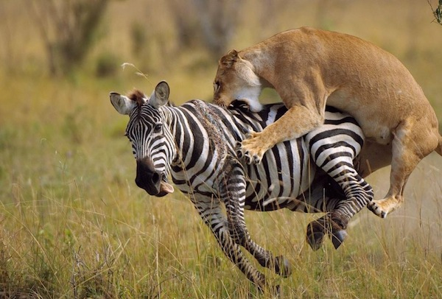
What interaction is taking place?
Listen
Predation

Slide 5
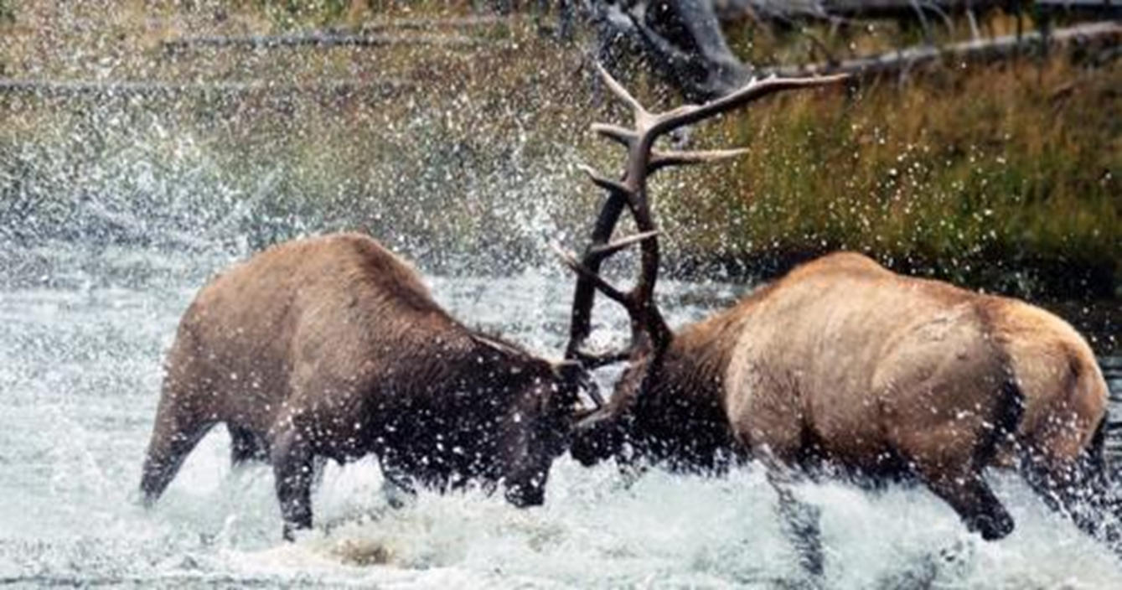
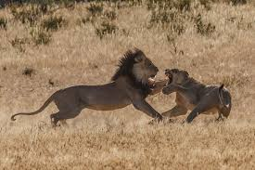
What interaction is taking place?
Listen
Competition

Slide 6
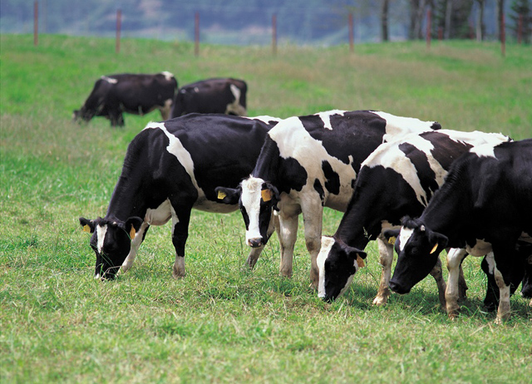
What interaction is taking place?
Listen
Predation

Slide 7
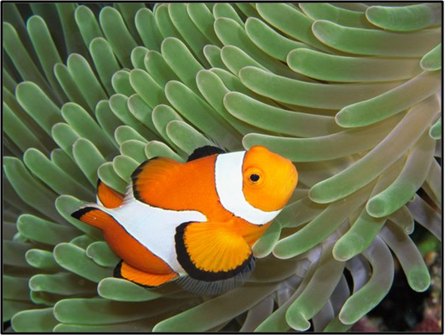
What interaction is taking place?
Listen
Mutualism

Slide 8
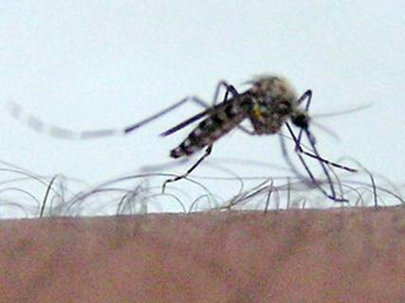
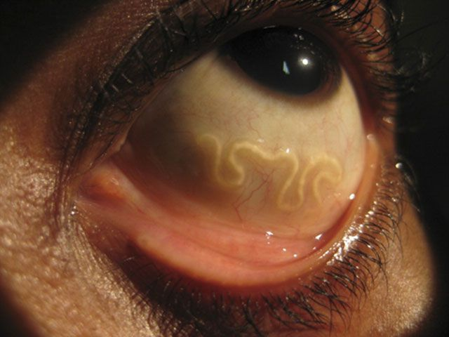
What interaction is taking place?
Listen
Parasitism

Slide 9
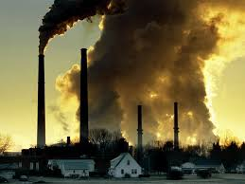
What interaction is taking place?
Listen
Pollution

Slide 10
Check In
Review
What does Ecology study?
Interactions living things have with other living things as well as their environment.

Slide 11
Interactions Video
Activity
Watch this video and try to identify as many interactions between living things and their environment as you can.
https://www.youtube.com/watch?v=G0Awq-I84Ow

Slide 12
Objective 9.2
Write
I know the difference between a biotic and abiotic factor

Slide 13
Abiotic and Biotic Factors
Write
Abiotic Factors
Something that is NOT alive
Biotic Factors
Something that is alive

Slide 14
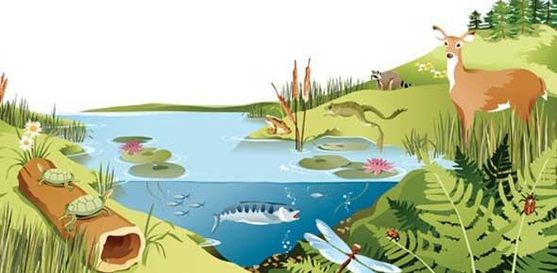
Identify Biotic and Abiotic Factors

Slide 15
Check In
Review
Abiotic Factors are
NOT ALIVE
Biotic Factors are
ALIVE

Slide 16
Objective 9.3
Write
I can define and correctly order the levels of organization

Slide 17
Individual
Listen
Individual
One individual of a species

Slide 18
Population
Listen
Population
A group of individuals of the same species that live in the same area

Slide 19
Community
Listen
Community
Different populations that live together in the same area

Slide 20
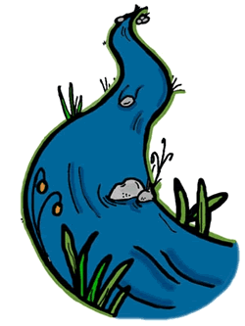
Ecosystem
Listen
Ecosystem
Community (biotic factors) plus physical environment (abiotic factors)

Slide 21
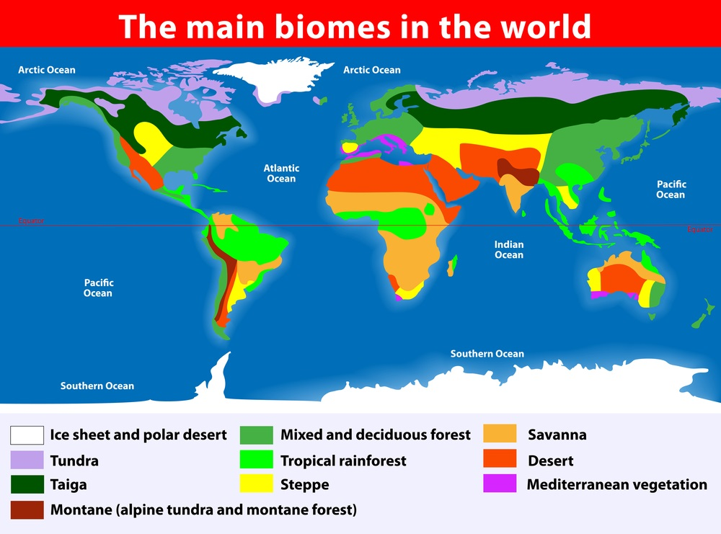
BIOME
Listen
Biome
Group of ecosystems with similar climate, plants and animals

Slide 22
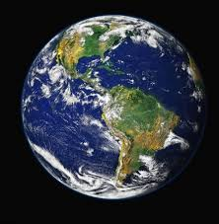
Biosphere
Listen
Biosphere
Planet Earth
https://vimeo.com/55073825

Slide 23
Review Game

Slide 24
Objective 9.4
Write
I know the four laws of ecology and can explain what they mean.

Slide 25
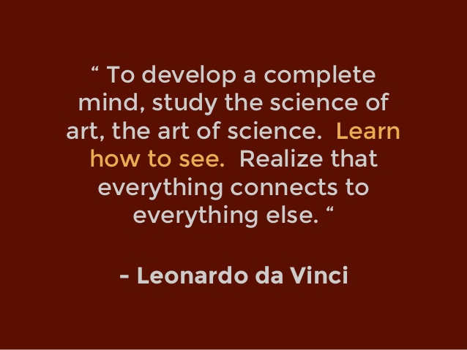
Listen

Slide 26
Write
1. Everything is connected to everything else

Slide 27
The Great Leap Forward
Listen
Starting in 1958, Mao Zedong, leader of the Communist Party of China, initiated a series of policies to transform the country into a modern, industrialized, communist society.
One of the first actions taken was known as the Four Pests Campaign.
This campaign sought to eliminate rats, flies, mosquitoes, and sparrows.

Slide 28
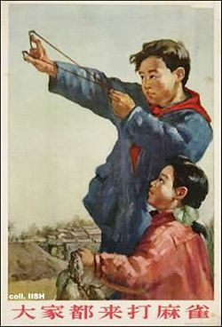
The Four Pests Campaign
Listen
Masses of people were mobilized to eradicate the Eurasian Tree Sparrow.
Tactics included:
Banging pots and pans, preventing the birds from landing, until they were exhausted.
Tearing down nests.
Shooting them from the sky using guns and sling shots.
“Everyone come and fight sparrows.”

Slide 29
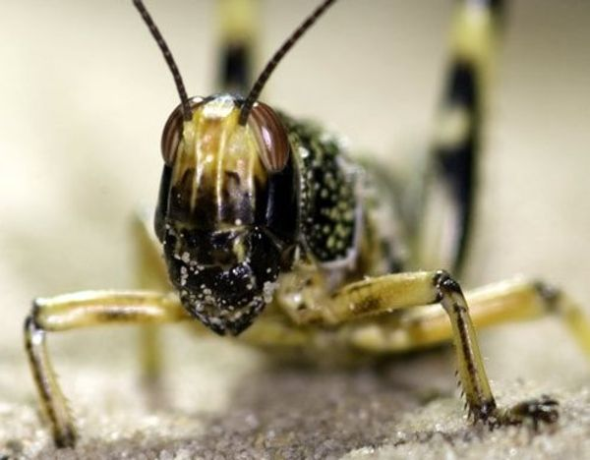
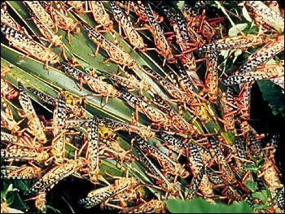
Unintended Consequences
Listen
The sparrows were hunted because they ate grain seeds; reducing crop yields.
By April of 1960, Chinese leaders came to realize that the sparrows also ate a large number of pest insects, including locusts.

Slide 30
The Great Famine
Listen
The locust plague, overplanting, and over plowing combined with a severe drought.
The number of victims is unknown, but estimated between 20-43 million.

Slide 31
Write
2. Everything must go somewhere

Slide 32
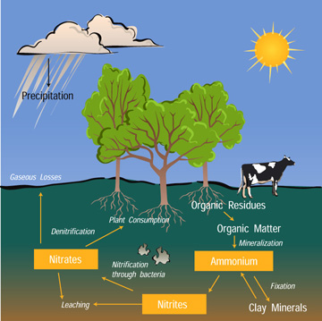
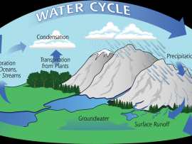
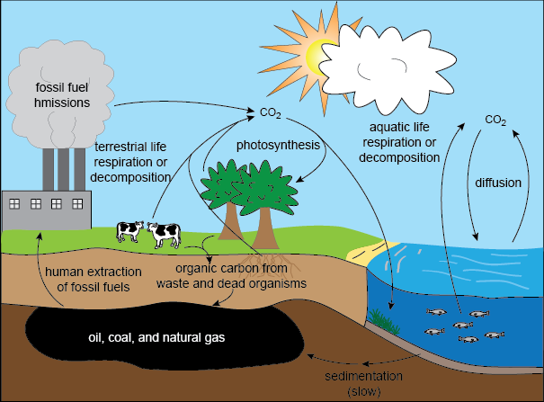
Listen

Slide 33
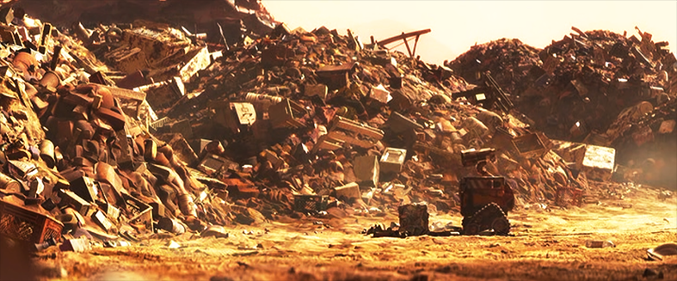
Listen

Slide 34
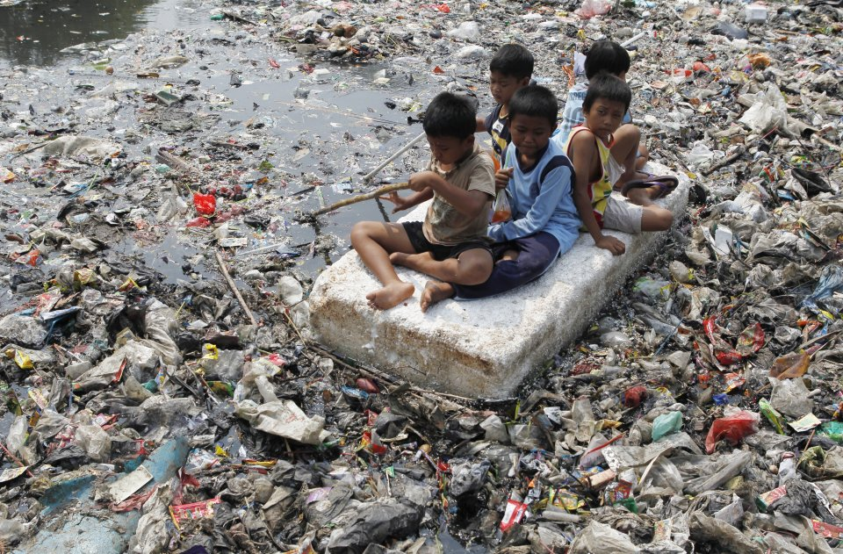
Listen

Slide 35
Watch
https://www.youtube.com/watch?v=rxjfRSQj2sY

Slide 36
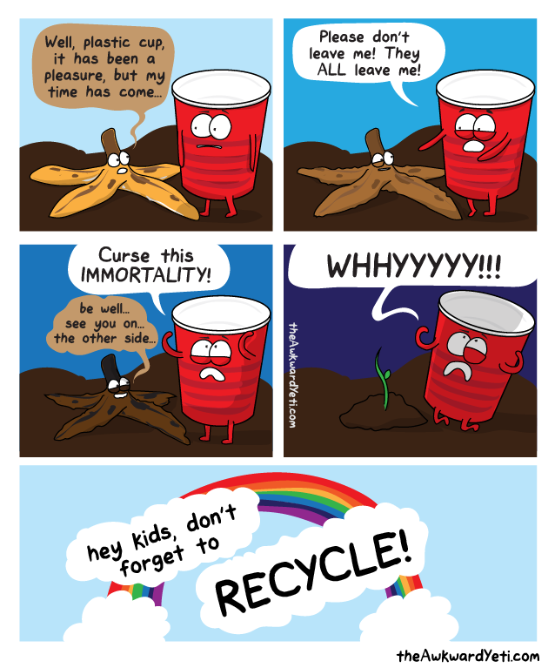
Listen

Slide 37
Write
Nature knows best.
“Humankind has fashioned technology to improve upon nature, but such change in a natural system is likely to be detrimental to that system”

Slide 38
Video Close Read:
We will watch the video, discuss the questions on your worksheet, and write down our answers.

Slide 39
Listen
There is no such thing as a free lunch.
Everything we consume has a cost.

