Slide 1
Unit 07 DNA Mutations

Slide 2
Mutations
Write
Mutation: A change in DNA that affects genetic information
Causes of Mutations:
Mistakes made during DNA Replication
Damage to DNA from the environment
UV Rays
Radiation
Exposure to Chemicals

Slide 3
Types of Mutations
Write
Point Mutations: Changes in one or a few nucleotides.
Substitution: One nucleotide is substituted for another
Original Strand:
Mutations:
Insertion: A nucleotide is inserted
Original Strand:
Mutation
Deletion: A nucleotide is deleted
Original Strand:
Mutation:
A | T | A | G | C | C | A | T | G | C | C | A | C
A | T | A | G | G | C | A | T | G | C | C | A | C
A | T | A | G | C | C | A | T | G | C | C | A | C
Frameshift Mutation
A | T | A | G | A | C | C | A | T | G | C | C | A | C
A | T | A | G | C | C | A | T | G | C | C | A | C
A | T | A | G | C | C | A | T | C | C | A | C

Slide 4
Types of Mutations
Frameshift Mutations: Cause the entire reading frame to shift
Insertion
Normal:
Mutation:
Deletion
Normal:
Mutation
THE
FAT
CAT
ATE
THE
RAT
THE
FAT
HCA
TAT
ETH
ERA
T
Inserted Nucleotide
THE
FAT
CAT
ATE
THE
RAT
TEF
ATC
ATA
TET
GER
AT
Deleted Nucleotide

Slide 5
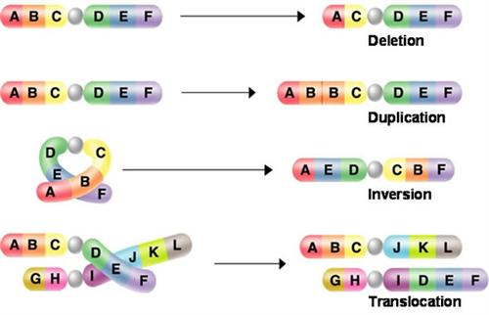
Chromosome Mutations

Slide 6
Chromosome Mutations
Chromosome Mutations:
Changes in number and structure of entire chromosomes
Original Chromosome ABC * DEF
Deletion AC * DEF
Duplication ABBC * DEF
Inversion AED * CBF
Translocation ABC * JKL
GHI * DEF

Slide 7
Germinal Mutations
Occur in sex cells
Child will inherit mutation in all cells
Somatic Mutation
Occurs in somatic cells
Stays in the individual, cannot be passed onto children

