Slide 1
PROTEINS

Slide 2
Keratin:
Hair, Skin, Nails
Listen
Anti-Bodies:
Immune System
Myoglobin:
Muscle
Living things are made of proteins.
Melanin:
Skin, Hair,
and Eye Color
Enzymes:
Tiny Machines

Slide 3
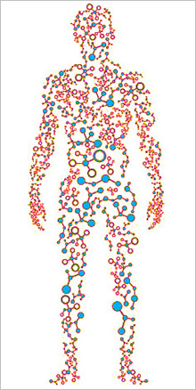
Listen
2 million types of
proteins in the
Human body
All the proteins in a human is known as a proteome

Slide 4
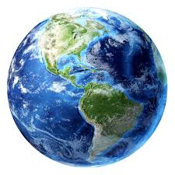
Listen
10 million types of proteins
In the world that we know of so far

Slide 5
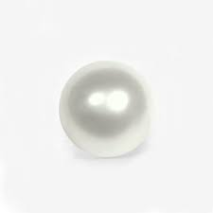
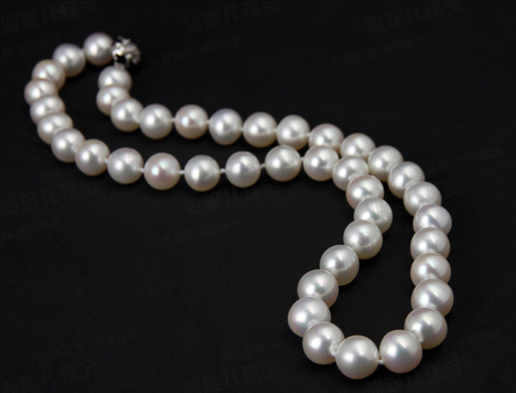
Polymer and Monomer Review
MONOMER
ONE THING
Small molecule
POLYMER
MANY ONE THINGS
Large Molecule
Example: Pearl
Example: Pearl Necklace
Example: Single Chain Link
Example: Chain

Slide 6
Protein
Listen
MONOMER:
Amino Acid
POLYMER:
Polypeptide (Protein)

Slide 7
Listen
ALL PROTEINS
ARE MADE FROM
20
AMINO ACIDS

Slide 8
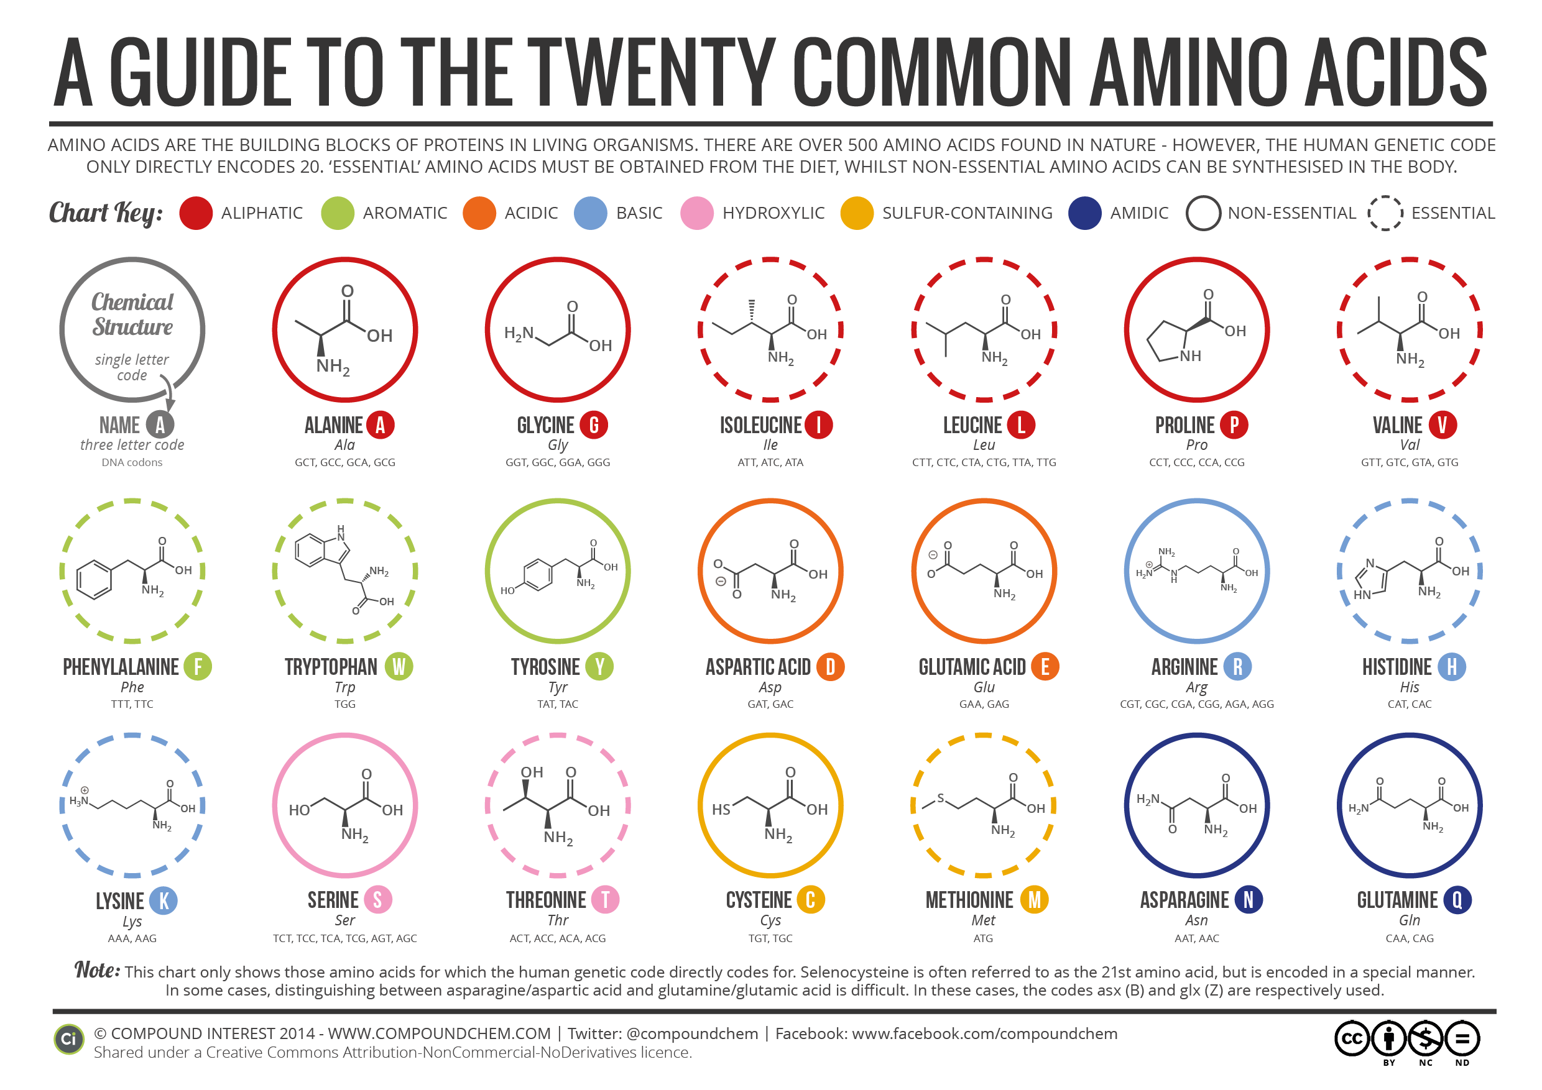
Listen

Slide 9
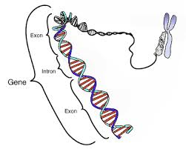
Listen

Slide 10
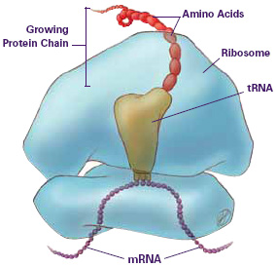
Listen

Slide 11
Proteins
Write
Living things are made up of proteins.
The information needed to create a protein is found on a gene. (1 gene = 1 protein)
Proteins are a polymer.
The monomer of a protein is an amino acid.
There are 20 types of amino acids.
Ribosomes combine amino acids to create proteins.

Slide 12
Review Questions
Why are proteins important to life?
A piece of DNA that contains the instructions to make one protein is called a ____________?
Proteins are considered polymers. What is the monomer of a protein?
How many different types of amino acids are there?
Life is made up of proteins.
Gene
Amino Acid
20

Slide 13
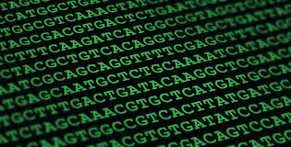
DNA is Information

Slide 14
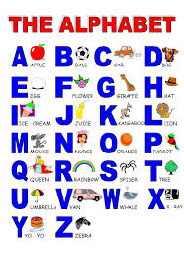
Alphabets
Listen
DOG
CAT
APPLE
CAR
GENES
AIRPLANE
SCHOOL

Slide 15
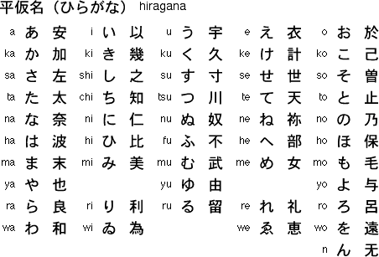
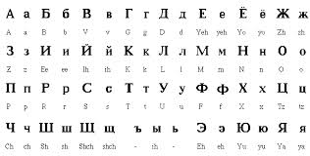
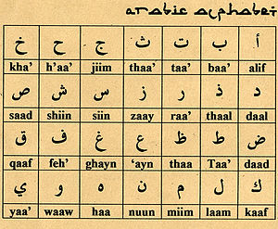
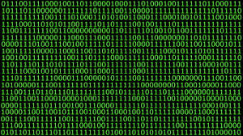
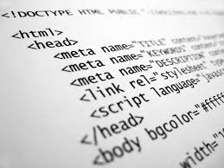
Listen

Slide 16
Listen
DNA Alphabet Letters
A
T
G
C
DNA Alphabet Words (Codons)
A
T
G
A
C
C
C
T
G
G
G
C

Slide 17
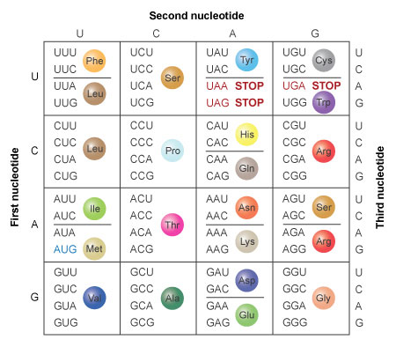
Listen
64 Codons
20 Amino Acids

Slide 18
DNA stores two types of information.
How to make proteins (Genes)
How many proteins to make and when (Junk DNA)
The letters of the DNA alphabet are: A, T, C, G
DNA words (codons) are three nucleotides (or letters) long.
There are 64 codons that code for 20 amino acids.
Different codons can code for the same amino acid.
like synonyms in the English language, different words can mean the same thing.
1 codon = 1 amino acid
Write

Slide 19
Review Questions
What are the four letters in the DNA alphabet
DNA can only have three letter words, what do we call these three letter words?
How many total codons are there?
What does one codon code for?
Can there be more than one codon for an amino acid?
A, T, C, G
CODONS
64
One Amino acid
Yes, different codons can code for the same amino acid

Slide 20
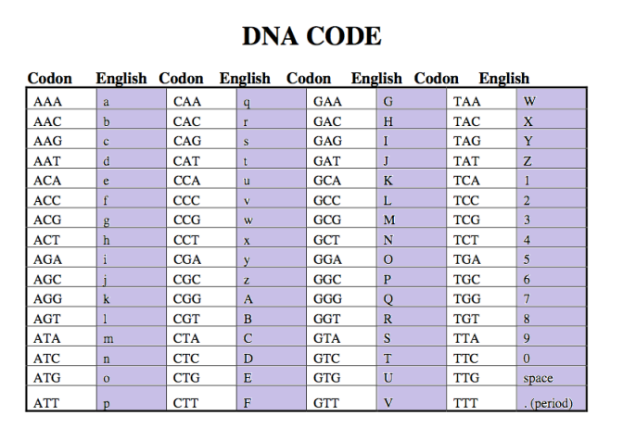
On a half sheet of paper write:
My Name is: GTCACACACAGA My favorite color is: CGTAGTCCAACA

Slide 21
PUT YOUR NAME ON TOP OF THE PAPER
DECODE THE DNA!

Slide 22
CENTRAL DOGMA

Slide 23
CENTRAL DOGMA OF BIOLOGY
Write
DNA
→
RNA
→
PROTEINS
Transcription
Translation

Slide 24
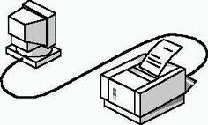
DNA
PROTEIN
RNA
RIBOSOME

Slide 27
Central Dogma
Write
Information on how to make proteins is stored on genes found in DNA.
Ribosomes need to read genes to make proteins.
DNA cannot leave the nucleus, but RNA can.
RNA makes a copy of the DNA information and delivers it to the Ribosome.
Now the ribosome has the information it needs to make a protein.

Slide 28
Terminology https://www.youtube.com/watch?v=gG7uCskUOrA
Write
Central Dogma
DNA makes RNA makes protein
Protein Synthesis
A two step process used by cells to create proteins.
Transcription (step 1 of Protein Synthesis)
RNA polymerase makes an RNA copy (messenger RNA) of the information found on DNA
Translation (Step 2 of Protein Synthesis)
Ribosomes, Messenger RNA and Transfer RNA work together to build proteins from amino acids in the cytoplasm of the cell.

Slide 29
Protein Synthesis

Slide 30
Video Questions 0-45s
Answer
Which structure contains the genome (genes)
DNA is packaged around histones and coiled up into 23 pairs of _______________.
Sections of DNA that contain the instructions for making proteins are called. ________________.

Slide 31
Video Questions 0:45 – 1:40
Answer
When a gene is switched on, this enzyme attaches to DNA and creates a messenger RNA using free RNA nucleotides in the nucleus.
When RNA polymerase creates a messenger RNA strand using information from the gene on the DNA we call this process ________________.

Slide 32
Transcription
Write
Purpose: Create a Messenger RNA by copying information found on DNA
Where: Nucleus
RNA Polymerase: Enzyme that creates the messenger RNA strand.

Slide 33
Video Questions 1:40 -
Answer
The organelle that acts as a protein factory is called a _______________?
Where does mRNA go after it leaves the nucleus?
What RNA molecule carries amino acids?
How does the tRNA and mRNA work together?
The growing chain of amino acids is called a ____________?

Slide 34
Translation
Write
Purpose: Ribosomes create proteins using information from the messenger RNA and amino acids from the transfer RNA.
Ribosome: combines amino acids together to create proteins
mRNA: tells the ribosome what amino acids it needs to make a certain protein.
tRNA: Brings the amino acids to the ribosome by base pairing its anticodon to the codon on the mRNA.

Slide 35
Start and Stop Codons
Write
Certain codons tell the ribosome to when to start making proteins and when to stop.
START CODON:
AUG – MET
STOP CODONS:
UAA
UAG
UGA

Slide 36
Transcription and Translation
Now that we’ve learned how the cell undergoes transcription and translation, we can now do transcription and translation ourselves.

Slide 37
USE YOUR mRNA strand to decode

Slide 38
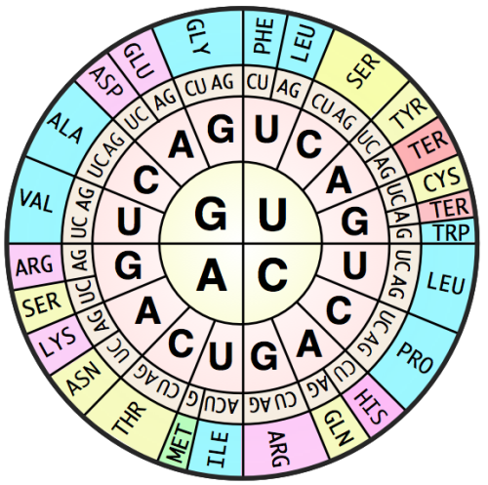
USE YOUR mRNA strand to decode
ALA = Alanine
ARG = Arginine
ASN = Asparagine
ASP = Aspartic Acid
CYS = Cysteine
GLN = Glutamine
GLU = Glutamic Acid
GLY = Glycine
HIS = Histidine
ILE = Isoleucine
LEU = Leucine
LYS = Lysine
MET = Methionine
PHE = Phenylalanine
PRO = Proline
S/TER = Stop/Terminate
SER = Serine
THR = Threonine
TRP = Tryptophan
TYR = Tyrosine
VAL = Valine
Quiz: Unit 07
Date: 3/20/2015

Slide 39
Transcription and Translation
USE YOUR mRNA strand to decode
Write
DNA:
TAC
AAA
GAT
GCC
CCT
TAA
AGA
GTT
TCC
ATC
Transcribe
mRNA:
CODON
AUG
UUU
CUA
CGG
GGA
AUU
UCU
CAA
AGG
UAG
Translate
T A C
A A A
G A T
G C C
C C T
A G A
tRNA:
ANTI-CODON
T A A
G T T
T C C
A T C
Amino Acid
START
PHE
LEU
ARG
GLY
ILE
SER
GLN
ARG
STOP

Slide 40
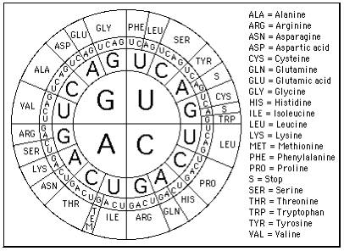
USE YOUR mRNA strand to decode

Slide 41
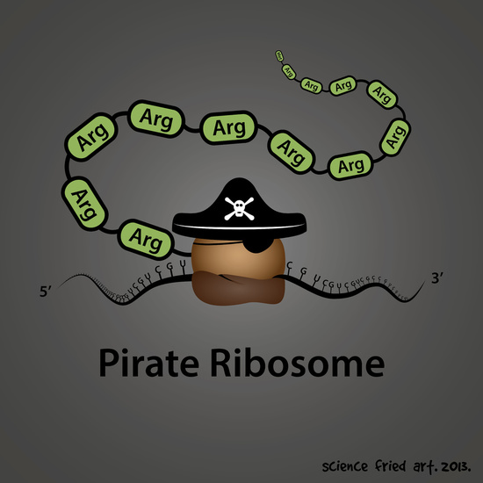
Translation

Slide 42
TURN IN YOUR REVIEW
CLEAR YOUR DESKS
SPREAD OUT – 1 person per table

Slide 43
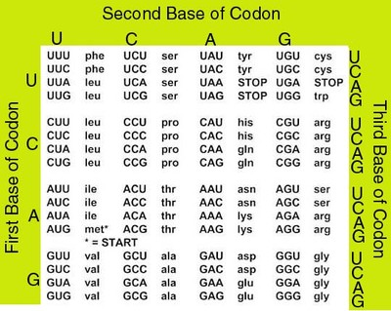
USE YOUR mRNA strand to decode

