Slide 1
You have 10 minutes to complete your DNA Replication brochure

Slide 2
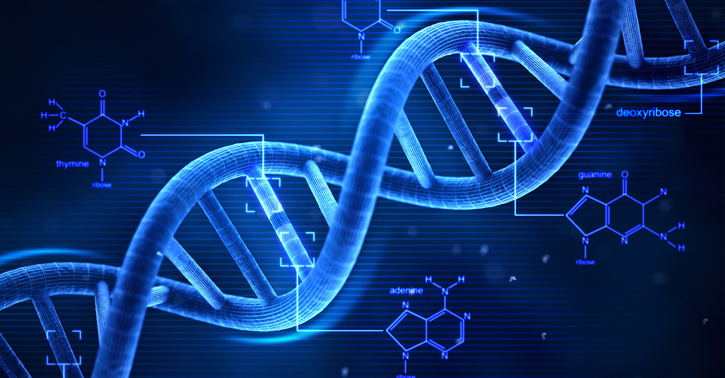
RNA Structure
RNA

Slide 3
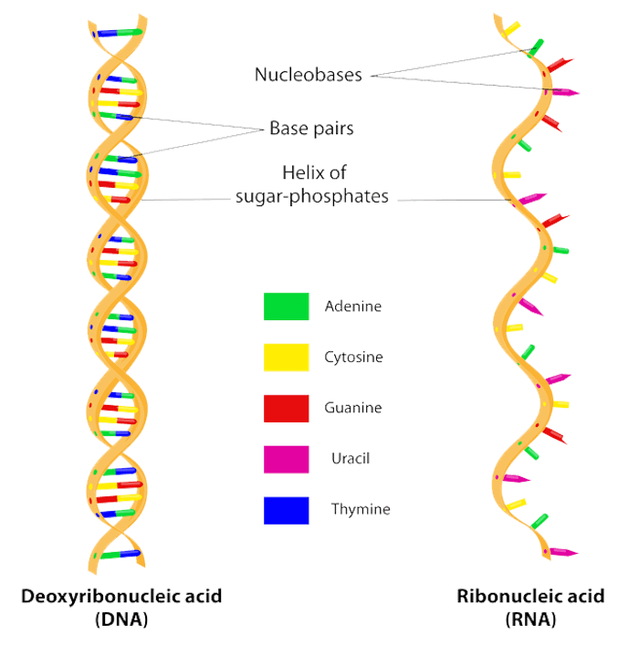
Listen
2 Strands
1 Strand
A, T, C, G
A, U, C, G

Slide 4
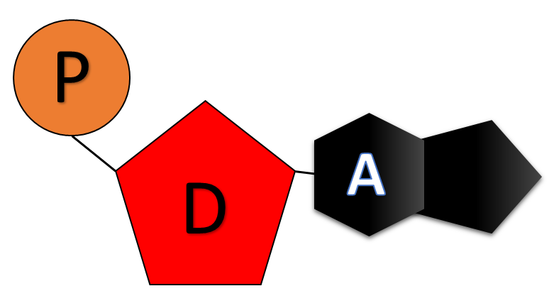
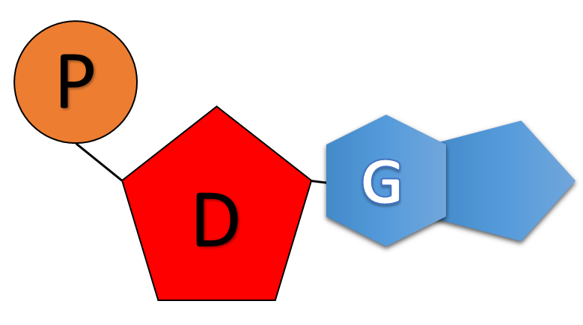
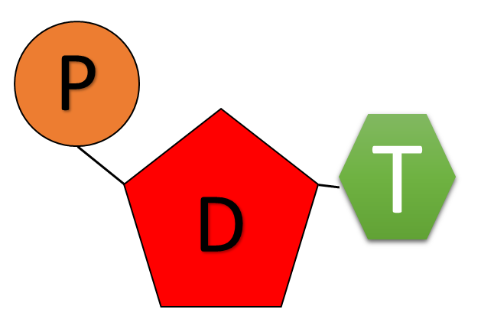
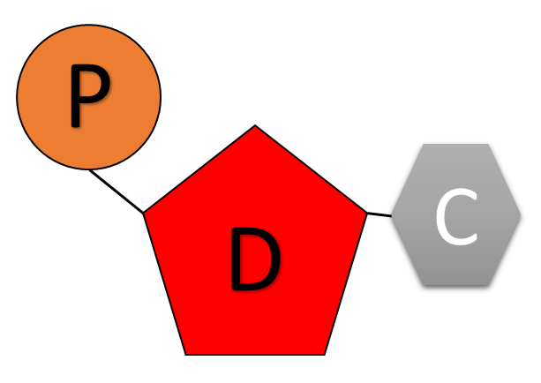
Listen
R
R
R
U
R
C

Slide 5
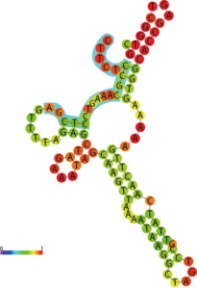
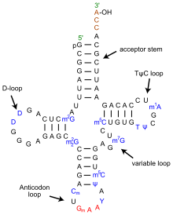

Slide 6
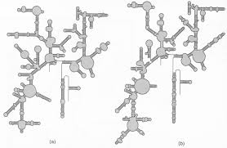

Slide 7
Write
DNA
RNA
Nucleic Acids
Made up of nucleotides
Double Stranded
Single Stranded
Deoxyribose Sugar
Ribose Sugar
A, T, C, G
A, U, C, G
Only has 1 shape and function
Can have multiple shapes and functions
Younger
Older
Stores Information
Moves Information
Found only in the nucleus
Found in the nucleus, and the cytoplasm

Slide 8
RNA Base Pairing
Listen
U
A
C
G

Slide 9
Base Pairing Key
Write
DNA → DNA
A = T
T = A
C = G
G = C
DNA → RNA
A = U
T = A
C = G
G = C
RNA → RNA
A = U
U = A
C = G
G = C

Slide 10
DNA
RNA
DNA
A
C
T
T
G
G
A
A
T
C
C
A
G
A
G
T
G
A
A
C
C
T
T
A
G
G
T
C
T
C
DNA

Slide 11
DNA
RNA
DNA
A
C
T
T
G
G
A
A
T
C
C
A
G
A
G
U
G
A
A
C
C
U
U
A
G
G
U
C
U
C
RNA

Slide 12
DNA
RNA
RNA
A
C
U
U
G
G
A
A
U
C
C
A
G
A
G
U
G
A
A
C
C
U
U
A
G
G
U
C
U
C
RNA

Slide 13
Review Questions
What type of macromolecule is RNA?
Is RNA double or single stranded?
How is a DNA and RNA nucleotide different?
What are the four nitrogenous bases for RNA?
Which bases pair together?
List 3 ways DNA and RNA are different.
Nucleic Acid
Single
Different sugars, Uracil and Thymine
Adenine, Uracil, Cytosine and Guanine
A = U and C = G
Number of strands, sugar type, Uracil and Thymine, Age, Function, location

Slide 14
RNA World Hypothesis Close Read
https://www.youtube.com/watch?v=VYQQD0KNOis
What is the main idea of this video?
What is DNA good for?
What are proteins good for?
What can RNA do?
List the following by age from oldest to newest: DNA, RNA, PROTEIN
True or False: DNA is a mutation of RNA
What does RNA do inside of our cells?
Why is RNA important?

Slide 15
RNA World Hypothesis Close Read
https://www.youtube.com/watch?v=VYQQD0KNOis
What is the main idea of this video? RNA is believed to be the molecule that started life.
What is DNA good for? Storing information
What are proteins good for? Molecular machines; building, catalyzing, breaking things down
What can RNA do? RNA can store information and act as a molecular machine
List the following by age from oldest to newest: DNA, RNA, PROTEIN RNA, Protein, DNA
True or False: DNA is a mutation of RNA True
What does RNA do inside of our cells? Codes, Catalyzes, Builds, breaks down, cuts
Why is RNA important? RNA is an ancient molecule that helped start life and is still an important molecule in our bodies today.

Slide 16
Types of RNA

Slide 17
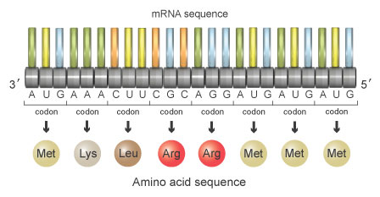
Messenger RNA
Listen

Slide 18
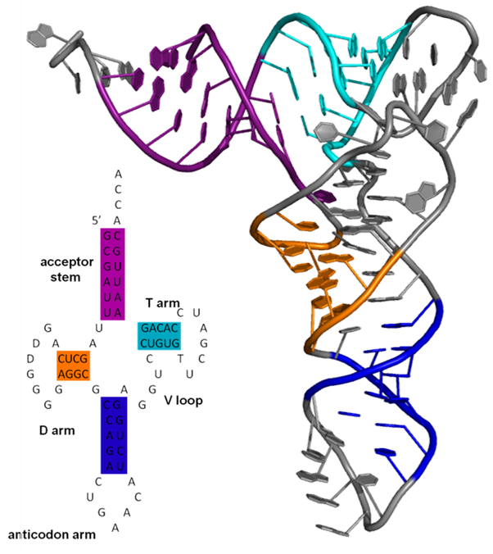
Transfer RNA
Listen

Slide 19
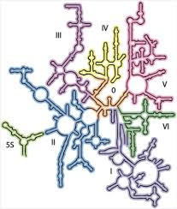
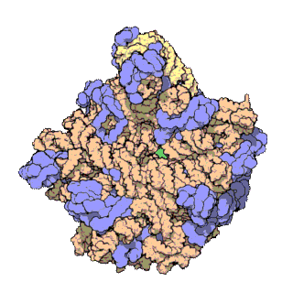
Ribosomal RNA
Listen

Slide 20
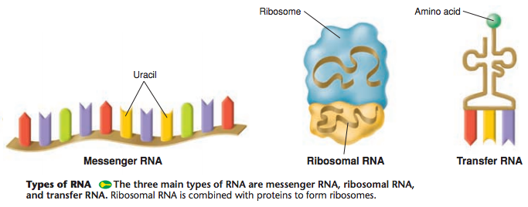
Listen

Slide 21
Codon
Codon
Codon
Full Name | Messenger RNA
Abbreviation | mRNA
Function | Delivers information stored in DNA to the ribosome
Location | Nucleus and Cytoplasm

Slide 22
Anticodon
Anticodon
Full Name | Transfer RNA
Abbreviation | tRNA
Function | Transfers amino acids to the ribosome
Location | Cytoplasm

Slide 23
Listen
Full Name | Ribosomal RNA
Abbreviation | rRNA
Function | Is a part of the ribosome.
Location | Ribosome

Slide 24
Types of RNA
Write and Draw
Full Name | Messenger RNA | Transfer RNA | Ribosomal RNA
Abbreviation | mRNA | tRNA | rRNA
Function | Delivers information stored in DNA to the ribosome | Transfers amino acids to the ribosome | Is a part of the ribosome.
Location | Nucleus and Cytoplasm | Cytoplasm | Ribosome

Slide 25
Listen
CODON
CODON
CODON

Slide 26
Listen
ANTI-CODON

Slide 27
Amino Acid
Amino Acid
Listen

Slide 28
Codons and Anti-Codons
Write
Codon – three nucleotides on a messenger RNA (mRNA) strand
Anti-codon – three nucleotides on a transfer RNA (tRNA)
Codons and Anti-codons base pair together.

Slide 29
Review Questions
What are the three types of RNA
What does messenger RNA (mRNA) look like and do?
What does transfer RNA (tRNA) look like and do?
Where is ribosomal RNA (rRNA) located?
What is a codon?
What is an anti-codon?
How do codons and anti-codons interact with one another?
Messenger RNA (mRNA), Transfer RNA (tRNA) and Ribosomal RNA (rRNA)
Single strand of RNA that delivers information from the DNA to the Ribosome
Folded into a T- Shape, transfers amino acids in the cytoplasm to the ribosome
Inside of the Ribosome
Three nucleotides found on a messenger RNA
Three nucleotides found on a transfer RNA
They base pair together.

