Slide 1
Unit 07
Write
DNA, RNA and Protein Synthesis

Slide 2
Nucleic Acids
Write

Slide 3
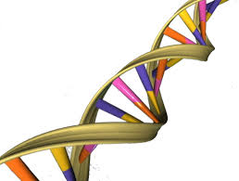
Discuss

Slide 4
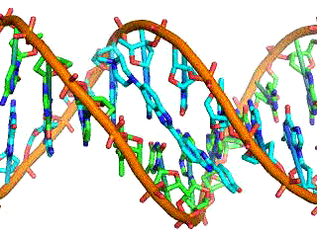
What is DNA?
Write
D.N.A. = Deoxy-ribo-nucleic-acid
DNA:
Is a double stranded nucleic acid
Has a helical (twisted) shape
Stores information
Is found in the nucleus

Slide 5
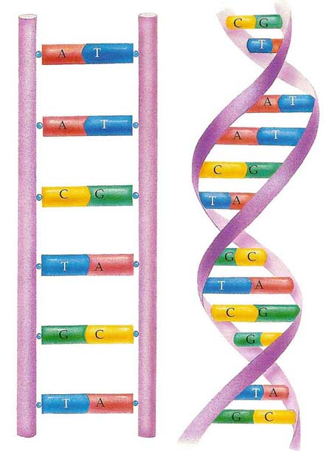
DNA Structure
Listen

Slide 6
DNA Structure
Draw and label
Bases
Backbone
Bases held together by hydrogen bonds
Helix or twisted
Double Stranded

Slide 7
DNA is a Nucleic Acid
Write
DNA is a Nucleic Acid
Nucleic Acid = Polymer
Nucleotide = Monomer

Slide 8
Listen
Polymer: Nucleic Acid
Monomer:
Nucleotide

Slide 9
Listen
DNA is made up of two nucleic acid strands (double stranded)

Slide 10
NUCLEOTIDES
Draw, Label, and Write
A nucleotide consists of:
A Phosphate
A sugar (Deoxyribose)
A base
P
Phosphate
B
D
Deoxyribose
(Sugar)
Deoxyribose
(Sugar)

Slide 11
NUCLEOTIDES
Listen
Backbone
P
Rungs
D
B
Phosphate
Base
Sugar

Slide 12
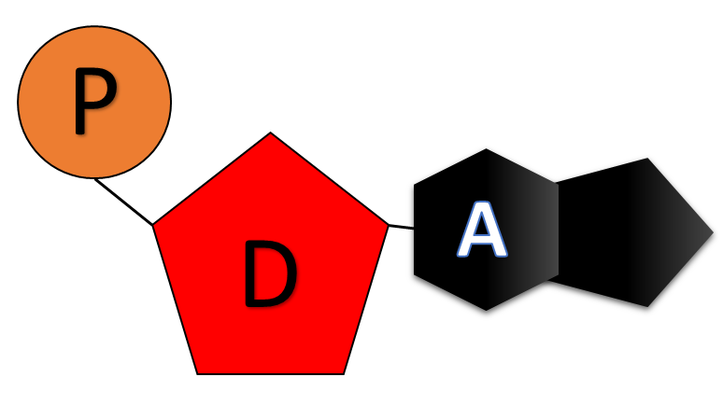
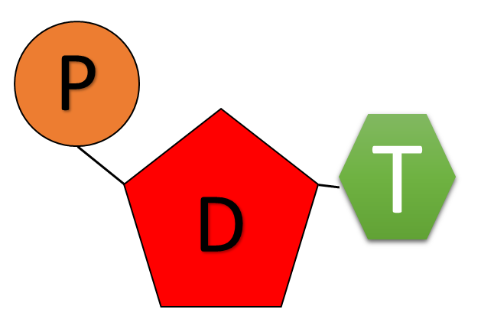
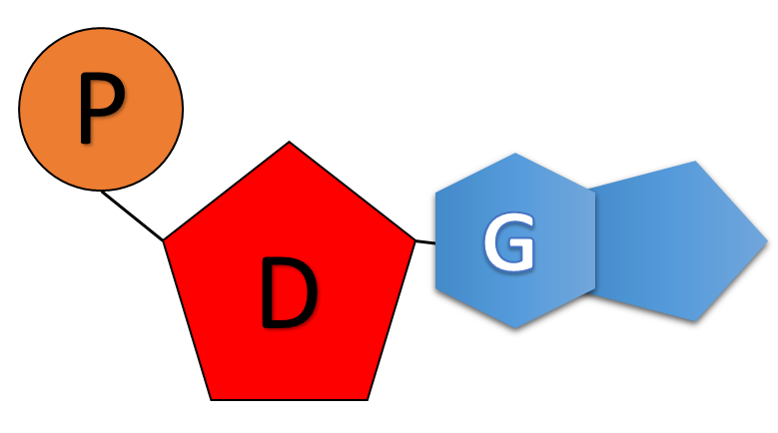
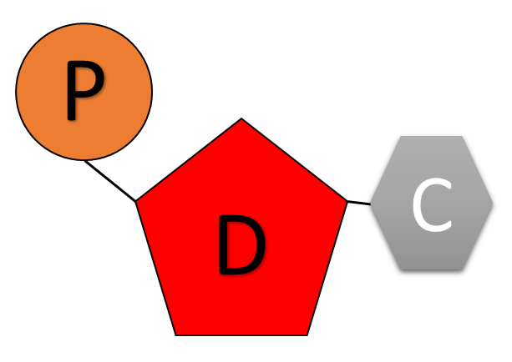
4 Nucleotides
Listen
Adenine
Thymine
Guanine
Cytosine

Slide 13
4 Nucleotides
Write
There are 4 Nucleotides that make up DNA. They are named after the base.
Adenine
Thymine
Cytosine
Guanine
Base Pairing
A = T
C = G

Slide 14
Purines and Pyrimidines
Write
Purines
Pyrimidines
Adenine and Guanine
Composed of Two Rings
Cytosine and Thymine
(also Uracil)
One Ring

Slide 15
DNA Structure
Listen
Backbone
Backbone
Middle
A
T
C
G
A
T
C
G

Slide 16
DNA Structure
Write
Backbone = Phosphate and Sugar
Rungs = Bases
Bases are held together by Hydrogen Bonds

Slide 17
Chagraff’s Rule - Base Pairing
Listen
T
A
C
G

Slide 18
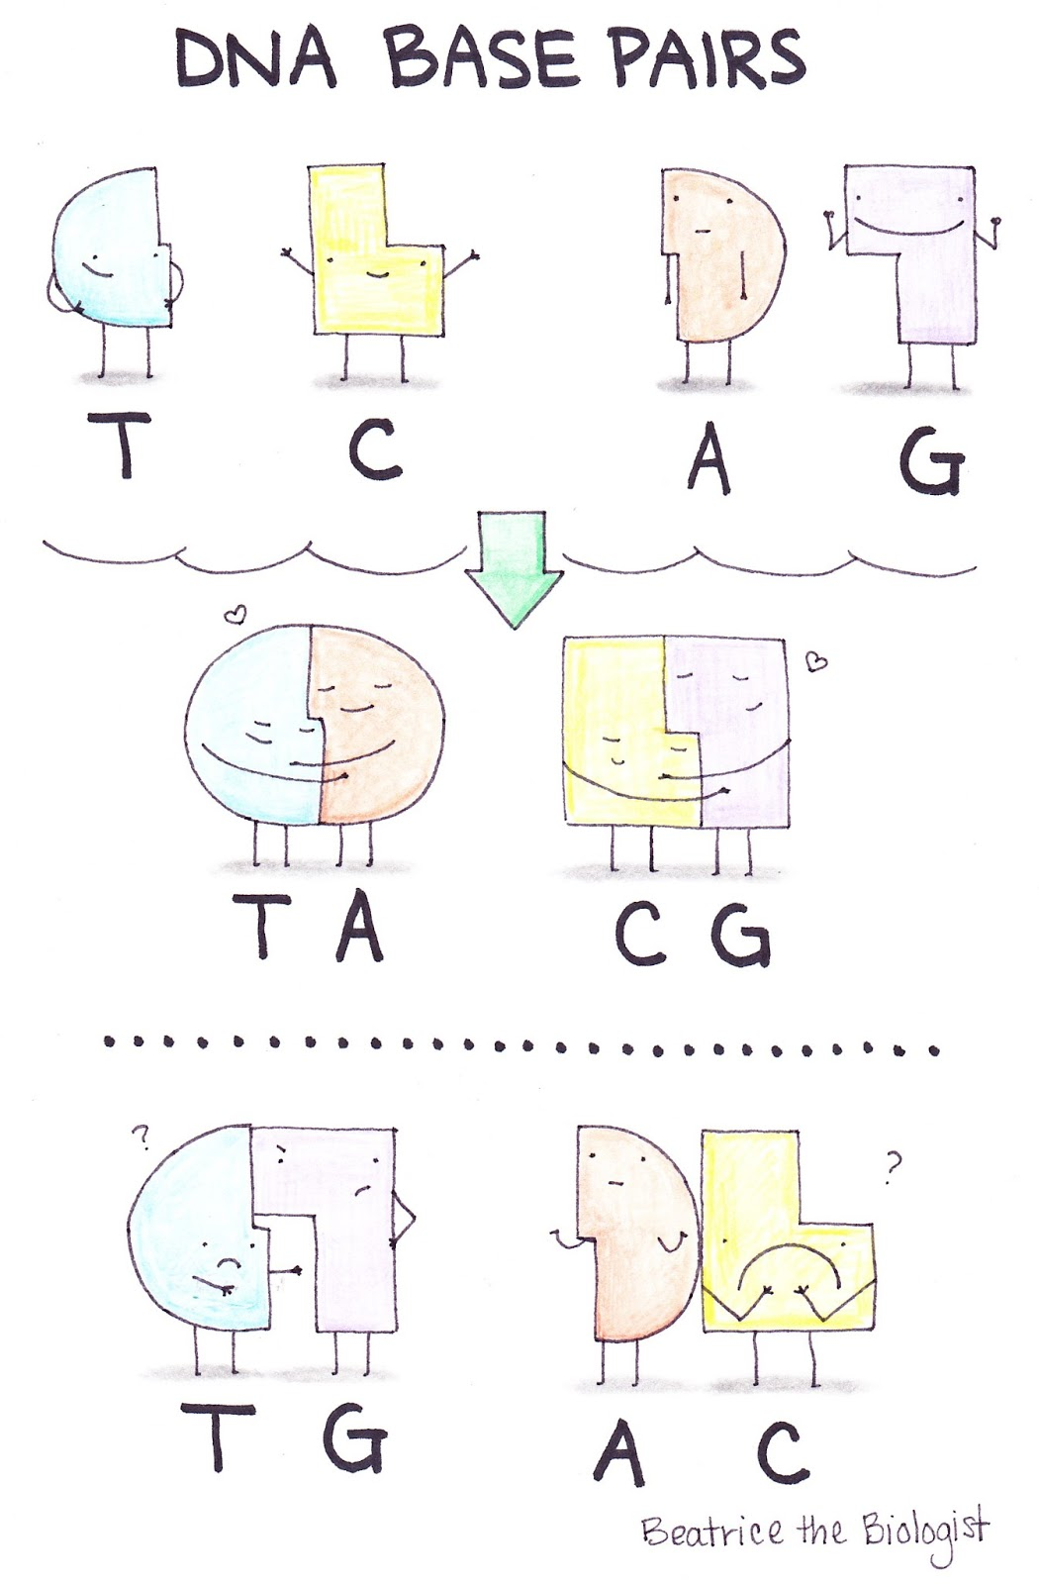
Listen

Slide 19
DNA Structure
Listen
DNA Is Twisted
(Helical)

Slide 20
Review Questions
What type of macromolecule is DNA?
Is DNA double or single stranded?
DNA is made up of repeating molecules called___________.
What are the three parts of a nucleotide?
What two parts of the nucleotide make up the sides of the DNA ladder?
What makes up the rungs of the DNA ladder?
Is DNA straight or twisted (helical)?
What are the four nitrogenous bases?
Which bases pair together?
What holds the bases together?
Nucleic Acid
Twisted (helical)
Double
Nucleotides
Adenine, Thymine, Cytosine, Guanine
Phosphate, Sugar, Base
A = T C = G
Phosphate and Sugar
Hydrogen Bonds
Bases

Slide 21
DNA Structure WS Directions
Complete the DNA Structure WS
Ask questions if you are confused
Color the DNA Diagram
You may listen to music.
Turn it into the basket when you are done

