Slide 1
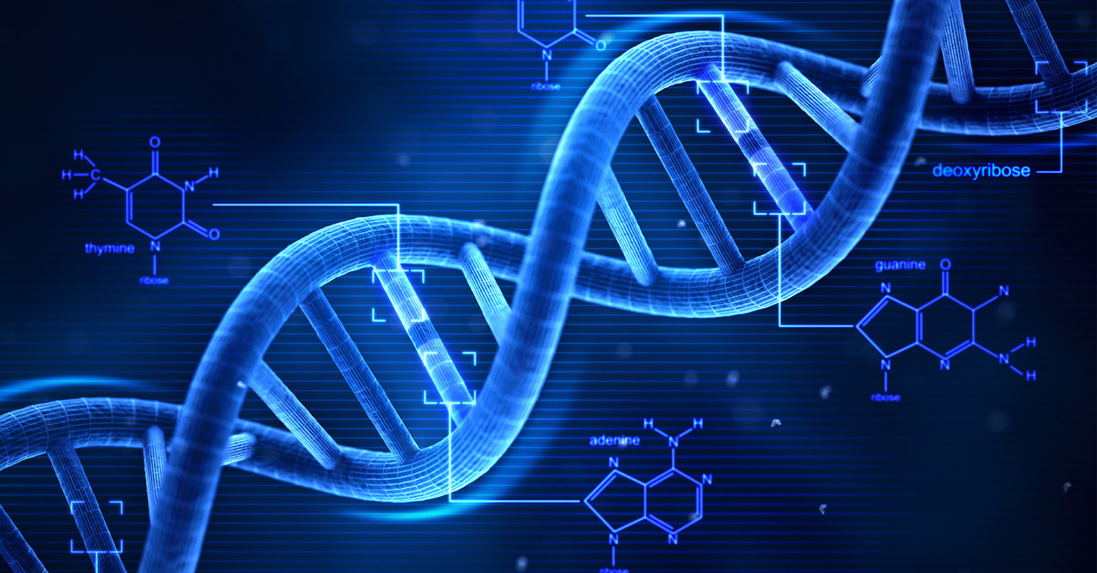
UNIT 07
DNA and RNA

Slide 2
DNA and RNA Vocabulary

Slide 3
DNA and RNA Vocabulary
Vocabulary Word | Definition
DNA | Double stranded nucleic acid bound together by hydrogen bonds and twisted into a double helix. Stores information.
Nucleotide | A monomer of a nucleic acid; consists of a phosphate, sugar, and one of four nitrogenous bases.
Purines | A type of nitrogenous base (Adenine and Guanine)
Pyrimidine | A type of nitrogenous base (Cyotisne and Guanine)
Adenine | Purine that base pairs with Thymine
Guanine | Purine that base pairs with Cytosine
Cytosine | Pyrimidine that base pairs with Guanine
Thymine | Pyrimidine that base pairs with Thymine
Rosalind Franklin | Female scientist that contributed to the discovery DNA structure
Chagraff’s Rule (Base Pairing) | A=T C=G
Watson & Crick | Two male scientists that officially discovered the structure of DNA
RNA | A single stranded nucleic acid. Moves information.
mRNA | Messenger RNA; a single stranded copy of the information stored in DNA that can move freely throughout the cell
tRNA | Transfer RNA; three dimensional object made of RNA that transfers Amino Acids to the ribosome
rRNA | Ribosomal RNA; three dimensional object made of RNA that is part of the ribosome.
Transcription | The process of copying DNA information onto a piece of mRNA.
RNA Polymerase | Enzyme that creates mRNA
Helicase | Enzyme that breaks the hydrogen bonds between DNA’s base pairs. (unzips DNA)
DNA Polymerase | Enzyme that creates copies of DNA
Translation | The process of building a protein using information on mRNA.
Codon | Three letters = 1 codon – found on mRNA – matches up with anti codon on tRNA
Anticodon | Three letters = 1codon – found on tRNA – matches up with codon on mRNA
Mutation
Point Mutation
Frame shift mutation

Slide 4
DNA Structure

Slide 5
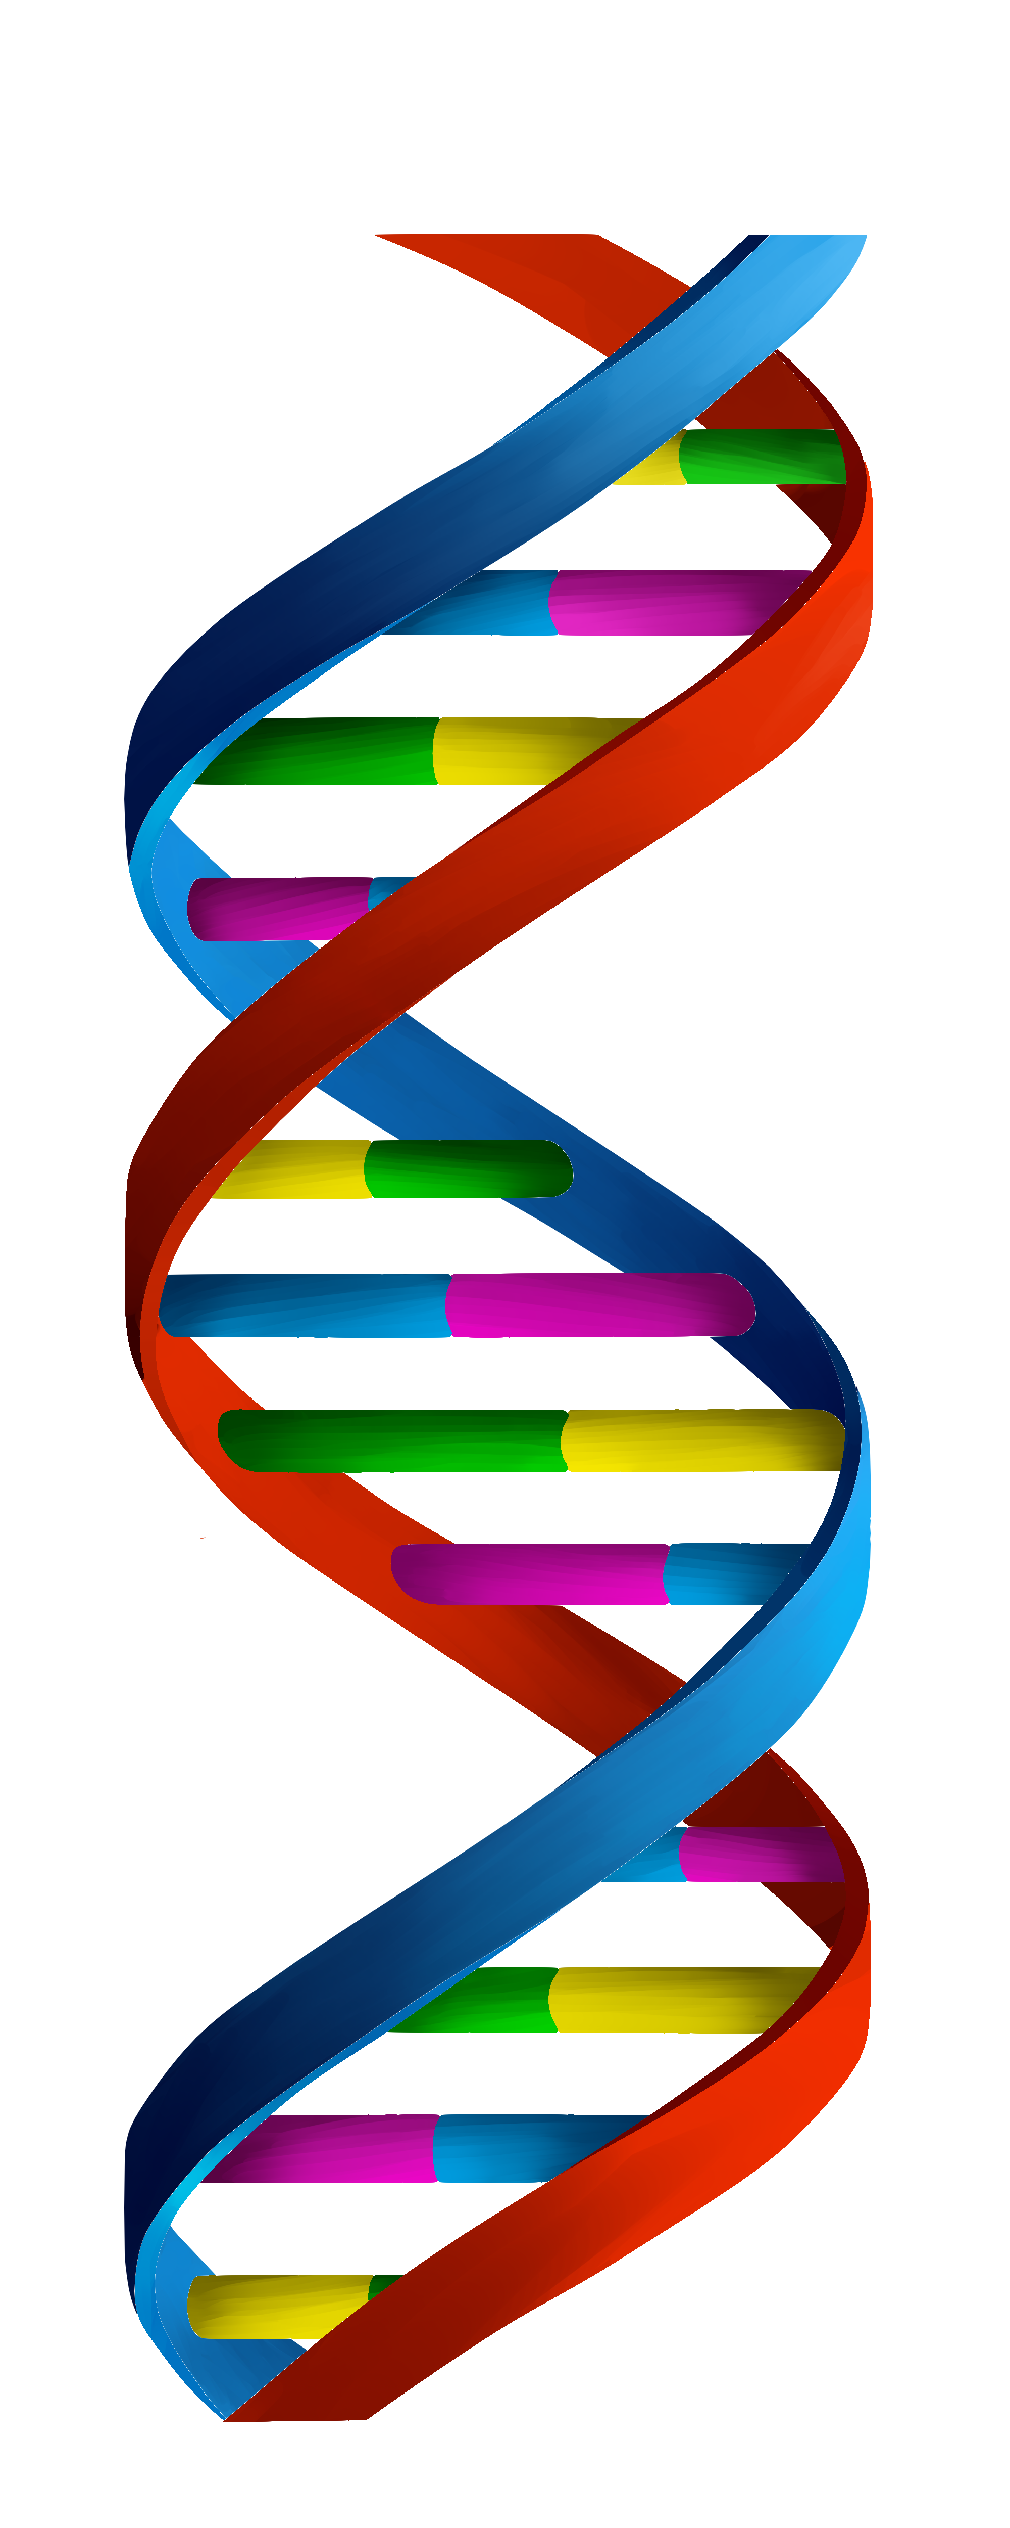
Listen

Slide 6
DNA
Write
DNA – Deoxyribonucleic Acid
A double stranded nucleic acid
Helix (twisted) shaped
Function: Stores Information
Location: Nucleus

Slide 7
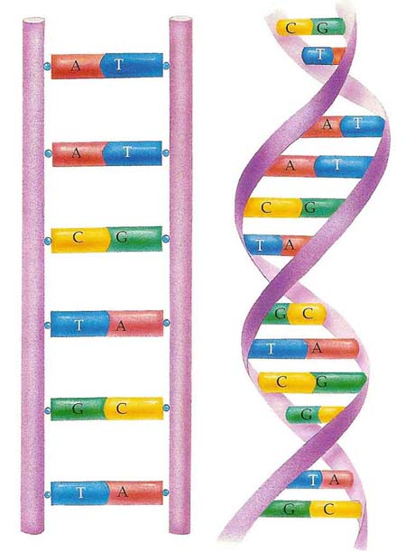
DNA Structure
Listen

Slide 8
DNA Structure
Draw and label
Bases
Backbone
Bases held together by hydrogen bonds
Helix or twisted
Double Stranded

Slide 9
DNA Structure
Write
DNA is like a ladder that has been twisted.
The sides of the ladder are made of phosphates and sugar.
The rungs of the ladder are made up of bases.
The rungs (bases) of the ladder are held together by hydrogen bonds

Slide 10
NUCLEOTIDES
Listen
Backbone
P
Rungs
D
B
Phosphate
Base
Sugar

Slide 11
NUCLEOTIDES
Draw and Label
Backbone
P
Rungs
D
B
Phosphate
Base
Sugar

Slide 12
NUCLEOTIDES
Draw and Label

Slide 13
DNA Structure
Listen
Backbone
Backbone
Middle
A
T
C
G
A
T
C
G

Slide 14
NUCLEOTIDES
Write
DNA is made up of repeating molecules called Nucleotides.
Nucleotides are made up of:
A Phosphate
A Sugar
1 of 4 Bases

Slide 15
Listen
T
A
C
G

Slide 16
Bases
Write
DNA has four different bases.
Adenine (A) Thymine (T)
Guanine (G) Cytosine (C)

Slide 17
Chagraff’s Rule - Base Pairing
Listen
T
A
C
G

Slide 18
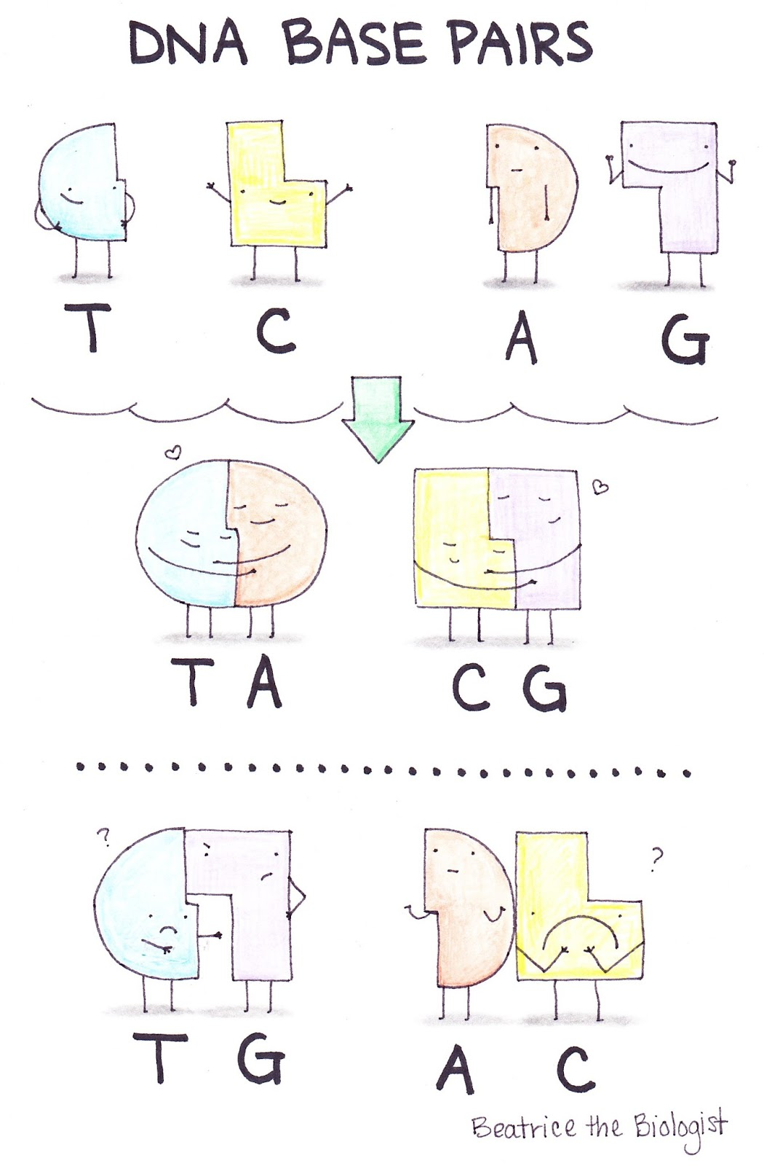
Listen

Slide 19
DNA Structure
Listen
Backbone
Backbone
Middle
A
T
C
G
A
T
C
G

Slide 20
Chagraff’s Rule/ Base Pairing
Write
Base Pairing
A=T
C=G
Base pairs are held together by hydrogen bonds.

Slide 21
DNA Structure
Listen
Backbone
Backbone
Middle
A
T
C
G
A
T
C
G

Slide 22
DNA Structure
Listen
DNA Is Twisted

Slide 23
Review Questions
What type of macromolecule is DNA?
Is DNA double or single stranded?
DNA is made up of repeating molecules called___________.
What are the three parts of a nucleotide?
What two parts of the nucleotide make up the sides of the DNA ladder?
What makes up the rungs of the DNA ladder?
Is DNA straight or twisted (helical)?
What are the four nitrogenous bases?
Which bases pair together?
What holds the bases together?

Slide 24
DNA REplication

Slide 25
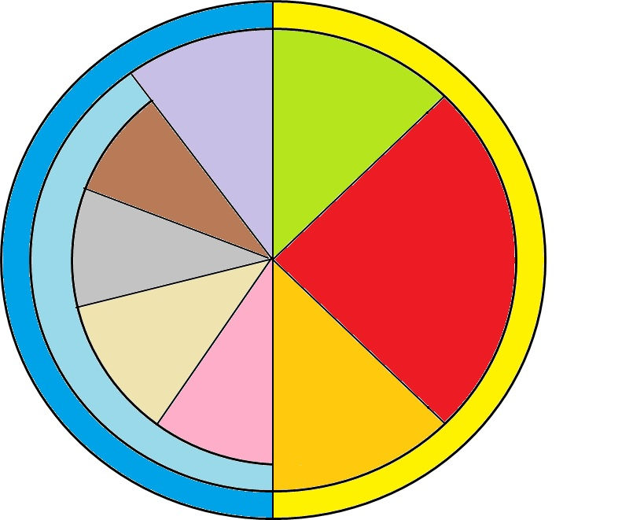
Listen
G1 Phase
Cytokinesis
Telophase
S Phase
DNA REPLICATION
M-Phase
Mitosis
Interphase
Anaphase
Metaphase
G2 Phase
Prophase

Slide 26
DNA Replication
Write
DNA Replication: The process of copying one’s DNA
DNA is copied in preparation for Mitosis and Meiosis
DNA Replication occurs during the S (Synthesis) phase of the Cell Cycle

Slide 27
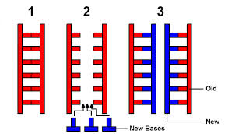
Listen

Slide 28
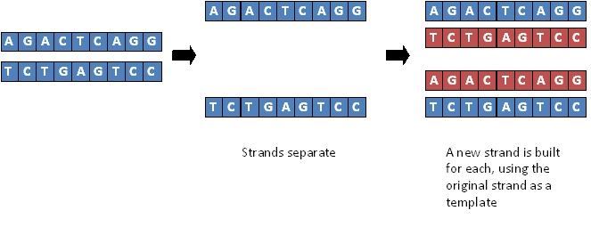
Listen

Slide 29
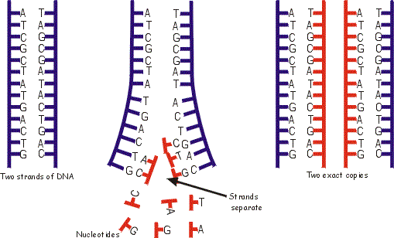
Listen
Template Strand
Template Strand
Template Strand
Complimentary Strands
Template Strand

Slide 30
DNA Replication
Write
DNA Replication is Semi-Conservative
Semi Conservative: The replicated DNA has one strand from the original DNA and one newly created strand.
Template Strand: Original DNA that is used to create the second Strand
Complimentary Strand: the second strand that is created by base pairing with the template strand.

Slide 31
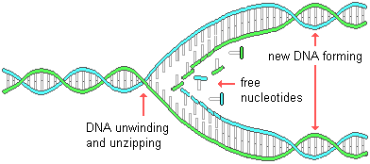
Listen

Slide 32
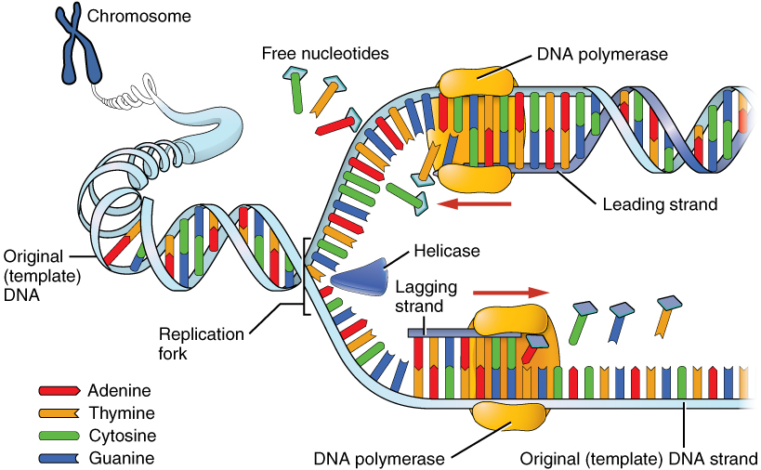
Listen

Slide 33
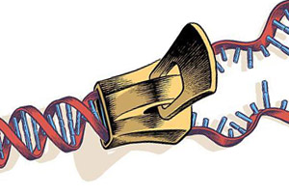
HELICASE
Listen

Slide 34
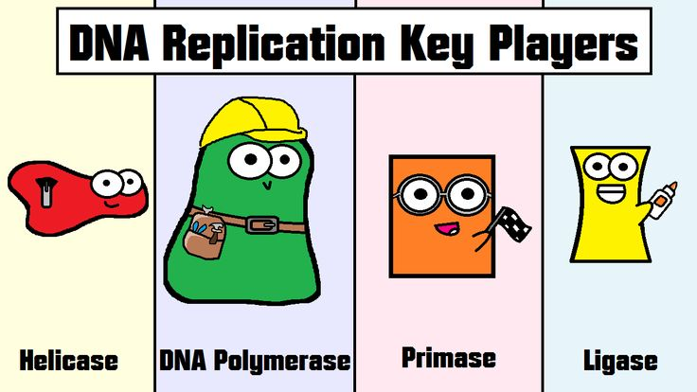
Listen

Slide 35
DNA Replication
Write
DNA Replication is carried out by enzymes.
Enzymes:
Helicase – “Unzips” DNA by breaking the hydrogen bonds between the bases.
DNA Polymerase – “Builds” complementary strand with free nucleotides by reading the template strand and base pairing.

Slide 36
Review Questions
What is DNA Replication?
When does DNA Replication occur?
Why is DNA replication necessary?
What does semi-conservative mean?
What do we call the enzyme that unzips DNA by breaking the hydrogen bonds between the bases?
What do we call the strand that is read to create a new strand?
What do we call the new strand that is being created?
What enzyme builds the complimentary strand?
How is the complimentary strand created?
What material is used to make the new complimentary strand?

Slide 37
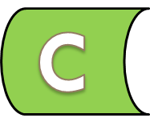
H
Listen

Slide 38
DNA Polymerase
Listen
DNA Polymerase

Slide 39
A
A
T
T
C
C
G
G

Slide 40
RNA Structure

Slide 41
Listen
A
C
G
U
C
U
A

Slide 42
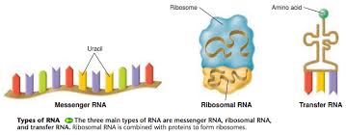
Listen

Slide 43
RNA
Write
RNA – Ribonucleic Acid
Older than DNA
A single stranded nucleic acid
Can be folded into three dimensional structures.
Function: Moves information

Slide 44
NUCLEOTIDES
Listen
P
R
B

Slide 45
Phosphate
Listen
P
Nitrogenous Base
R
NB
DNA
Nucleotide
RNA
Nucleotide
Sugar
Phosphate
P
D
NB
Nitrogenous Base
Sugar

Slide 46
Nucleotides
Write
RNA is also made up of nucleotides.
RNA nucleotides have a different sugar than DNA nucleotides.

Slide 47
Listen
U
A
C
G

Slide 48
Nitrogenous Bases
Write
RNA has four different bases.
Adenine (A) Uracil (U)
Guanine (G) Cytosine (C)

Slide 49
RNA Base Pairing
Listen
U
A
C
G

Slide 50
RNA Base Pairing
Write
RNA Base Pairing
A=U
C=G

Slide 51
DNA Vs. RNA
Write
DNA ONLY | DNA and RNA | RNA Only
Thymine A=T C=G | Nucleic Acids | Uracil A=U C=G
Double Stranded | Made up of nucleotides | Single Stranded
Stores Information | Have bases: Adenine Cytosine Guanine | Moves Information
Newer |  | Older
Deoxyribose Sugar |  | Ribose sugar

Slide 52
Review Questions
What type of macromolecule is RNA?
Is RNA double or single stranded?
How is a DNA and RNA nucleotide different?
What are the four nitrogenous bases for RNA?
Which bases pair together?
List 3 ways DNA and RNA are different.

Slide 53
RNA World Hypothesis Close Read
https://www.youtube.com/watch?v=VYQQD0KNOis
What is the main idea of this video?
List the following by age from oldest to newest: DNA, RNA, PROTEIN
True or False: DNA is a mutation of RNA

Slide 54
Types of RNA

Slide 55
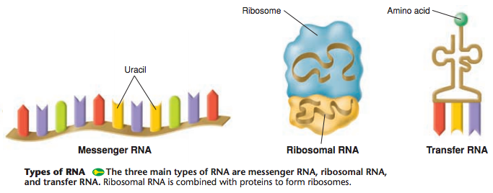
Listen

Slide 56
Types of RNA
Write and Draw
Full Name | Messenger RNA | Transfer RNA | Ribosomal RNA
Abbreviation | mRNA | tRNA | rRNA
Function | Delivers information to the ribosome | Transfers amino acids to the ribosome | Is a part of the ribosome.
Location | Nucleus and Cytoplasm | Cytoplasm | Ribosome

Slide 57
Listen
CODON
CODON
CODON

Slide 58
Listen
ANTI-CODON

Slide 59
Listen

Slide 60
Codons and Anti-Codons
Write
Codon – three nucleotides on a messenger RNA (mRNA) strand
Anti-codon – three nucleotides on a transfer RNA (tRNA)
Codons and Anti-codons base pair together.

Slide 61
Review Questions
What are the three types of RNA
What does messenger RNA (mRNA) look like and do?
What does transfer RNA (tRNA) look like and do?
Where is ribosomal RNA (rRNA) located?
What is a codon?
What is an anti-codon?
How do codons and anti-codons interact with one another?

Slide 62
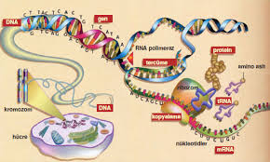
DNA and Proteins

Slide 63
Proteins
Anti-Bodies:
Immune System
Listen
Keratin:
Hair, Skin, Nails
Myoglobin:
Muscle
Melanin:
Skin, Hair,
and Eye Color
Enzymes:
Tiny Machines

Slide 64
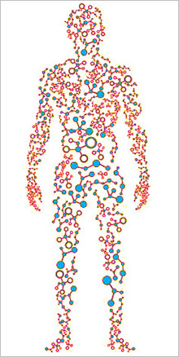
Listen
2 million types of
proteins in the
Human body

Slide 65
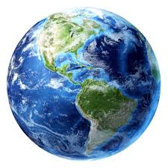
Listen
10 million types of proteins
In the world that we know of so far

Slide 66
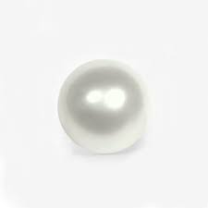
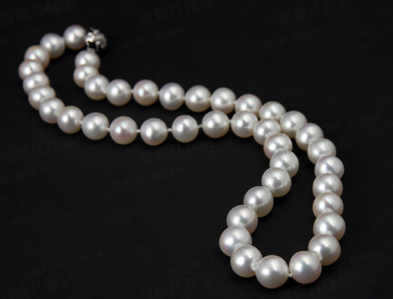
Polymer and Monomer Review
MONOMER
ONE THING
Small molecule
POLYMER
MANY ONE THINGS
Large Molecule
Example: Pearl
Example: Pearl Necklace
Example: Single Chain Link
Example: Chain

Slide 67
Protein
Listen
MONOMER:
Amino Acid
POLYMER:
Polypeptide (Protein)

Slide 68
Listen
ALL PROTEINS
ARE MADE FROM
20
AMINO ACIDS

Slide 69
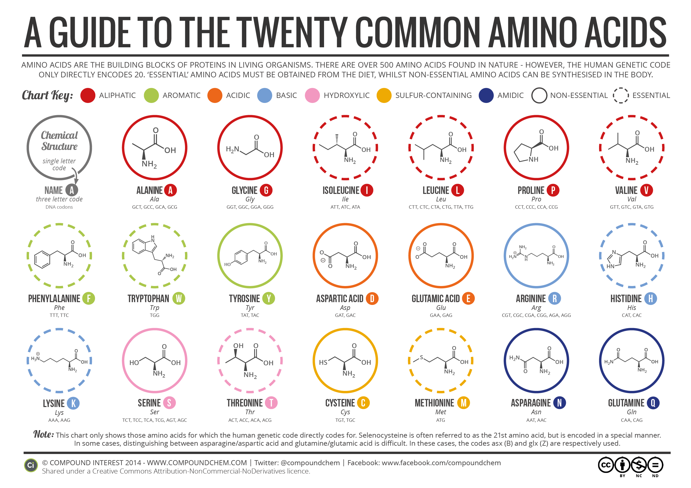
Listen

Slide 70
Proteins
Write
Protein Synthesis: How your body makes proteins.
Living things are made up of proteins.
Proteins are essential to life.
There are millions of different types of proteins.
Proteins are a polymer.
The monomer for proteins is the amino acid.
There are 20 different kinds of amino acids.

Slide 71
Review Questions
Why are proteins important to life?
Proteins are considered polymers. What is the monomer of a protein?
How many different types of amino acids are there?

Slide 72
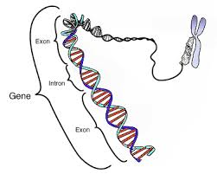
Listen

Slide 73
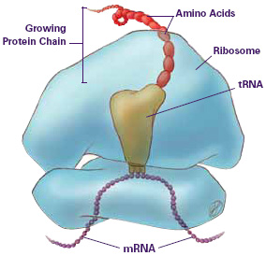
Listen

Slide 74
Proteins
Write
The information needed to make a protein is stored in DNA and is called a gene.
1 gene = 1 protein
Ribosomes make proteins.

Slide 75
Review Questions
What do we call segments of DNA that provide the information to make a protein?
What organelle actually makes proteins?

Slide 76
Central Dogma
DNA → RNA → PROTEINS
Transcription
Translation

Slide 77
CENTRAL DOGMA OF BIOLOGY
Listen
DNA → RNA → PROTEINS
Transcription
Translation

Slide 78
CENTRAL DOGMA OF BIOLOGY
Draw
DNA → RNA → PROTEINS
Transcription
Translation

Slide 79
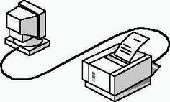
DNA
PROTEIN
RNA
RIBOSOME

Slide 80
Central Dogma
Write
Ribosomes need the information in DNA to make proteins.
DNA cannot leave the nucleus.
RNA can leave the nucleus.
You need RNA to carry the information to the ribosome so it can make proteins.

Slide 81
Review Questions
What do ribosomes need to make proteins?
What does DNA store that ribosomes need?
Why do we need RNA?
The process of going from DNA → RNA is called?
The process of going from RNA → Proteins is called?

Slide 82
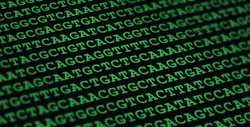
DNA as Information

Slide 83
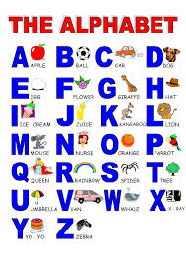
Alphabets
Listen
DOG
CAT
APPLE
CAR
GENES
AIRPLANE
SCHOOL

Slide 84
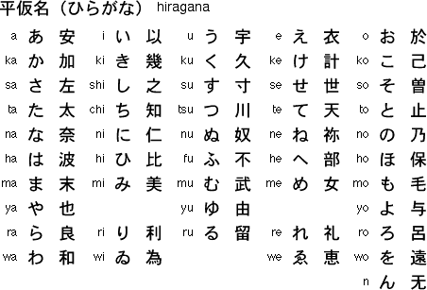
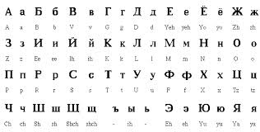
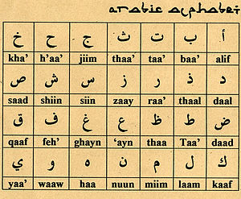
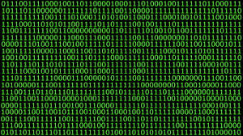
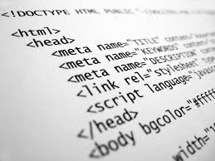
Listen

Slide 85
Listen
DNA Alphabet Letters
A
T
G
C
DNA Alphabet Words (Codons)
A
T
G
A
C
C
C
T
G
G
G
C

Slide 86
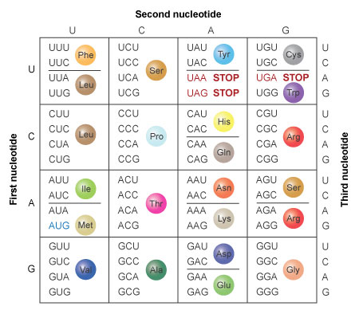
Listen
64 Codons
20 Amino Acids

Slide 87
DNA as Information
Write
DNA is an alphabet. (A, T, G, C)
In this alphabet you can create three letter words called CODONS.
There are 64 Codons
Codons translate into one of the 20 amino acids
3 Nucleotides = 1 CODON = 1 Amino acid

Slide 88
Review Questions
What are the four letters in the DNA alphabet
DNA can only have three letter words, what do we call these three letter words?
How many total codons are there?
What does one codon code for?
Can there be more than one codon for an amino acid?

Slide 89
Use the table below to:
1. Write your first and last name 2. Write Nampa High School

Slide 90
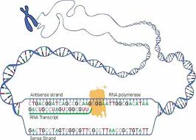
Transcription

Slide 91
Listen

Slide 92
Listen

Slide 93
Listen
U
U
U
U
RNA POLYMERASE

Slide 94
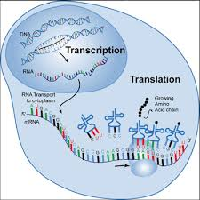
Listen

Slide 95
Transcription Video
http://www.dnalc.org/resources/3d/12-transcription-basic.html

Slide 96
Transcription
Write
Occurs in the Nucleus
Messenger RNA is created by the enzyme RNA Polymerase.
RNA Polymerase reads template strand and builds messenger RNA by base Pairing.
Messenger RNA leaves the nucleus and attaches at the Ribosome.

Slide 97
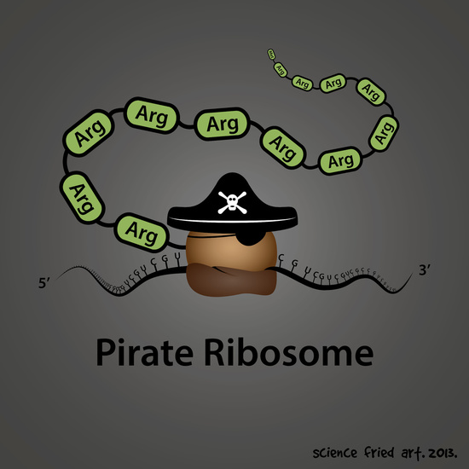
Translation

Slide 98
Listen

Slide 99
Listen

Slide 100
Listen

Slide 101
Translation
https://www.youtube.com/watch?v=8dsTvBaUMvw

Slide 102
Translation
Write
mRNA attaches to Ribosome
tRNA anti-codons attach to mRNA codons.
Ribosome attaches amino acids that tRNA drops off and creates a protein.

Slide 103
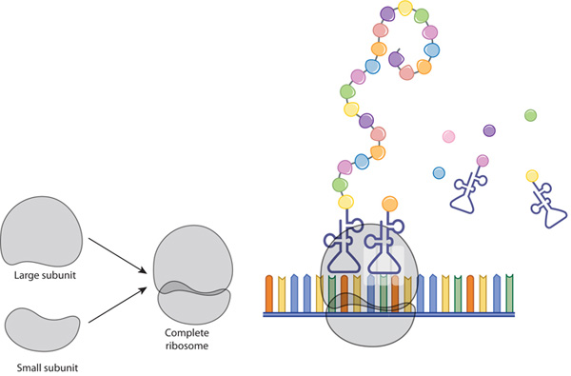
HOW DOES OUR BODY MAKE PROTEINS?
Listen

Slide 104
Transcription and Translation
USE YOUR mRNA strand to decode
Write
DNA:
GGG ATC GAT GCC CCT TAA AGA GTT TAC ATA
Transcribe
mRNA:
CODON
CCC UAG CUA CGG GGA AUU UCU CAA AUG UAU
Translate
tRNA:
ANTI-CODON
GGG AUC GAU GCC CCU UAA AGA GUU UAC AUA
Amino Acid
PRO
STOP
LEU
ARG
GLY
ILE
SER
GLN
MET
TYR

Slide 105
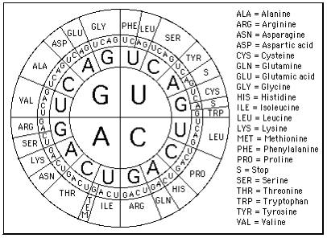
USE YOUR mRNA strand to decode

Slide 106
TURN IN YOUR REVIEW
CLEAR YOUR DESKS
SPREAD OUT – 1 person per table

Slide 107
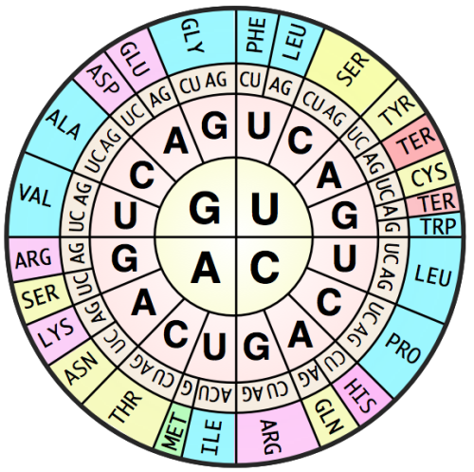
USE YOUR mRNA strand to decode
ALA = Alanine
ARG = Arginine
ASN = Asparagine
ASP = Aspartic Acid
CYS = Cysteine
GLN = Glutamine
GLU = Glutamic Acid
GLY = Glycine
HIS = Histidine
ILE = Isoleucine
LEU = Leucine
LYS = Lysine
MET = Methionine
PHE = Phenylalanine
PRO = Proline
S/TER = Stop/Terminate
SER = Serine
THR = Threonine
TRP = Tryptophan
TYR = Tyrosine
VAL = Valine
Quiz: Unit 07
Date: 3/20/2015

Slide 108
USE YOUR mRNA strand to decode

Slide 109
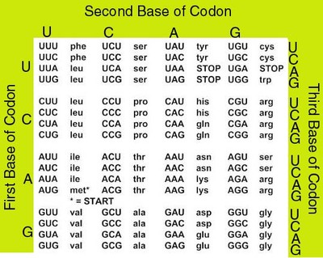
USE YOUR mRNA strand to decode

