Slide 1
Unit 06 – Genetics – Punnet Squares

Slide 2
Punnet Squares
Write
Punnet Square
A tool used to predict how likely (probability) a trait will be inherited
Probability
How likely it is for something to happen
Example:
There’s a 50% chance of rain this Friday
There’s a 25% chance that your child will have blue eyes
There is a 0% chance that I will go out with you.

Slide 3
Listen
P
p
x
P
p
This is a Punnet Square.
To use a punnet square, you need to have the genotype of the parents.
For example:
Trait: Lactose Persistence
P = Lactose Persistence
Mom’s Genotype Pp
Dad’s Genotype Pp
Pp X Pp means they are going to have children.
Pp x Pp is known as a cross.

Slide 4
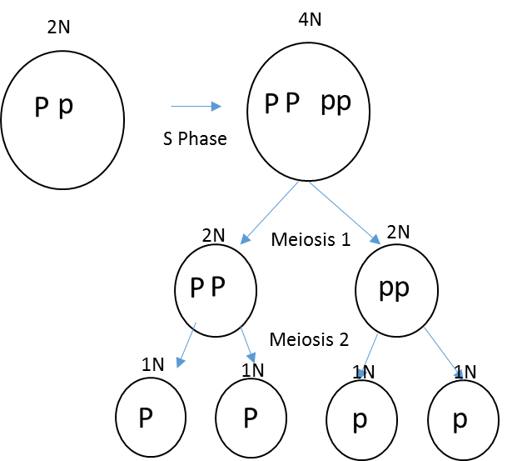
Segregating Alleles
Listen
Before these parents can have children, they have to go through Meiosis and make sex cells.
When they do this they segregate their alleles.
Segregate: to split up or keep apart In this example, we will take our alleles and put one into each egg.

Slide 5
P
p
P
p
p
x
P
Listen
P
p
Segregating Alleles is easy.
Just take one letter and separate them into each egg or sperm.

Slide 6
Listen
P
p
x
P
p
Combining Alleles
Put together the possible combinations of sperm and egg to predict the genotype of your offspring.
p
P
p
P
P
P
p
p

Slide 7
P
p
x
P
p
Genotype Probability
¼
25%
2/4
50%
¼
25%
PP
Pp
pp
P
P
P
p
Phenotype Probability
¾
75%
1/4
25%
p
p
p
P
Lactose
Persistent
Lactose
Intolerant

Slide 8
How To Punnet Square
Write
Draw Punnet Square
Write Cross
Segregate Alleles
Combine Possible Allele combinations
Determine probability of inheritance

Slide 9
Let's say that in seals, the gene for the length of the whiskers has two alleles. The dominant allele (W) codes long whiskers & the recessive allele (w) codes for short whiskers.
a) What percentage of offspring would be expected to have short whiskers from the cross of two long-whiskered seals, one that is homozygous dominant and one that is heterozygous?
Practice
W
W
x
W
w
W
W
W
w

Slide 10
Let's say that in seals, the gene for the length of the whiskers has two alleles. The dominant allele (W) codes long whiskers & the recessive allele (w) codes for short whiskers.
a) What percentage of offspring would be expected to have short whiskers from the cross of two long-whiskered seals, one that is homozygous dominant and one that is heterozygous?
W
W
x
W
w
w
W
w
W
2/4
50%
2/4
50%
0/4
0%
WW
Ww
ww
W
W
4/4
100%
0/4
0%
Long Whiskers
Short Whiskers
W
W

Slide 11
Writing Genotypic and Phenotypic Ratios
GENOTYPIC RATIO
________________:______________:_____________________
HOMOZYGOUS DOMINANT: HETEROZYGOUS: HOMOZYGOUS RECESSIVE
AA: Aa: aa:
PHENOTYPIC RATIO
_______________:_______________
DOMINANT TRAIT: RECESSIVE TRAIT

