Slide 1
Unit 06
Mendelian Genetics and meiosis

Slide 2
Unit 06 - Latin Root Words

Slide 3
Unit 06 Latin Root Words
Latin Root Word | Definition
Hetero | Opposite or other
2. Homo | Same
3. Zygous | Pertaining to the zygote

Slide 4
Basic Genetics

Slide 5
Basic Genetics
Genetics is the study of heredity.
Heredity is the study of how things are inherited or passed down from parent to offspring.

Slide 6
Heredity in Photos
http://www.bbc.com/future/story/20130712-genetic-portraits-of-families
What did you inherit from your parents?

Slide 7
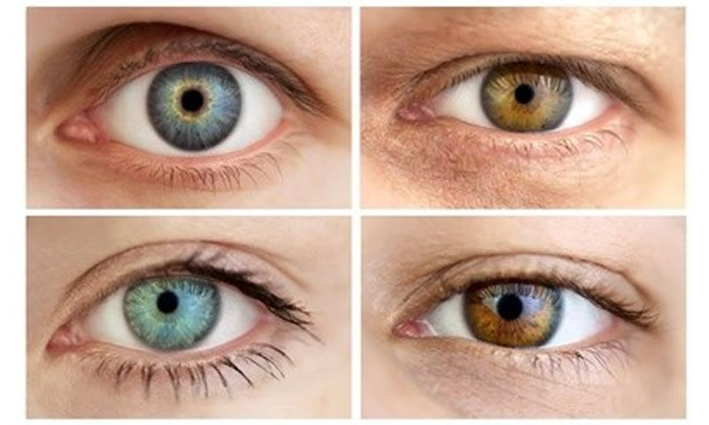
Traits
Traits – Characteristics that can be inherited.
Examples:
Eye color
Hair color
Skin color
Height
How likely you are to get a diseases
Longevity (how long you will live)

Slide 8
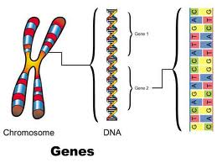
What are Genes?
Gene:
Pieces of DNA that contain instructions that the cell can use to make proteins.

Slide 9
Genes and Junk DNA
Did you know?
Only 2% of our DNA is actually made of Genes.
What about the other 98%?
At first scientists didn’t know what it was so they called it Junk DNA.
Later they changed it to Intergenic DNA and it’s very important.
Intergenic DNA (Junk DNA):
Regulates whether or not proteins will be made from genes
Determines the amount of proteins made.
Creates RNA that can control reactions within a cell

Slide 10
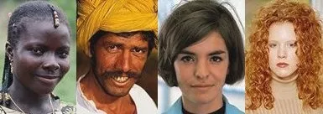
Genes and Intergenic DNA
Here is an example of how Genes and Intergenic DNA work together.
Every human being has a gene that tells the body to make a protein called melanin.
Melanin is a pigment and is what determines the color of our hair, eyes, and skin.
If your body makes lots of melanin, then you have darker skin, hair and eyes. If your body makes less melanin, then you will have lighter skin, hair and eyes.
The intergenic DNA that you inherit from your parents will determine how much Melanin is made and will therefore determine what color your hair, eyes and skin are.

Slide 11
Traits, Genes, and Alleles
For every trait you have two genes.
One gene from your mother
One gene from your father
But not all genes are the same.
Your father may have given you the gene for wet ear wax
Your mother may have given you the gene for dry ear wax
When a gene for a trait has different variations we call these alleles.
Alleles: Different variations of a gene.
Some alleles will cover up other alleles we call these dominant alleles. The alleles that are covered up are called recessive alleles.

Slide 12
Alleles
Dominant Alleles = Capital Letter (A)
Recessive Alleles = Lowercase Letter (a)

Slide 13
Genes and Alleles
Ear Wax Consistency gene
Allele 1: Wet
Allele 2: Dry
Pea Color
Allele 1: Green
Allele 2: Yellow
Pea Plant Height
Allele 1: Tall
Allele 2: Short

Slide 14
Genes, Alleles and Traits
 | Genes | Alleles | Traits
 | Piece of DNA with information | Different versions of a gene | Actual physical characteristic.
Pea Color | AGGGTGTGGT (DNA CODE) | G (Yellow) | Pea is Yellow
 | AGGTTGTCCC (DNA CODE) | g (Green) | Pea is green
Pea Shape | CCGGATATAC | S (Smooth) | Pea is smooth
 | CCTTCGCGAT | s (wrinkled) | Pea is wrinkled

Slide 15
Genotype and Phenotype
Genotype: The two alleles that you inherit from your parents.
One allele from dad
One allele for mom
Phenotype: The actual physical trait that is expressed because of the two alleles.
AA
Aa
aa
A = Red
a = yellow
Genotype: Homozygous Dominant
Genotype: Heterozygous
Genotype: Homozygous Recessive
Phenotype:
Red
Phenotype:
Red
Phenotype:
Yellow

Slide 16
Three types of Genotypes
There are three combinations of genotypes that you can inherit.
Homozygous Dominant: (AA) Two dominant alleles
Heterozygous: (Aa) One dominant and one recessive allele
Homozygous Recessive: (aa) Two recessive alleles

Slide 17
Gregor Mendel

Slide 18
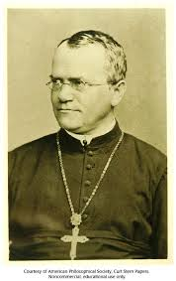
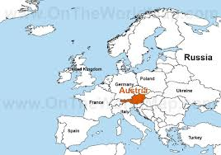
Gregor Mendel
Considered to be the father of Genetics
Published his ideas on genetics in 1860’s
Roughly the time of the American Civil War
Was a Monk for the Catholic Church
but grew up as a farmer’s son.
Most of his scientific work was destroyed by his successor
They didn’t get along very well.
His work was later discovered and scientists were like, “this is totally awesome.”

Slide 19
Gregor Mendels Three Laws

Slide 20
Gregor Mendel’s 3 Discoveries
Law of Segregation (Meiosis)
Law of Dominance
Law of Independent Assortment

Slide 21
The Law of Segregation (Meiosis)

Slide 22
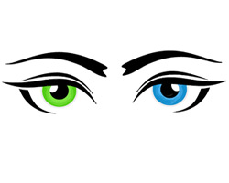
The Law of Segregation (AKA Meiosis)
Each inherited trait is defined by a gene pair or genotype. Parental genes are randomly separated to the sex cells so that sex cells contain only one gene of the pair. Offspring therefore inherit one genetic allele from each parent when sex cells unite in fertilization
2N
4N
g
g
G
g
G
G
Phenotype: Green Eyes
S Phase
2N
Meiosis 1
2N
g
G
g
G
Meiosis 2
Genotype: Combination of Alleles
1N
1N
1N
1N
G
G
g
g
G
g

Slide 23
The Law of Segregation (AKA Meiosis)
Gregor Mendel was the first to predict the presence of genes and their alleles. He called them factors.
He also believed that the offspring of two parents received one factor from each parent.
This meant that at some point the parent would have to segregate their two alleles, so that they only passed on one allele.
Mendel didn’t know what this process was, but we do now. It’s called Meiosis.

Slide 24
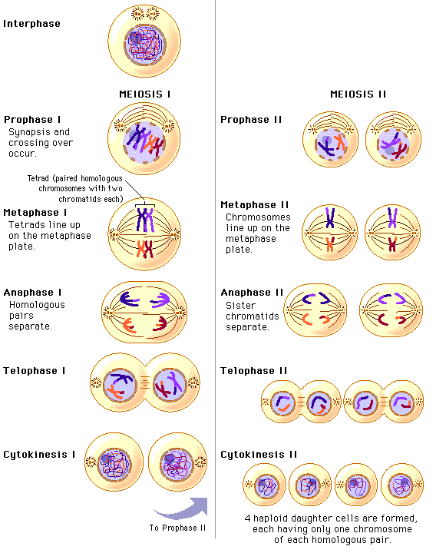
Meiosis
Meiosis – (The process of lessening) - When the body takes one diploid cell and turns it into four unique haploid cells.

Slide 25
Remember the Cell Cycle?
*DRAW THIS IN YOUR NOTES
Meiosis is basically going through Mitosis twice.
But there are also some other important things that happen.
MEIOSIS II
G1
CYTOKINESIS II
TELOPHASE II
ANAPHASE II
METAPHASE II
M-PHASE
PROPHASE II
S
CYTOKINESIS I
INTERPHASE
TELOPHASE I
ANAPHASE I
METAPHASE I
G2
MEIOSIS I
PROPHASE I

Slide 26
G1 - The cell is going about its daily business of making energy, protein and preparing for Meiosis
S - The DNA is replicated
G2 - Final Preprarations for M Phase are made
Interphase
Chromatin
Interphase
G1 → S → G2

Slide 27
1
1
2
2
3
3
Prophase I
The Chromatin winds itself up into chromosomes.
Homologous Chromosomes bind to create tetrads.
Crossing over occurs
Nuclear envelope dissolves

Slide 28
The Chromatin winds itself up into chromosomes.
The Nuclear Envelope Dissolves
M Phase
Meiosis I
Prophase I

Slide 29
2. Homologous Chromosomes and their copies combine to form tetrads 3. Crossing Over Occurs
3
1
3
1
2
2
M Phase
Meiosis
Prophase 1

Slide 30
Crossing Over
Crossing over:
When homologous chromosomes shuffle their genes between one another.

Slide 31
Tetrads
Tetrad: When two homologous chromosomes stack together like pancakes. There are a total of four chromatids which is why we call them tetrads.

Slide 32
Crossing Over
This is a three dimensional representation of tetrads and crossing over. Genes can be swapped at any area of the chromosome. Which genes are swapped is completely random.

Slide 33
Crossing Over Video

Slide 34
4. The nuclear envelope dissolves
M Phase
Meiosis
Prophase 1

Slide 35
1
1
2
2
3
3
Metaphase I
Tetrads line up along the center of the cell

Slide 36
Homologous chromosomes lie next to one another along the center of the cell to create tetrads.
M Phase
Meiosis I
Metaphase

Slide 37
1
1
2
2
3
3
Anaphase I
Spindle fibers attach to random homologous chromosomes and pull the tetrads apart

Slide 38
Spindle Fibers attach to homologous chromosomes and randomly pull one half of the tetrad to opposite sides of the cell.
M Phase
Meiosis I
Anaphase I

Slide 39
Telophase I
Chromosomes unwind into Chromatin
Two Nuclear Envelopes Form

Slide 40
Two nuclear envelopes form
Chromosomes unwind into chromatin
M Phase
Meiosis I
Telophase 1

Slide 41
Cell Splits into two cells.
M Phase
Cytokinesis I

Slide 42
M Phase II
Chromatin winds into Chromosomes
Nuclear Envelopes Dissolve
Prophase II

Slide 43
M Phase II
Chromatin winds into Chromosomes
Nuclear Envelopes Dissolve
Prophase II

Slide 44
M Phase II
Chromosomes line up along the center of the cell
Metaphase II

Slide 45
M Phase II
Chromosomes line up along the center of the cell
Metaphase II

Slide 46
M Phase II
Spindle fibers attach to kinetochores and pull the sister chromatids to opposite ends of the cells
Anaphase II

Slide 47
M Phase II
Spindle fibers attach to kinetochores and pull the sister chromatids to opposite ends of the cells
Anaphase II

Slide 48
M Phase II
Four Nuclear Envelopes form
Chromosomes unwind into chromatin
Telophase II

Slide 49
M Phase II
Four Nuclear Envelopes form
Chromosomes unwind into chromatin
Telophase II

Slide 50
Each of the two cells split into two cells for a total of four haploid cells.
M Phase II
Cytokinesis II

Slide 51
Meiosis and Fertilization
1. Meiosis will split (Segregate) your genotype, so that each allele goes into either a sperm or an egg depending on your gender.
2. Fertilization will put the genotype back together so that you have two alleles again.

Slide 52
Law of Segregation: Meiosis
G
g
4N
2N
g
2N
g
4N
g
g
G
g
G
g
G
g
g
g
g
g
S Phase
S Phase
2N
Meiosis 1
2N
2N
Meiosis 1
2N
g
G
g
G
g
g
g
g
Meiosis 2
Meiosis 2
1N
1N
1N
1N
1N
1N
1N
1N
G
G
g
g
g
g
g
g

Slide 53
Law of Segregation: Fertilization
1N
1N
1N
1N
1N
1N
1N
1N
g
g
g
g
g
g
g
G
1N
1N
1N
1N
1N
G
G
G
G
Gg
Gg
g
1N
1N
g
g
1N
1N
1N
g
gg
gg
g
g
1N
g
1N
g

Slide 54
Meiosis and Genetic Diversity
Meiosis creates genetic diversity in the following ways.
1. Crossing over
Like shuffling cards.
2. Randomly pulling tetrads apart
Whether or not a half of the tetrad goes to the left or right side of the cell during metaphase I and anaphase I is completely random.
Fertilization creates genetic diversity in the following ways.
3. Every haploid cell has a random and unique combination of your parents alleles. The sperm that fertilizes the egg is also completely random.

Slide 55
The Law of Dominance

Slide 56
The Law of Dominance
Some alleles will cover up other alleles.
Alleles that cover up other alleles are called dominant
Alleles that are covered up are called recessive.
Dominant Alleles are written with capital letters
Recessive Alleles are written with lower case letters
A
a

Slide 57
The Law of Dominance
This is how Gregor Mendel came up with the law of dominance.
1. Gregor self-pollinated flowers until they only expressed one trait.
2. Then he bred them together in what we call the parent cross.
Genotype: PP (Homozygous Dominant)
Phenotype: Purple
Genotype: pp (Homozygous Recessive)
Phenotype: White

Slide 58
Parent Cross (PPxpp)
First we have to segregate our genotypes.
P
p
P
p
Genotype: PP (Homozygous Dominant)
Phenotype: Purple
Genotype: pp (Homozygous Recessive)
Phenotype: White
Pp
Heterozygous
Pp
Heterozygous
*Gregor Mendel noted that the white trait completely disappeared. Almost like it was being covered up.
He decided to breed two of the offspring together to see if the white flower trait showed up again.
Pp
Heterozygous
Pp
Heterozygous

Slide 59
F1 Cross (Pp x Pp)
First we have to segregate our genotypes.
P
P
p
p
Genotype: Pp (Heterozygous) Phenotype: Purple
Genotype: Pp (Heterozygous)
Phenotype: Purple
PP
Homozygous Dominant
Pp
Heterozygous
*White flowers showed up roughly 25% of the time.
Gregor mendel hypothesized that some alleles cover up other alleles. Some alleles are dominant and some are recessive.
Pp
Heterozygous
pp
Homozygous Recessivet

Slide 60
Punnet Squares

Slide 61
Predicting Traits
We can predict traits using Punnett Squares.

Slide 62
In a Punnett square, you will be given two genotypes to cross.
Genotype = DD x dd
Step 1: Draw your Punnett square.
Step 2: Segregate your genotypes to your Punnett squares.
one genotype goes to the left hand side of the Punnett square
one genotype goes to the top of the Punnett square
d
d
D = Black
d = White
D
D

Slide 63
Now that your Punnett square is set up you can use it to determine the types of genotypes that would be possible. Each box represents the possible combination that a sperm and egg could produce if they were to become fertilized. You can find the probability of the combination occurring by dividing the number of times it appears by the total number of boxes.
Step 3: Determine the probabilities of your genotypes and phenotypes by pairing the genes together.
Step 4: Write your Genotype Ratio and Phenotype ratio to the side of your Punnett square.
d
d
d
d
d
d
Genotype Ratio
Homozygous Dominant DD = 0/4
Heterozygous Dd = 4/4
Homozygous Recessive dd = 0/4
Or
0:4:0
Phenotype Ratio
Black: 4/4
White: 0/4
Or
4:0
There is a 100 percent chance that the offspring will have a heterozygous genotype and a black phenotype.
D = Black
d = White
D
D
D
D
D
D

Slide 64
Writing Genotypic and Phenotypic Ratios
GENOTYPIC RATIO
________________:______________:_____________________
HOMOZYGOUS DOMINANT: HETEROZYGOUS: HOMOZYGOUS RECESSIVE
AA: Aa: aa
PHENOTYPIC RATIO
_______________:_______________
DOMINANT TRAIT: RECESSIVE TRAIT

Slide 65
Writing Genotypic and Phenotypic Ratios Example
Genotypic Ratio:
1:2:1
25%:50%:25%
P
p
Pp
Heterozygous
PP Pp pp
PP
Homozygous Dominant
P
PP Pp pp
Pp
Heterozygous
pp
Homozygous Recessive
Phenotypic Ratio: 3:1
75%: 25%
p
Purple White
Purple White

Slide 66
Probability and Punnett Squares

Slide 67
Probability
Probability: The likelihood that something will happen.
Example: A coin flip
Two possible outcomes: Heads (1/2) or Tails (1/2)
Example: A Punnett Square
Four possible outcomes:
Egg 1 + Sperm 1 ¼
Egg 1 + Sperm 2 ¼
Egg 2 + Sperm 1 ¼
Egg 2 + Sperm 2 ¼
*Punnett squares do not tell you the traits your offspring will have they predict the likelihood of traits being inherited.

Slide 68
Independent Assortment

Slide 69
The Law of Independent Assortment
The inheritance of one trait is not dependent on the inheritance of another.
Just because you have one trait does not mean you have to inherit another.
Traits are not linked.

Slide 70
Mendel’s Experiment
Mendel wanted to know if having one trait meant you had to have another.
For example, if you have a wrinkled seed does it have to be yellow?
In order to do this he had to breed his pea plants together for two traits.

Slide 71
Dihybrid Cross
Di = two
Hybrid = offspring with different alleles

Slide 72
Di-hybrid Cross
Trait 1: Color
Yellow: Dominant
Green: Recessive
Trait 1: Shape
Smooth: Dominant
Wrinkled: Recessive
AA
BB
Bb
Aa
bb
aa

Slide 73
Segregating Alleles for Two Traits
Aa
Bb
Ab
aB
ab
AB

Slide 74
Di-hybrid Cross
A
B
A
A
a
a
a
B
B
b
b
b
A
B
A
A
a
a
a
B
B
b
b
b

Slide 75
Di-hybrid Cross
A
a
B
b
a
B
a
b
A
B
A
a
B
a
b
A
B
A
b
b
A
A
A
A
B
A
B
B
B
B
A
b
AABb
AAbb
AaBb
Aabb
A
a
B
b
a
AaBb
AaBb
aaBB
aaBb
B
a
Aabb
aaBb
aabb
b
AaBb

Slide 76
Di-hybrid Cross
Genotypes:
AABB 1
AABb 2
Aabb 1
AaBB 1
AaBb 5
Aabb 1
aaBB 1
aaBb 2
Aabb 1
1:2:1:1:5:1:1:2:1
Phenotypes
Round and Yellow 9
Wrinkled and Yellow 3 Round and Green 3
Wrinkled and Green 1
9:3:3:1
A
B
A
b
a
B
a
b
A
B
AABB
AABb
AaBB
AaBb
A
b
AABb
AAbb
AaBb
Aabb
a
AaBB
AaBb
aaBB
aaBb
B
a
Aabb
aaBb
aabb
b
AaBb

Slide 77
Gregor Mendel Video

Slide 78
Vocabulary
Vocabulary Word | Definition
Heredity | The passing of traits from parent to offspring
Genetics | The study of heredity
Traits | Characteristic that can be inherited
Gene | Units of DNA that contain information that can be translated into physical traits.
Allele | Different variations of a gene. For example, everyone has a gene for eye color, but not everyone’s gene is the same. There are different variations of that gene. Brown, Green and Blue. We call these variations, alleles
Genotype | The combination of alleles
Homozygous Dominant | A combination of alleles that has two dominant alleles. (AA)
Heterozygous Dominant | A combination of alleles that has one of each type of allele (Aa)
Homozygous Recessive | A combination of alleles that has two recessive alleles (aa)
Phenotype | The physical expression of a trait

Slide 79
Other Rules for Genetics

Slide 80
Other Rules for Genetics
Incomplete Dominance
Co-dominance
Multiple Alleles
Sex-linked Traits
Polygenic Traits

Slide 81
Incomplete Dominance
When the one allele does not completely cover up the other allele.
RR
Red + Red = Red
RW
Red + White = Pink
WW
White + White = White

Slide 83
Co-dominance
When both alleles are present in the phenotype. (Co = together)
RR
Red + Red = Red
RW
Red + White = Red and White
WW
White + White = White

Slide 84
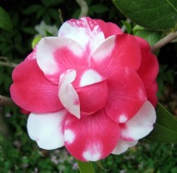

Slide 85
Erminette Chicken
Both Black and White are being shown.
BW

Slide 86
Incomplete and Co-dominance
Incomplete Dominance
Co-Dominance
When one allele does not completely cover up the other allele.
When both alleles are present in the phenotype. (Co = together)

Slide 87
Multiple Alleles
When there are more than just two alleles for a trait.
Example: ABO blood types
Allele 1 = A
Allele 2 = B
Allele 3 = O

Slide 88
Multiple Alleles
Rabbit Coat Color
C = Dark Gray
C^{ch} = Chinchilla
c^{c} = light Gray
c^{h} = Himalya
cc = albino
C > c^{ch} > c^{c} > c^{h} >cc
Most Dominant → Most recessive

Slide 89
Blood Type Genotypes and
Phenotypes
Phenotype | Genotype
 | Homozygous | Heterozygous
Type A | AA | AO
Type B | BB | BO
Type AB |  | AB
Type O | OO
Remember: A=B > O
A and B are co-dominant to each other, but dominant to O

Slide 90
Blood Type Phenotypes
Blood Type | Type A | Type B | Type AB | Type O
Phenotype | A Antigens | B Antigens | A and B Antigens | No Antigens
Possible Genotypes | AA, AO | BB, BO | AB | OO
Antibodies in Blood | B | A | None | A and B

Slide 91
Blood Types
You’re blood type is determined by the type of antigen found on your blood cells.
Antigen – Protein tags on your red blood cells.
There are A antigens and B antigens
A antigen
B antigen

Slide 92
Blood Types: A=B > O
Your blood type is determined by multiple alleles. These three alleles have different relationships to each other.
For example, Allele A and Allele B are both Dominant to Allele O
If you were to receive an A allele from your Dad and an O allele from your mom, the O allele would not be expressed.
Another Example, Allele A is Co-dominant to Allele B.
If you were to receive an A allele from your Dad and a B allele from your mom you would express both A and B antigens

Slide 93
Blood Types and Transfusion
Why are blood types important?
When someone has lost a lot of blood, a blood transfusion could save their life. However, our bodies react badly to blood types that are different from our own, and most early blood transfusions resulted in death.
Why do our bodies react badly to certain blood types?
You’re body has a kind of police force called anti-bodies. They roam the blood looking for invaders. When a different blood type is introduced into someone’s blood stream, the antibodies will attack the blood causing it to clot. These clots can prevent blood from getting to important areas like your brain and cause a person to die.

Slide 94
Anti-Bodies and Antigens
Anti-Bodies and Antigens work like locks and keys.
Antibodies have specific shapes to match with specific antigens.
A
B
A antigen
B antigen

Slide 95
A Blood Cell in B Blood
Patient Blood Cell
Patient Blood Cell
Donor Blood Cell
Patient Blood Cell
Patient Blood Cell

Slide 96
Donor Blood Cell

Slide 97
Blood Types and Transfusions
Universal Donor
Blood Type | Donate | Receive
O | A, B, AB, O | O
A | A, AB | O, A
B | B, AB | O, B
AB | AB | O, A, B, AB
O
A
B
AB
Universal Receiver

Slide 98
Predicting Blood Types
Jack and Jill get married and have a child. Jack is heterozygous for the blood Type A and Jill has type AB blood. What is the chance that they will have a baby with type B blood?
Jack’s Genotype: AO
Jill’s Genotype : AB
Type A: 2/4 = 50%
Tybe B: ¼ = 25%
Type AB: ¼ = 25%
Type O : 0/4 = 0%
A
O
A
AA
AO
B
AB
BO

Slide 99
Blood Type Booklet

Slide 100
Each page needs the following information:
Blood Type
____
Blood Type | Has Antigen | Antibody
A+ | A RH | B
A- | A | B RH
B+ | B RH | A
B- | B | A
AB+ | A & B & RH | None
AB - | A & B | None, but RH
O+ | RH | A & B
O - | None | A & B
Can develop
Can develop
Has ___________ antigens
Has ___________ antibodies
Can Develop _____ antibodies (only for RH-)
Can Give to:
_______________________________
Can Receive from:
_______________________________
O
RH+ → Rh- = ☹
RH- → RH+ = ☺
A
B
AB

Slide 101
Blood Type
____
Blood Type
____
Blood Type
____
Blood Type
____
Has ___________ antigens
Has ___________ antibodies
Can Develop _____ antibodies (only for RH-)
Can Give to:
_____________________________
Can Receive from:
_____________________________
Has ___________ antigens
Has ___________ antibodies
Can Develop _____ antibodies (only for RH-)
Can Give to:
_____________________________
Can Receive from:
_____________________________
Has ___________ antigens
Has ___________ antibodies
Can Develop _____ antibodies (only for RH-)
Can Give to:
_____________________________
Can Receive from:
_____________________________
Has ___________ antigens
Has ___________ antibodies
Can Develop _____ antibodies (only for RH-)
Can Give to:
_____________________________
Can Receive from:
_____________________________
Blood Type
____
Blood Type
____
Blood Type
____
Blood Type
____
Has ___________ antigens
Has ___________ antibodies
Can Develop _____ antibodies (only for RH-)
Can Give to:
_____________________________
Can Receive from:
_____________________________
Has ___________ antigens
Has ___________ antibodies
Can Develop _____ antibodies (only for RH-)
Can Give to:
_____________________________
Can Receive from:
_____________________________
Has ___________ antigens
Has ___________ antibodies
Can Develop _____ antibodies (only for RH-)
Can Give to:
_____________________________
Can Receive from:
_____________________________
Has ___________ antigens
Has ___________ antibodies
Can Develop _____ antibodies (only for RH-)
Can Give to:
_____________________________
Can Receive from:
_____________________________

Slide 102
Autosomal and Sex Linked Traits
Autosomal Traits – traits that come from genes on autosomes
Sex linked traits – traits that come from genes on sex chromosomes.

Slide 103
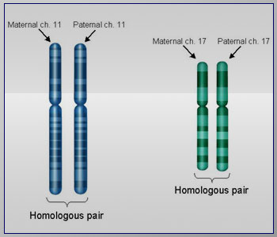
Autosomal Traits
Autosomes have homologous chromosomes. Therefore, traits found on autosomal chromosomes have two alleles.
A
a
a
a

Slide 104
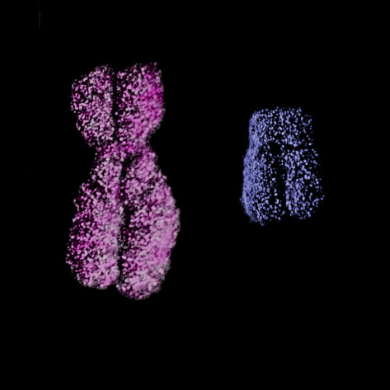
Sex Linked Traits
These are not the same shape and do not have the same genes.
Traits found on the Sex chromosomes are different because the X and Y chromosomes are not homologous.
X
Y

Slide 105
Sex Linked Traits
The X chromosome has genes that the Y chromosome does not. This means that females receive two alleles for a sex linked trait, but males only receive one.
a
A
a
X
Y
X
X
MALE
FEMALE

Slide 106
Predicting Sex Linked Traits
Write the two sex chromosome.
Add the allele if it is on the chromosome.
Determine the Possible Combinations
Mom’s Genotype: X^{H}X^{h}
Dad’s Genotype: X^{H}Y
Dominant Trait = ¾ 75%
Recessive Trait = ¼ 25%
X^{H}
X^{h}
X^{H}
X^{H}X^{H}
X^{H}X^{h}
Y
X^{H}Y
X^{h}Y

Slide 107
Sex Linked Traits and Men
Men are more at risk for inheriting recessive traits because they don’t have a second allele.
Female Male
XHXH X^{H}Y
XHXh X^{h}y
X^{h}X^{h}
Dominant
½ 50%
Dominant
2/3 or 67%
Recessive
½ 50%
Recessive
1/3 or 33%

Slide 108
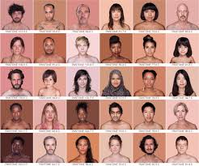
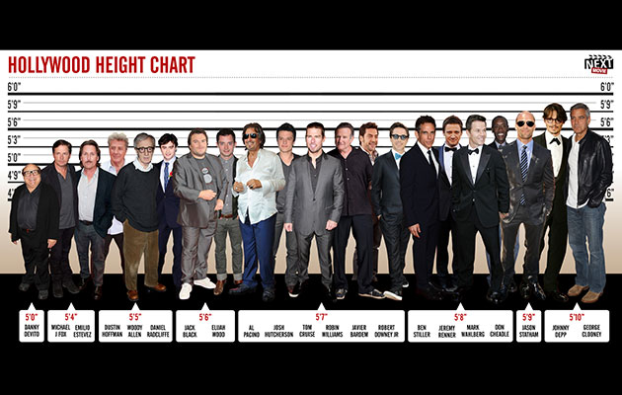
Polygenic Traits
Traits that are determined by more than one gene.
Examples:
Height
Skin Color

Slide 109
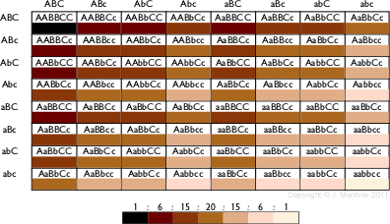

Slide 110
Pedigrees

Slide 111
Pedigree Charts
The family tree of genetics
Notes:
A quick refresher for the teacher on important terms:
Autosomal gene- a gene found on any chromosome except for the sex chromosome. These are chromosomes numbered 1-22.
X-linked gene- a gene found on a chromosome designated as a sex chromosome (X or Y).
Dominant- Refers to an allele that is expressed phenotypically and masks any recessive counterpart.
Recessive- An allele that is not phenotypically expressed when its counterpart is dominant.

Slide 112
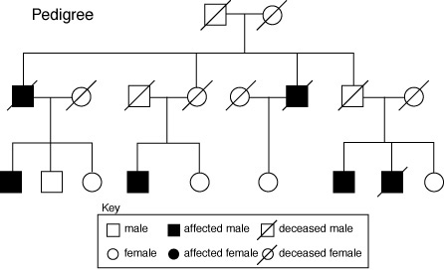
Pedigree Charts
I
II
III

Slide 113
What is a Pedigree?
A pedigree is a chart of the genetic history of family over several generations.
Scientists or a genetic counselor would find out about your family history and make this chart to analyze.
Notes:
A pedigree is a chart of the genetic history of family over several generations. Scientists or a genetic counselor would find out about your family history and make this chart to analyze it. For example, a couple might like to know their chances of having a child that has muscular dystrophy. So the scientists or a genetic counselor would find out who had muscular dystrophy in the mother’s and/or father’s families. This information would be used to and then calculate the probability of the couple having a child with MD.

Slide 114
Constructing a Pedigree
Female
Male
Notes:
You must learn the symbols of the pedigree charts before you can start to learn how to interpret it. These are the symbols that represent a male and a female.

Slide 115
Connecting Pedigree Symbols
Examples of connected symbols:
Married Couple
Children/Siblings
Notes:
These symbols also represent relationships between people. some may have to each other.

Slide 116
Connecting Pedigree Symbols
Examples of connected symbols:
Incest
Notes:
These symbols also represent relationships between people. some may have to each other.

Slide 117
Connecting Pedigree Symbols
Examples of connected symbols:
Fraternal twins
Identical twins
Notes:
Here are examples of symbols that represent relationships between people.

Slide 118
Example
What does a pedigree chart look like?
Notes:
This is just an example of a pedigree and there can be many more different types.

Slide 119
Symbols in a Pedigree Chart
Affected
X-linked
Autosomal carrier
Deceased
Notes:
These are examples of different types of symbols. These symbols would be the same for males or for females, except for X-linked carrier which is only used for females. So an affected male would be a square that is filled in completely. A deceased female would be a circle with a diagonal slash.

Slide 120
Identifying Individuals
Generation Number: I II III IV V VI etc…
Individual Number 1, 2, 3, 4, 5 6, 7
I-2
I
II-2
II-6
1 2 3 4
II
III-3
1 2 3 4 5 6
III
1 2 3

Slide 121
Interpreting a Pedigree Chart
Determine if the pedigree chart shows an autosomal or X-linked disease.
If most of the males in the pedigree are affected the disorder is X-linked
If it is a 50/50 ratio between men and women the disorder is autosomal.
Notes:
When interpreting a pedigree chart of a family with a disease like muscular dystrophy, it is important to consider two steps. The first is to determine if the disorder is autosomal or X-linked.
If the disorder is X-linked most of the males will have the disorder because the Y-chromosome cannot mask the affects of an affected X-chromosome. A female can have the disorder, but it would be a very low percentage. For a female to be affected, she would have had to receive an affected gene from the mother and the father. This means that the father would have the disorder and the mother was a carrier.
In an autosomal disorder, the disorder is not found on the X or Y chromosome. It is found on the other 22 chromosomes in the human body. This means that men and women have an equal chance of having the disorder. The mother and father can be homozygous dominant, heterozygous, and homozygous recessive. If a person is homozygous dominant, the person has two of the same dominant genes. For example if someone is homozygous dominant for being tall it may be represented as TT. Capital letter always represent a dominant gene. If a person is heterozygous, this person would have a dominant trait and a recessive trait. It may be represent as Tt. The dominant gene will mask the recessive gene, so the person is still tall. If a person is homozygous recessive, the person has two of the same recessive genes. For example if someone is homozygous recessive for height, it may be represented as tt. The tt would mean the person is short.

Slide 122
Example of Pedigree Charts
Is it Autosomal or X-linked?
Notes:
Take a minute and try to decide if this slide is autosomal or X-linked.

Slide 123
Answer: Autosomal
Males and Females affected equally – not sex linked
Notes:
It is autosomal because it is 50/50 men to women with the disorder, if it was X-linked most of the men in the diagram would have the disorder.
Make sure you count the number of men with the disorder and the number of women with the disorder. In this pedigree, 3 men and 3 women have the disorder.

Slide 124
Example of Pedigree Charts
Is it Autosomal or X-linked?
Notes:
Take a minute and try to decide if this slide is autosomal or X-linked.

Slide 125
Answer: X linked
Males are more affected than females.
Notes:
It is autosomal because it is 50/50 men to women with the disorder, if it was X-linked most of the men in the diagram would have the disorder.
Make sure you count the number of men with the disorder and the number of women with the disorder. In this pedigree, 3 men and 3 women have the disorder.

Slide 126
Interpreting a Pedigree Chart
Determine whether the disorder is dominant or recessive.
If the disorder is dominant, one of the parents must have the disorder.
If the disorder is recessive, neither parent has to have the disorder because they can be heterozygous.
Notes:
The second step is to determine if the disorder is dominant or recessive. It is important to find out if a disorder is dominant or recessive. For example, Huntington’s disease is a dominant disorder. If you have only one dominant gene you will have Huntington’s disease, which is a lethal disorder. The disorder does not show up until a person is in their middle ages such as 45. It will quickly decrease their motor skills and the brain will begin to deteriorate.
If a disorder is dominant, one parent must have the disorder (either homozygous dominant (TT) or heterozygous recessive (Tt). Both parents do not have to have the disorder. One parent might not have the disorder or be a carrier. If a disease is dominant, it does not skip a generation unless one parent is heterozygous dominant (Tt) and the other parent is homozygous recessive (tt). In this case the child has a chance of not receiving the dominant gene.
If the disorder is recessive, a parent does not have to have the disorder, but could still pass it to their offspring. This would happen when a parent is heterozygous recessive (Tt) and passes on the recessive (t) gene. This means this disorder can skip generations. An example of a recessive disorder would be sickle cell anemia.

Slide 127
Example of Pedigree Charts
Dominant or Recessive?
Notes:
Is this pedigree dominant or recessive?

Slide 128
Answer: Dominant
Notes:
It is dominant because a parent in every generation have the disorder. Remember if a parent in every generation has the disorder, the disorder has not skipped a generation. If the disorder has not skipped a generation the disorder is dominant.

Slide 129
Example of Pedigree Charts
Dominant or Recessive?
Notes:
Is this pedigree dominant or recessive?

Slide 130
Answer: Recessive
Notes:
It is recessive because a parent in every generation does not have the disorder. Remember the disorder can skipped a generation if the disorder is recessive. The parents can be heterozygous and be carriers of the disorder but not have the symptoms of the disorder.

Slide 131
Summary
Pedigrees are family trees that explain your genetic history.
Pedigrees are used to find out the probability of a child having a disorder in a particular family.
To begin to interpret a pedigree, determine if the disease or condition is autosomal or X-linked and dominant or recessive.
Notes:
This summary will help reiterate the important parts of this lesson.
[Created by Lauren Almaguer, CDC Science Ambassador, 2004.]

Slide 132
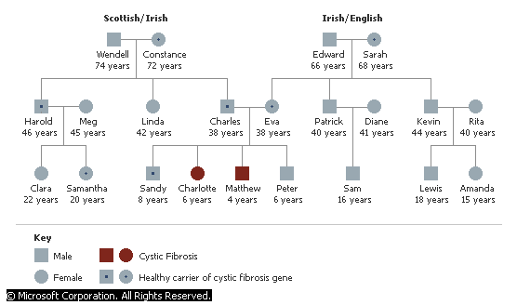
Pedigree Chart -Cystic Fibrosis

Slide 133
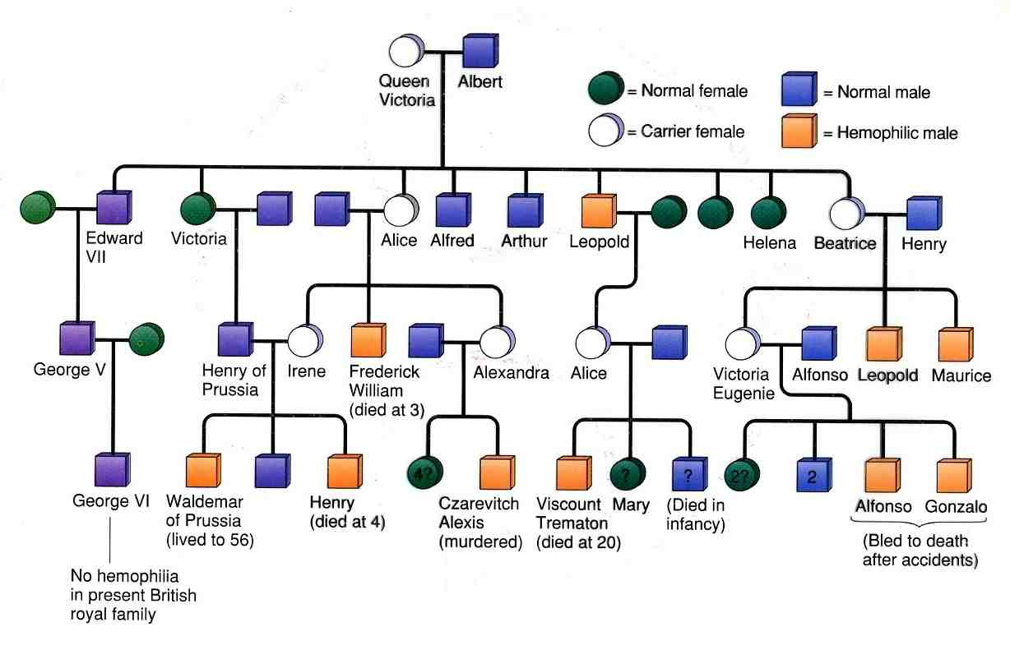
Trait: Hemophilia
Sex-linked
Recessive

Slide 134
Genetic Disorders
http://learn.genetics.utah.edu/content/disorders/

Slide 135
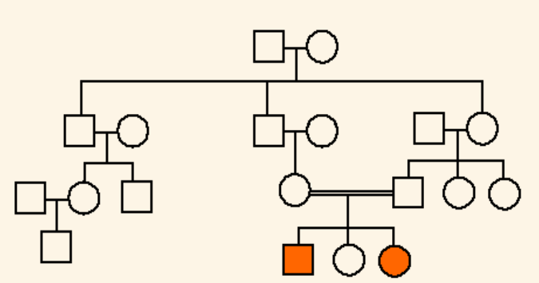
I
1
2
II
1
2
3
4
5
6
III
1
2
3
4
5
6
7
IV
1
2
3
4

