Slide 1
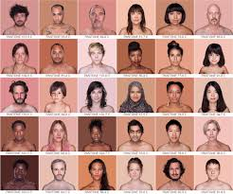
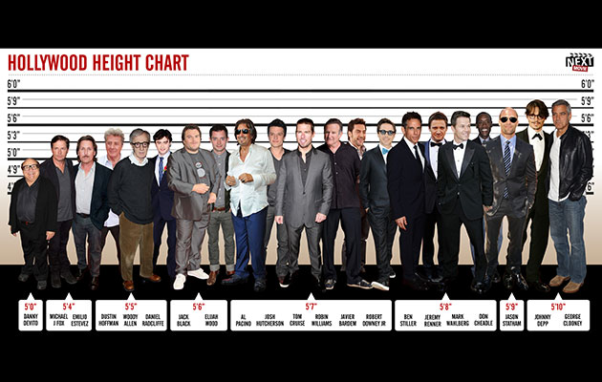
Polygenic Traits
Traits that are determined by more than one gene.
Examples:
Height
Skin Color

Slide 2
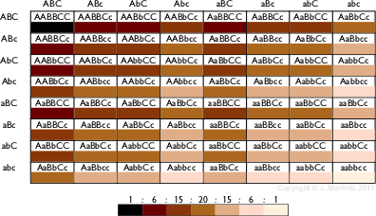

Slide 3
Fraternal Twin Sisters

Slide 4
