Slide 1
Bill Nye Video Reflection
½ page
Why is sexual reproduction important and what are some ways sexual reproduction affects how living things look and act.

Slide 2
Daily Warm Up
Categorize the following Genotypes as Homozygous dominant, Heterozygous or Homozygous recessive.
AA
Aa
RW
WW
If R is an allele that makes mushroom caps red and W is an allele that makes mushroom caps white, what color would a mushroom be if it had a genotype of RW and showed incomplete dominance?
If R is an allele that makes mushroom caps red and W is an allele that makes mushroom caps white, what color would a mushroom be if it had a genotype of RW and showed Codominance?
If A is an allele for Wet ear wax and a is an allele for dry ear wax what kind of ear wax will a person with the genotype Aa have?
Homozygous Dominant
Heterozygous
Heterozygous
Homozygous Dominant
Pink Mushroom Cap
Red and White Mushroom Cap
Wet Ear Wax (recessive allele is covered up)

Slide 3
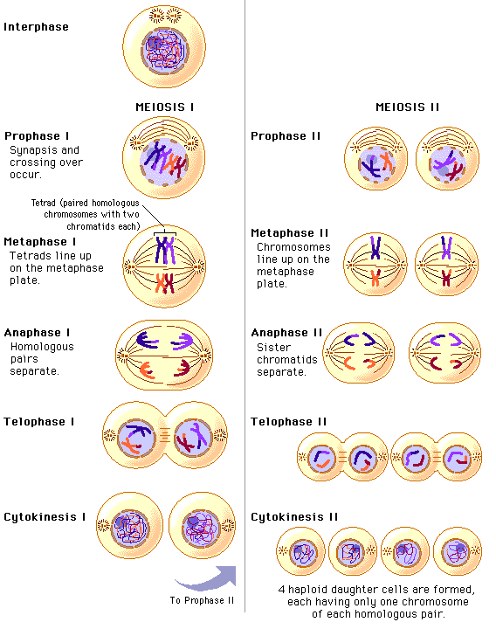
Meiosis
Meiosis – (The process of lessening) - When the body takes one diploid cell and turns it into four unique haploid cells.
Or how the body makes sperm and egg

Slide 4
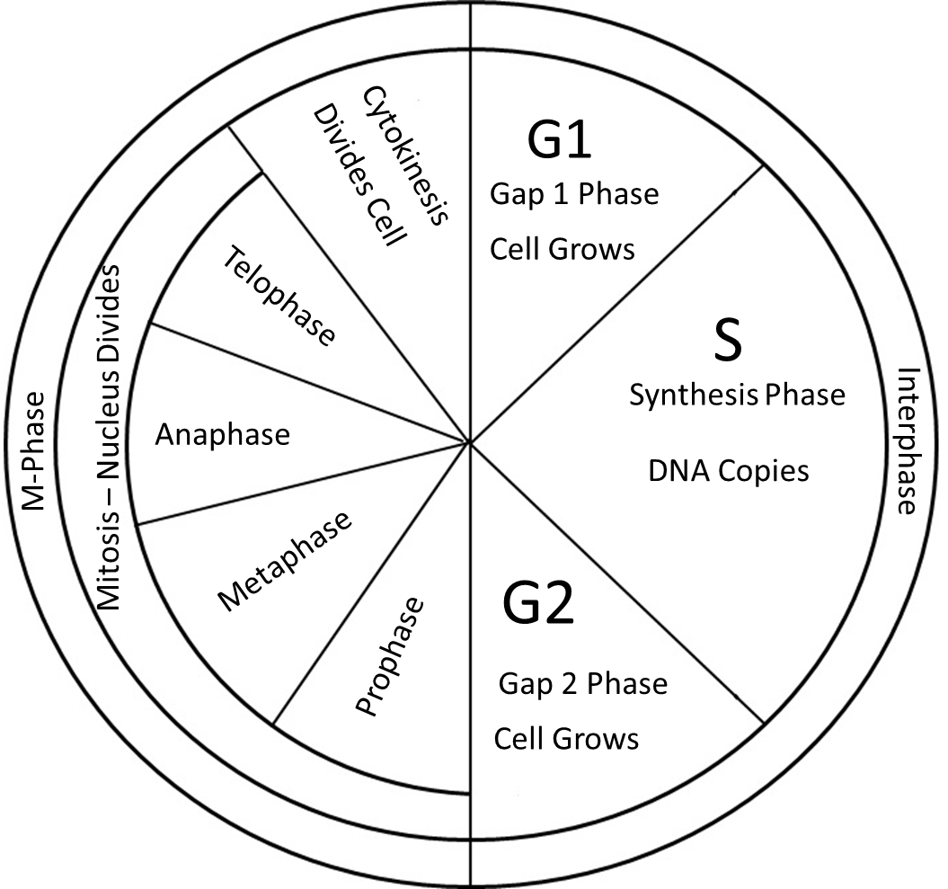
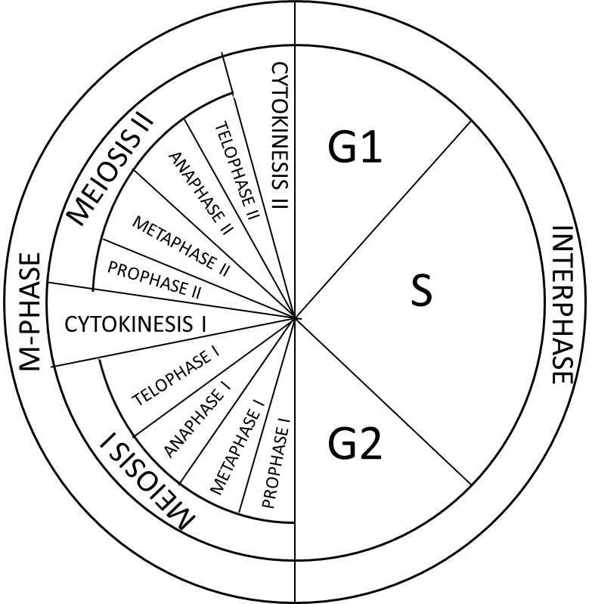
Mitosis Meiosis

Slide 5
Remember the Cell Cycle?
Meiosis is basically going through Mitosis twice.
But there are also some other important things that happen.
MEIOSIS II
G1
CYTOKINESIS II
TELOPHASE II
ANAPHASE II
METAPHASE II
M-PHASE
PROPHASE II
S
CYTOKINESIS I
INTERPHASE
TELOPHASE I
ANAPHASE I
METAPHASE I
G2
MEIOSIS I
PROPHASE I

Slide 6
Note Assignment
Draw the phases of Meiosis
Write their steps beneath

Slide 7
1
1
1
1
1
2
2
2
2
1
1
1
2
2
2
2
Y
X
Y
X
X
Y
X
Before Crossing Over
After Crossing Over
Prophase I
Metaphase I
Anaphase I
Telophase I
Cytokinesis I
1
1
1
1
2
2
2
2
X
X
X
X
1
1
1
1
2
2
2
2
Y
Y
Y
Y
Prophase II
Metaphase II
Anaphase II
Telophase II
Cytokinesis II

Slide 8
The Chromatin winds itself up into chromosomes.
Homologous Chromosomes bind to create tetrads.
Crossing over occurs
Nuclear envelope dissolves
*Crossing Over: Homologous chromosomes (mom and dad) exchange genes
Tetrads line up along the center of the cell
Centrioles and spindle fibers pull tetrads apart into chromosomes
Chromosomes unwind back into Chromatin
Nuclear Envelope forms
Cell Splits into two unique diploid cells
Before Crossing Over
After Crossing Over
Prophase I
Metaphase I
Anaphase I
Telophase I
Cytokinesis I
The Chromatin winds itself up into chromosomes.
Nuclear Envelope Dissovles
Chromosomes line up along the center of the cell
Centrioles and spindle fibers pull sister chromatids apart
Chromatids unwind into Chromatin
Nuclear Envelope Reforms
Cells split into four unique haploid cells
Prophase II
Metaphase II
Anaphase II
Telophase
Cytokinesis II

Slide 9
G1 - The cell is going about its daily business of making energy, protein and preparing for Meiosis
S - The DNA is replicated
G2 - Final Preprarations for M Phase are made
Interphase
Chromatin
Interphase
G1 → S → G2

Slide 10
1
1
2
2
3
3
Prophase I
The Chromatin winds itself up into chromosomes.
Homologous Chromosomes bind to create tetrads.
Crossing over occurs
Nuclear envelope dissolves

Slide 11
The Chromatin winds itself up into chromosomes.
The Nuclear Envelope Dissolves
M Phase
Meiosis I
Prophase I

Slide 12
2. Homologous Chromosomes and their copies combine to form tetrads 3. Crossing Over Occurs
3
1
3
1
2
2
M Phase
Meiosis
Prophase 1

Slide 13
Crossing Over
Crossing over:
When homologous chromosomes shuffle their genes between one another.

Slide 14
Tetrads
Tetrad: When two homologous chromosomes stack together like pancakes. There are a total of four chromatids which is why we call them tetrads.

Slide 15
Crossing Over
This is a three dimensional representation of tetrads and crossing over. Genes can be swapped at any area of the chromosome. Which genes are swapped is completely random.

Slide 16
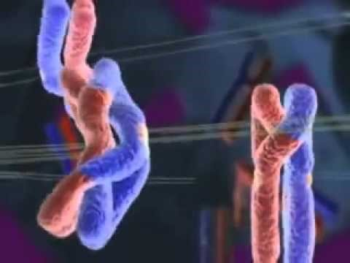
Crossing Over Video

Slide 17
4. The nuclear envelope dissolves
M Phase
Meiosis
Prophase 1

Slide 18
1
1
2
2
3
3
Metaphase I
Tetrads line up along the center of the cell

Slide 19
Homologous chromosomes lie next to one another along the center of the cell to create tetrads.
M Phase
Meiosis I
Metaphase

Slide 20
1
1
2
2
3
3
Anaphase I
Spindle fibers attach to random homologous chromosomes and pull the tetrads apart

Slide 21
Spindle Fibers attach to homologous chromosomes and randomly pull one half of the tetrad to opposite sides of the cell.
M Phase
Meiosis I
Anaphase I

Slide 22
Telophase I
Chromosomes unwind into Chromatin
Two Nuclear Envelopes Form

Slide 23
Two nuclear envelopes form
Chromosomes unwind into chromatin
M Phase
Meiosis I
Telophase 1

Slide 24
Cell Splits into two cells.
M Phase
Cytokinesis I

Slide 25
M Phase II
Chromatin winds into Chromosomes
Nuclear Envelopes Dissolve
Prophase II

Slide 26
M Phase II
Chromatin winds into Chromosomes
Nuclear Envelopes Dissolve
Prophase II

Slide 27
M Phase II
Chromosomes line up along the center of the cell
Metaphase II

Slide 28
M Phase II
Chromosomes line up along the center of the cell
Metaphase II

Slide 29
M Phase II
Spindle fibers attach to kinetochores and pull the sister chromatids to opposite ends of the cells
Anaphase II

Slide 30
M Phase II
Spindle fibers attach to kinetochores and pull the sister chromatids to opposite ends of the cells
Anaphase II

Slide 31
M Phase II
Four Nuclear Envelopes form
Chromosomes unwind into chromatin
Telophase II

Slide 32
M Phase II
Four Nuclear Envelopes form
Chromosomes unwind into chromatin
Telophase II

Slide 33
Each of the two cells split into two cells for a total of four haploid cells.
M Phase II
Cytokinesis II

Slide 34
Writing
Drawing
Before Crossing Over
After Crossing Over
Prophase I
Metaphase I
Anaphase I
Telophase I
Cytokinesis I
Writing
Drawing
Prophase II
Metaphase II
Anaphase II
Telophase II
Cytokinesis II

Slide 35
The Chromatin winds itself up into chromosomes.
Homologous Chromosomes bind to create tetrads.
Crossing over occurs
Nuclear envelope dissolves
*Crossing Over: Homologous chromosomes (mom and dad) exchange genes
Tetrads line up along the center of the cell
Centrioles and spindle fibers pull tetrads apart into chromosomes
Chromosomes unwind back into Chromatin
Nuclear Envelope forms
Cell Splits into two unique diploid cells
Before Crossing Over
After Crossing Over
Prophase I
Metaphase I
Anaphase I
Telophase I
Cytokinesis I
The Chromatin winds itself up into chromosomes.
Nuclear Envelope Dissovles
Chromosomes line up along the center of the cell
Centrioles and spindle fibers pull sister chromatids apart
Chromatids unwind into Chromatin
Nuclear Envelope Reforms
Cells split into four unique haploid cells
Prophase II
Metaphase II
Anaphase II
Telophase II
Cytokinesis II

Slide 36
1
1
1
1
1
2
2
2
2
1
1
1
2
2
2
2
Y
X
Y
Y
X
X
Y
X
Before Crossing Over
After Crossing Over
Prophase I
Metaphase I
Anaphase I
Telophase I
Cytokinesis I
1
1
1
1
2
2
2
2
X
X
X
X
1
1
1
1
2
2
2
2
Y
Y
Y
Y
Prophase II
Metaphase II
Anaphase II
Telophase II
Cytokinesis II

Slide 37
Dragon Meiosis
If you are homozygous dominant or recessive you do not need to flip a penny
If you are heterozygous, flip the penny to determine which allele will go in your egg or sperm
Heads = Dominant Allele
Tails = Recessive allele
You cannot give 4 recessive alleles even if you flip 4 tails. You only have 2 dominant and 2 recessive alleles to distribute

Slide 38
Phenotype Trait | Alleles after S Phase | Homozygous/ Heterozygous
Neck Length: Short | nn (nn) | HO
Eye Color: Red | Ee (Ee) | HE
Horn: Horn | HH (HH) | HO
Spikes: Spikes | Ss (Ss) | HE
Tail Length: Long | LL (LL) | HO
Body Color: Green | Gg (Gg) | HE
Color of Wings: Yellow | Rr (Rr) | HE
Number of Toes:FourToes | TT (TT) | HO
Belly Color: Yellow/White | YW (YW) | HE
Color of Spikes: Black | Bb (Bb) | HE
Freckles: 5 | KJ (KJ) | HE
Fire Breathing: Yes | FF (FF) | HO
Ear Frills: No | Xh Xh
Gender: Male | Y Y
n
E
H
s
L
G
R
T
W
B
F
X | h

