Slide 1
Unit 06
Write
NEARPOD: FRGHM
Genetics and Meiosis

Slide 2
Unit 06 - Latin Root Words
Write

Slide 3
Unit 06 Latin Root Words
Write
Latin Root Word | Definition
Hetero | Opposite or other
2. Homo | Same
3. Zygous | Pertaining to the zygote

Slide 4
Basic Genetics
Write

Slide 5
Write
Genetics is the study of heredity.
Heredity is the study of how things are inherited or passed down from parent to offspring.

Slide 6
Heredity in Photos
http://www.bbc.com/future/story/20130712-genetic-portraits-of-families
What did you inherit from your parents?

Slide 7
Traits
Write
Traits – Characteristics that can be inherited.
Examples:
Eye color
Hair color
Skin color
Height
How likely you are to get a diseases
Longevity (how long you will live)

Slide 8
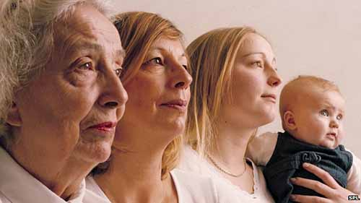
What are some traits that were inherited?
Discuss

Slide 9
Daily Warm Up 01/07/2015 – 01/08/2015
What is a trait?
What are some traits that are common in your family?
What are some traits that are common to Idaho?

Slide 10
Daily Warm Up 01/07/2016 – 01/08/2016
What is a trait?
What are some traits that are common in your family?
What are some traits that are common to Ireland? What about Japan?
A characteristic that can be inherited, such as eye or skin color.
Answers will vary
Answers will vary

Slide 11
How are traits made?
Write
Traits are determined by proteins and proteins are created from genes.
GENE → PROTEIN → TRAIT
Different genes will result in different proteins and therefore different traits.
Most traits are created from a combination of proteins and therefore a combination of genes.
Very few traits are determined by only one gene.

Slide 12
Listen
Ear Wax Consistency
Ear Wax Consistency
WET
DRY
Lactose Intolerance
Lactose Intolerance
YES
NO
Blood Type
Blood Type
A
O
Chromosome 1 Chromosome 1
From Father From Mother

Slide 13
Traits, Genes, and Alleles
Write
For every protein you have two genes.
One gene from your mother
One gene from your father
But not all genes are the same.
Your father may have given you the gene for wet ear wax
Your mother may have given you the gene for dry ear wax
When a gene for a trait has different variations we call these alleles.
Alleles: Different variations of a gene.
Alleles are represented by letters

Slide 14
Trait = Star Color
A = Red allele
a = yellow allele
AA
Aa
aa

Slide 15
Genotype and Phenotype
Write
Genotype: The two alleles that you inherit from your parents.
One allele from dad
One allele from mom
Phenotype: The actual physical trait that is expressed because of the two alleles.
A = Red allele
a = yellow allele
AA
Aa
aa
Genotype: Homozygous Dominant
Genotype: Heterozygous
Genotype: Homozygous Recessive
Phenotype:
Red
Phenotype:
Red
Phenotype:
Yellow

Slide 16
Three types of Genotypes
Write
There are three combinations of genotypes that you can inherit.
Homozygous: Alleles are the same
AA, aa, RR, WW
Homozygous Dominant: Two Dominant Alleles (AA)
Homozygous Recessive: Two Recessive Alleles (aa)
Heterozygous: Alleles are different
Aa, RW

Slide 17
Allele Interactions
Listen
Dominant and Recessive
A
a
Incomplete Dominance
R
W
Co-dominance
R
W

Slide 18
Incomplete Dominance
Listen
R
R
R
W
W
W

Slide 19
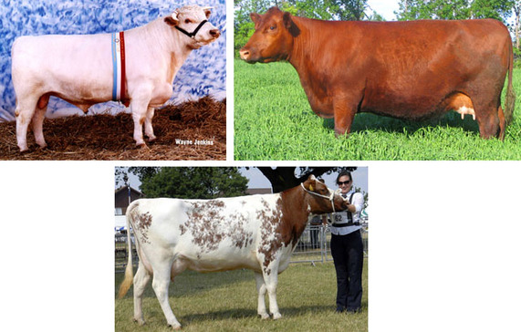
Codominance
Listen
W
W
B
B
B
W

Slide 20
Allele Interaction
Write
Dominant/Recessive
One allele covers up the other
Dominant Allele covers (A)
Recessive allele is covered (a)
Incomplete dominance
Neither allele is dominant and they mix together
Red Allele (R) and White Allele (W) = Pink Trait (RW)
Codominance
Neither allele is dominant and both traits are expressed in the phenotype
Red Allele (R) and White Allele (W) = Red and White Trait (RW)

Slide 21
Ear Wax Consistency (W)
Ear Wax Consistency (w)
WET
DRY
Lactose Persistence (P)
Lactose Persistence (p)
YES
NO
Blood Type (A)
Blood Type (O)
A
O
Chromosome 1 Chromosome 1
From Father From Mother

Slide 22
Ear Wax Consistency
Ear Wax Consistency
Ear Wax Consistency:
WET = (W)
DRY = (w)
Lactose Persistence:
YES = (P)
NO = (p)
Blood Type
A = A
B = B
O = o
Genotype: Phenotype:
Ww Wet Ear Wax
Pp Lactose persistent
AO Blood Type A
WET
DRY
Lactose Persistence
Lactose Persistence
YES
NO
Blood Type
Blood Type
A
O
Chromosome 1 Chromosome 1
From Father From Mother

