Slide 2
M-Phase: Mitosis and Cytokinesis
2N → 2N

Slide 3
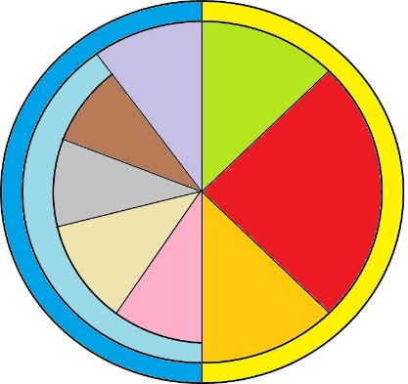
G1 - The cell is going about its daily business of making energy, protein and preparing for Mitosis.
S - The DNA is replicated
G2 - Final Preparations for M Phase are made
Interphase
Chromatin
Interphase
Father Original DNA
Mother Original DNA
G1 → S → G2
Father DNA Copy
Mother DNA Copy

Slide 4
G1
2N
Growth

Slide 5
S
2N → 4N
Copy DNA

Slide 6
G2
4N
Growth

Slide 7
The Chromatin winds itself up into chromosomes.
The nuclear envelope dissolves.
M Phase
Mitosis
Prophase

Slide 8
Prophase
4N
Nuclear Envelope Dissolves
Chromatin winds up into chromosomes

Slide 9
The chromosomes line up vertically along the center of the cell
Spindle fibers attach to kinetochores
M Phase
Mitosis
Metaphase

Slide 10
Metaphase
4N
Chromosomes are going to line up along the center of the cell
Spindle fibers attach to kinetochores

Slide 11
The spindle fibers pull the sister Chromatids apart.
The spindle fibers disappear.
M Phase
Mitosis
Anaphase

Slide 12
Anaphase
4N
The spindle fibers pull the sister Chromatids apart.
The spindle fibers disappear.

Slide 13
The nuclear envelope develops around the chromosomes.
The chromosomes unwind back into Chromatin
M Phase
Mitosis
Telophase

Slide 14
Telophase
4N
Two nuclear envelopes will form around the chromosomes on opposites of the cell
Chromosomes will unwind into chromatin

Slide 15
Cell Splits
4N
4N
Original Daughter Cell
2N
Copied Daughter Cell
2N

Slide 16
The Cell splits into two daughter cells and goes back into G₁ phase
M Phase
Cytokinesis

Slide 17
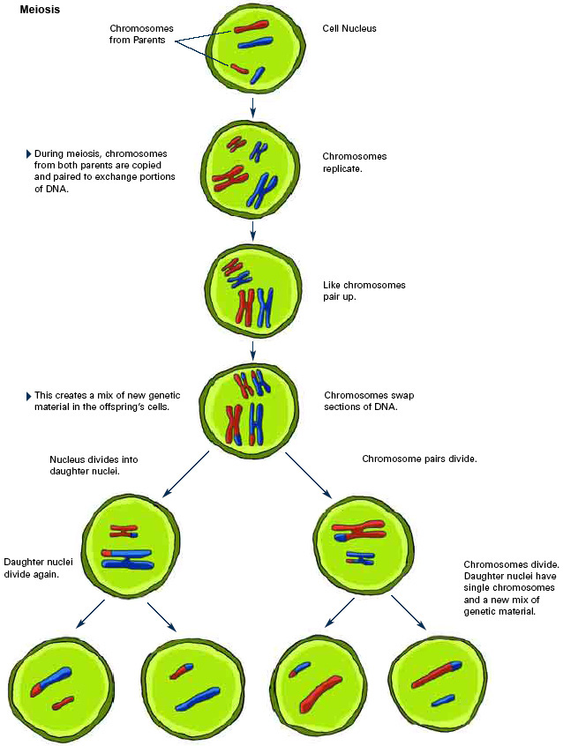
Meiosis
Meiosis
The process of taking a Diploid cell and turning it into 4 haploid cells.
1 Diploid → 4 Haploid

Slide 18
G1 - The cell is going about its daily business of making energy, protein and preparing for Mitosis.
S - The DNA is replicated
G2 - Final Preprarations for M Phase are made
Interphase
Chromatin
Interphase
G1 → S → G2

Slide 19
The Chromatin winds itself up into chromosomes.
M Phase
Meiosis
Prophase 1

Slide 20
2. Homologous Chromosomes and their copies line up to form tetrads 3. Crossing Over Occurs
M Phase
Meiosis
Prophase 1

Slide 21
Crossing Over

Slide 22
Crossing Over
This is a three dimensional representation of tetrads and crossing over. Genes can be swapped at any area of the chromosome. Which genes are swapped is completely random.

Slide 23
Crossing Over Video

Slide 24
4. The nuclear envelope dissolves
M Phase
Meiosis
Prophase 1

Slide 25
The chromosomes line up vertically along the center of the cell
M Phase
Mitosis
Metaphase

