Slide 1
Unit 05 Notes
Cellular Division

Slide 2
Unit 05 Latin Root Words

Slide 3
Latin Root Words
Latin Root Word | Definition
Chromo | Color
Some | Body
Centro | Center
Mere | Part
Kine | To Move
Di | Double
Hap | Single
Tetra | Four
Homo | Same
10. Logos | Proportion or ratio
11. Mei | To lessen

Slide 4
Objective 1
I can explain the importance of cell division to living things

Slide 5
Why do cells divide?
Reproduction
Growth and Development - all multi-cell creatures start out as a single cell
3. Repair and Replacement
- millions of our cells die and are replaced every second of every day

Slide 6
Replication via Mitosis Video
https://www.youtube.com/watch?v=m73i1Zk8EA0

Slide 7
Bacteria Growth
https://www.youtube.com/watch?v=gEwzDydciWc

Slide 8
Growth and Development Video
https://www.youtube.com/watch?v=P1h611sNji8

Slide 9
Repair and Replacement Video
https://www.youtube.com/watch?v=Cf3c5Um5gHc

Slide 10
Why can’t we regenerate limbs?
https://www.youtube.com/watch?v=QFa6jP6WgzM

Slide 11
Chromosomes
Objective 2: I know the two components that make up a chromosome.

Slide 12
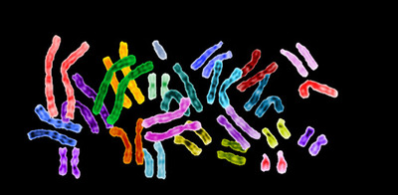
Chromosomes

Slide 13
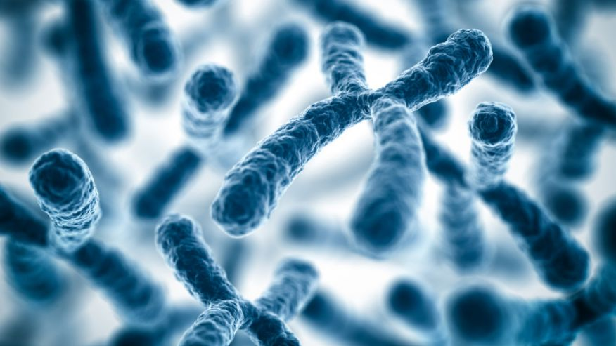
Chromosome
*Chromosome:
DNA and proteins tightly coiled together

Slide 14
Did you Know:
If you put all the DNA molecules in your body end to end, the DNA would reach from the Earth to the Sun and back over 600 times (100 trillion times six feet divided by 92 million miles)

Slide 15
Activity
In every cell of your body is about 6 feet of DNA!
How does it all fit?
Try to fit your DNA (string) into your Nucleus (Circle on Paper)
You can try using some proteins (beads) to help you out.

Slide 16
Chromosome Condensation
Objective 3: I know the four levels of condensation for DNA.

Slide 17
Chromosome Parts
DNA
A nucleic acid that contains the information for our genes.

Slide 18
Chromosome Vocabulary
Nucleosome
DNA wrapped around a protein called Histone

Slide 19
Chromosome Vocabulary
Chromatin
DNA and proteins wound up together into a cord like structure

Slide 20
Chromosome Vocabulary
Chromosome
Coiled up Chromatin

Slide 21
Building a Chromosome
DNA
Nucleosome
Chromatin
DNA
1. DNA is wound around the protein histone
2. Nucleosomes pack together to become chromatin
3. Chromatin packs together to become chromosomes

Slide 22
Diploid and Haploid Cells
Objective 4: I know the difference between Haploid and Diploid Cells

Slide 23
Chromosome Sets
*Every organism has a unique number of chromosomes.
Humans = 23 Chromosomes
Fruit Fly = 4 Chromosomes
Carp = 52 Chromosomes
Adders tongue = 63 Chromosomes
Dog = 39 Chromosomes
Ploidy
the number of sets of chromosomes in a cell
Haploid Number (1N)
The number of chromosomes in a single set

Slide 24
Building Words
2 Sets of chromosomes
DI – PLOID =
HAP –PLOID =
1 Sets of chromosomes

Slide 25
Fruit Fly Chromosomes
The Fruit Fly has 4 distinct chromosomes.
1 Chromosome Set

Slide 26
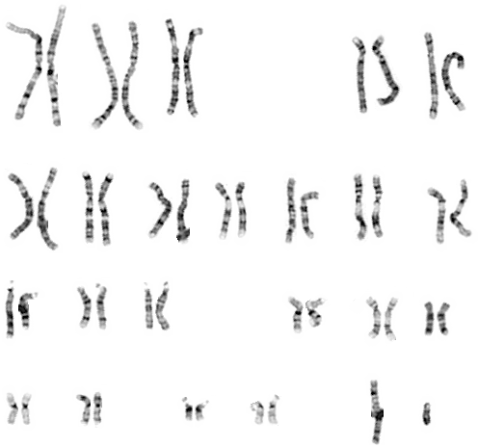
Human Chromosomes
Chromosomes from a DIPLOID Cell
How many chromosomes are there?
46
How many would there be in a HAPLOID CELL?
23
What is the Haploid Number for Humans
23

Slide 27
Haploid and Diploid Cells
*Different Cells have different number of sets of chromosomes.
Haploid (1N)
Diploid
(2N)
A haploid cell has 1 set of chromosomes.
A diploid cell has 2 set of chromosomes.
*The Majority of your cells have two sets of chromosomes and are considered to be diploid.

Slide 28
All Cells
No Nucleus
Nucleus
Prokaryotic
Eukaryotic
Plant
Animal
Haploid
Diploid
Haploid
Diploid

Slide 29
Other Names for Haploid And Diploid Cells
Haploid Cells
Sex Cells
Gametes
Germ Cells
Diploid Cells
Body Cells
Somatic Cells
Liver, Skin, Brain, etc.

Slide 30
Homologous Chromosomes
Objective 5. I can describe what makes two chromosomes homologous

Slide 31
Homologous Chromosomes
Homo = Same Logous = Ratio
Homologous Chromosomes are chromosomes from different sets that have the same genes, look similar, and have the same ratio of light and dark areas.
Homologous Chromosomes
Homologous Chromosomes
Homologous Chromosomes
Homologous Chromosomes

Slide 32
Homologous Chromosomes Practice
http://www.execulink.com/~ekimmel/karyotype_drag_and_drop.swf

Slide 33
Where do your Chromosome sets come from?
1 set comes from your mother
1 set comes from your father

Slide 34
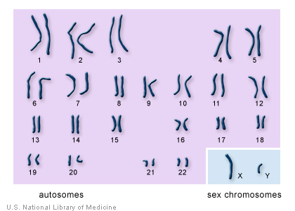
Types of Chromosomes
Autosomes
Any chromosomes not considered a sex chromosome or is not involved in sex determination.
Sex Chromosomes
a chromosome involved with determining the sex of an organism. X or Y in humans.

Slide 35
Karyotypes

Slide 36
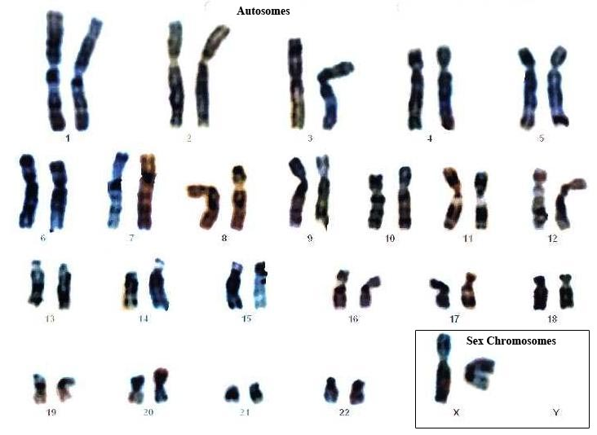
Karyotypes
Karyotype – a picture of all the chromosomes in the cell of an organism matched up with their homologous pairs.

Slide 37
This is a human karyotype. How many chromosomes do humans have?
23 chromosome pairs
46 chromosomes

Slide 38
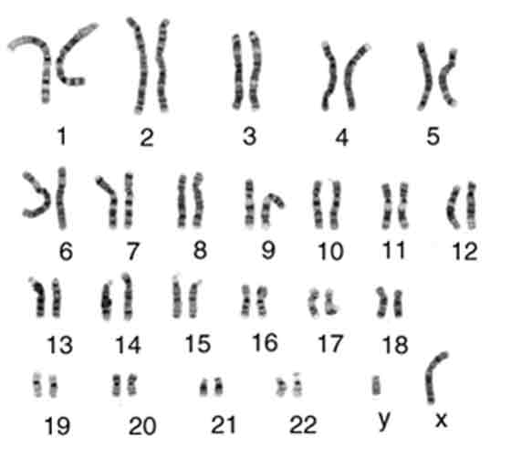
Human Karyotype

Slide 39
Humans
All human cells, except for gametes, are diploid.
They have 2 sets of 23 chromosomes
1 set comes from your father
1 set comes from your mother
Humans have two sets of chromosomes
Two sets of 23 for a total of 46 chromosomes

Slide 40
Types of Reproduction

Slide 41
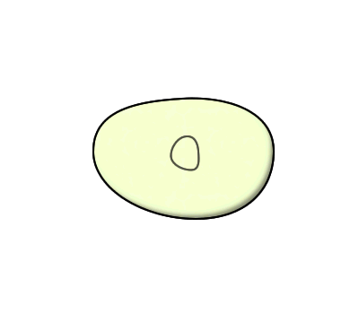
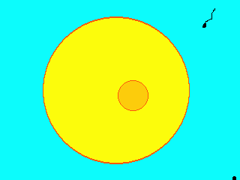
Two Types of Reproduction
Asexual Reproduction
reproduction without the fusion of gametes (Mitosis) to make an exact copy of the original cell
2N → 2N
Sexual Reproduction
Reproduction with the fusion of gametes
1N + 1N = 2N

Slide 42
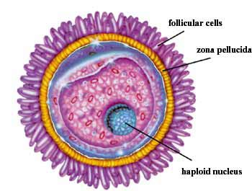
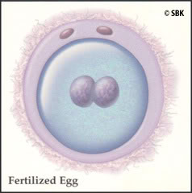
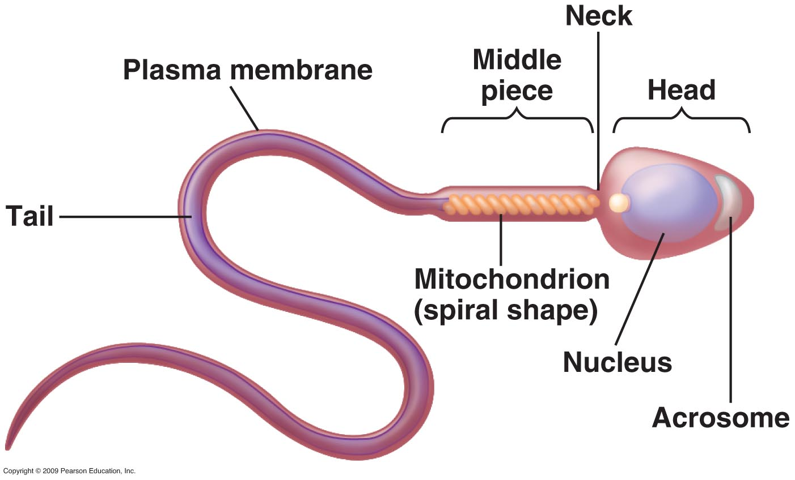
Fertilization
Fertilization
the action or process of fertilizing an egg via the fusion of the male sperm with the female egg to form a zygote.
Zygote
a diploid cell resulting from the fusion of two haploid gametes; a fertilized egg.

Slide 43
Fertilization Video

Slide 44
Cell Cycle

Slide 45
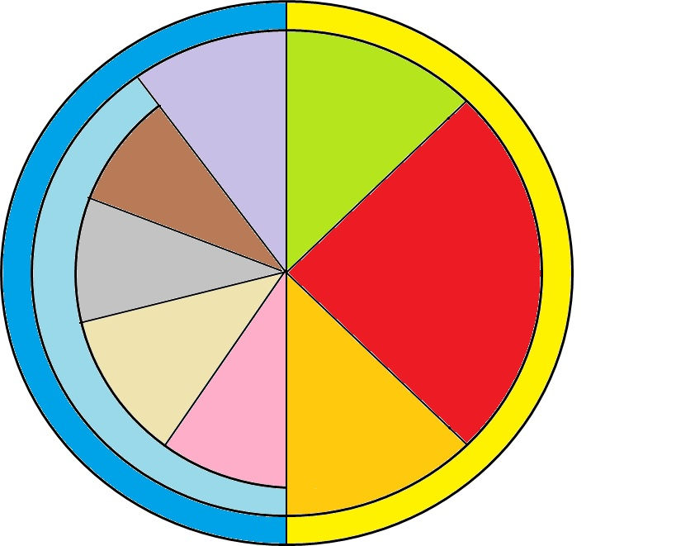
How do we know when Cell Division Occurs?
Cell Cycle
A series of events that take place in eukaryotic cells leading to their division and duplication
G1 Phase
Cytokinesis
Telophase
M-Phase
Mitosis
Interphase
Anaphase
S Phase
Metaphase
Prophase
G2 Phase

Slide 46
The Two Major Phases of the Cell Cycle
Interphase
The resting phase between mitosis or meiosis
M Phase
The phase where mitosis (or meiosis) and cytokinesis occurs.
Cytokinesis
G1 Phase
Telophase
M-Phase
Mitosis
Interphase
Anaphase
S Phase
Metaphase
Prophase
G2 Phase

Slide 47
What are the three phases of Interphase?
G1 – Gap 1 – Phase
Gap 1 phase – cell gets larger and prepares for mitosis
S Phase
Synthesis phase – DNA makes a copy of itself
G2 – Gap 2 – Phase
Gap 2 phase - final preparation for mitosis
G1 Phase
Interphase
S Phase
G2 Phase

Slide 48
S Phase and Chromosomes
Centromere: Center Part that binds two sister chromatids together.
Kinetechore: an area on a chromosome where spindle fibers attach to help move the sister chromatids apart.
Sister Chromatid (original)
Sister Chromatid (copy)
Chromosome
Chromosome

Slide 49
S Phase and Chromosomes
After S Phase
Before S Phase
Centromere
Centromere
Kinetochore
Kinetochore
Sister Chromatid (original)
Sister Chromatid (copy)
Chromosome
Chromosome

Slide 50
Chromosome Vocabulary
Centromere
The part on the chromosome that connects the two chromatids together
Original Chromatid
Copied Chromatid
Chromosome

Slide 51
Chromosome Vocabulary
Kinetechore
Attachment point for spindle fibers
Original Chromatid
Copied Chromatid
Chromosome

Slide 52
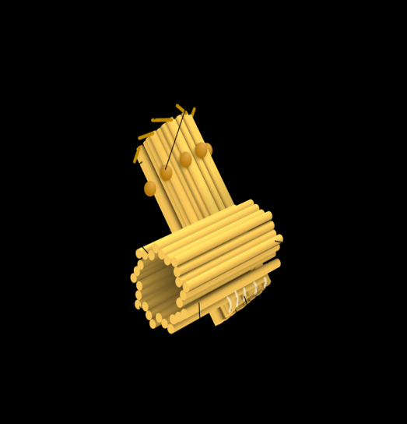
Mitosis Organelles Vocabulary
Centriole
An organelle that organizes the spindle fibers that assist in mitosis and cytokinesis.
Spindle Fibers
Filaments that attach to a kinetechore and pulls the two chromatids apart.

Slide 53
Chromosome Structure
Spindle Fibers
Spindle Fibers
Centromeres
Centriole
Centriole
Kinetechore
Kinetechore
Original Chromatid
Copied Chromatid
Chromosome

Slide 54
What are the two phases of M-Phase?
Mitosis
The process wherein the nucleus divides into two nuclei
Cytokinesis
The process wherein a cell divides into two daughter cells
Cytokinesis
G1 Phase
Telophase
M-Phase
Mitosis
Interphase
Anaphase
S Phase
Metaphase
Prophase
G2 Phase

Slide 55
What are the Four Phases of Mitosis?
PMAT
Prophase
Metaphase
Anaphase
Telophase
Cytokinesis
G1 Phase
Telophase
M-Phase
Mitosis
Interphase
Anaphase
S Phase
Metaphase
Prophase
G2 Phase

