Slide 1
Unit 05 Notes
Cellular Division

Slide 2
Unit 05 Latin Root Words

Slide 3
Latin Root Words
Latin Root Word | Definition
Chromo | Color
Some | Body
Centro | Center
Mere | Part
Kine | To Move
Di | Double
Hap | Single
Tetra | Four
Homo | Same
10. Logos | Proportion or ratio
11. Mei | To lessen

Slide 4
Why do Cells Divide?

Slide 5
Why do cells divide?
Reproduction
Growth and Development - all multi-cell creatures start out as a single cell
3. Repair and Replacement
- millions of our cells die and are replaced every second of every day

Slide 6
Replication via Mitosis Video
https://www.youtube.com/watch?v=m73i1Zk8EA0

Slide 7
Bacteria Growth
https://www.youtube.com/watch?v=gEwzDydciWc

Slide 8
Growth and Development Video
https://www.youtube.com/watch?v=P1h611sNji8

Slide 9
Repair and Replacement Video
https://www.youtube.com/watch?v=Cf3c5Um5gHc

Slide 10
Why can’t we regenerate limbs?
https://www.youtube.com/watch?v=QFa6jP6WgzM

Slide 11
Chromosomes

Slide 12
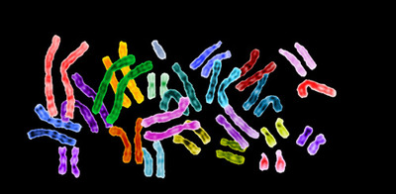
Chromosomes

Slide 13
Chromosome
*Chromosome:
Coiled up DNA and proteins that contain the genetic code for living things.
The term chromosome comes from the Greek words for color (chroma) and body (soma). Scientists gave this name to chromosomes because they are cell structures, or bodies, that are strongly stained by some colorful dyes used in research.
They were first seen under a microscope in 1842.
Chromosomes vary in number and shape among living things.

Slide 14
Chromosome Parts
DNA
A nucleic acid that contains the information for our genes.

Slide 15
Chromosome Vocabulary
Nucleosome
DNA wrapped around a protein called Histone

Slide 16
Chromosome Vocabulary
Chromatin
DNA and proteins wound up together into a cord like structure

Slide 17
Chromosome Vocabulary
Chromosome
Coiled up Chromatin

Slide 18
Building a Chromosome
Chromosome
Chromatin
Nucleosome
DNA
3. Chromatin packs together to become chromosomes
2. Nucleosomes pack together to become chromatin
1. DNA is wound around the protein histone

Slide 19
Diploid and Haploid Cells

Slide 20
Chromosome Sets
*Every organism has a certain number of chromosomes
Humans = 23 Chromosomes
Fruit Fly = 4 Chromosomes
Carp = 52 Chromosomes
Adders tongue = 63 Chromosomes
Dog = 39 Chromosomes
Each set of chromosomes contains all the genes of an organism
Humans have about 20,000 genes on 23 chromosomes

Slide 21
Fruit Fly Chromosomes
The Fruit Fly has 4 distinct chromosomes.
1 Chromosome Set

Slide 22
Haploid and Diploid Cells
*Different Cells have different number of sets of chromosomes.
Haploid
Diploid
A haploid cell has 1 set of chromosomes.
A diploid cell has 2 set of chromosomes.
*The Majority of your cells have two sets of chromosomes and are considered to be diploid.

Slide 23
Haploid Vs. Diploid
Diploid 2(N)
Haploid 1(N)
Total Number of Chromosomes: 10
Sets of Chromosomes: 2
Number of Chromosomes in each Set: 5
Total Number of Chromosomes: 5
Sets of Chromosomes: 1
Number of Chromosomes in each Set: 5

Slide 24
Haploid and Diploid Cells
Ploidy
the number of sets of chromosomes in a cell
Haploid Number (N)
The number of chromosomes in a single set
Example: Humans Haploid number is 23, but the majority of our cells are diploid, so in the majority of our cells we have 2 X 23 chromosomes for a total of 46 chromosomes
Haploid (1N)
A cell containing only one set of chromosomes
Also called Gametes or sex cells
Diploid (2N)
A cell containing two sets of chromosomes
Also called somatic or body cells

Slide 25
Types of Cells
All Cells
Prokaryotic
Eukaryotic
Animal
Plant
Somatic/Body
(Diploid)
Germ/Gamete/Sex/Egg
(Haploid)
Somatic/Body(Diploid)
Germ/Gamete/Sex/Egg
(Haploid)
Eggs/Ovum
(Female)
Sperm
(Male)
Many different types
Many different types
Eggs/Ovum
(Female)
Sperm
(Male)

Slide 26
Homologous Chromosomes

Slide 27
Homologous Chromosomes
Homo = Same Logous = Ratio
Homologous Chromosomes are chromosomes from different sets that have the same genes, look similar, and have the same ratio of light and dark areas.
Homologous Chromosomes
Homologous Chromosomes
Homologous Chromosomes
Homologous Chromosomes

Slide 28
Homologous Chromosomes Practice
http://www.execulink.com/~ekimmel/karyotype_drag_and_drop.swf

Slide 29
Where do your Chromosome sets come from?
1 set comes from your mother
1 set comes from your father

Slide 30
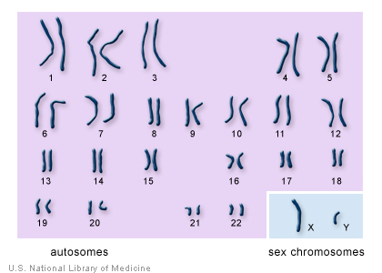
Types of Chromosomes
Autosomes
Any chromosomes not considered a sex chromosome or is not involved in sex determination.
Sex Chromosomes
a chromosome involved with determining the sex of an organism. X or Y in humans.

Slide 31
Karyotypes

Slide 32
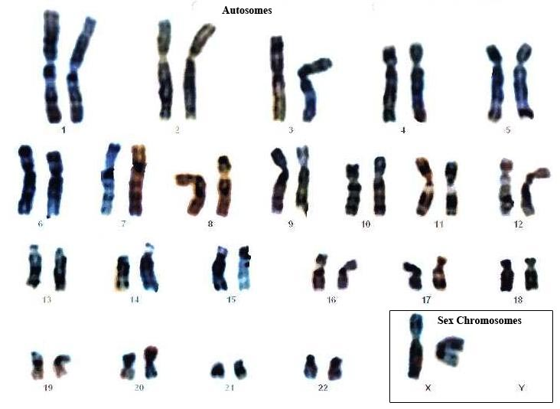
Karyotypes
Karyotype – a picture of all the chromosomes in the cell of an organism matched up with their homologous pairs.

Slide 33
This is a human karyotype. How many chromosomes do humans have?
23 chromosome pairs
46 chromosomes

Slide 34
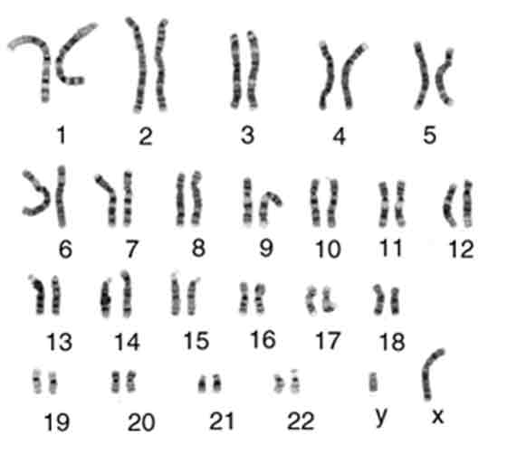
Human Karyotype

Slide 35
Humans
All human cells, except for gametes, are diploid.
They have 2 sets of 23 chromosomes
1 set comes from your father
1 set comes from your mother
Humans have two sets of chromosomes
Two sets of 23 for a total of 46 chromosomes

Slide 36
Types of Reproduction

Slide 37
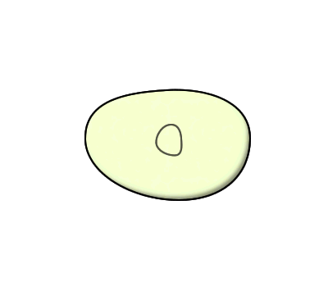
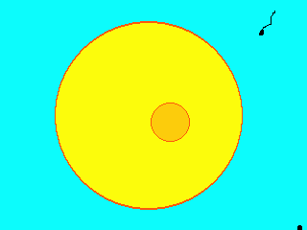
Two Types of Reproduction
Asexual Reproduction
reproduction without the fusion of gametes (Mitosis) to make an exact copy of the original cell
2N → 2N
Sexual Reproduction
Reproduction with the fusion of gametes
1N + 1N = 2N

Slide 38
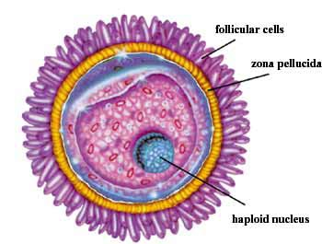
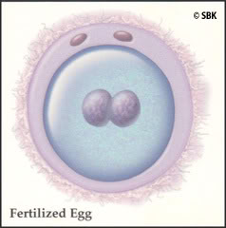
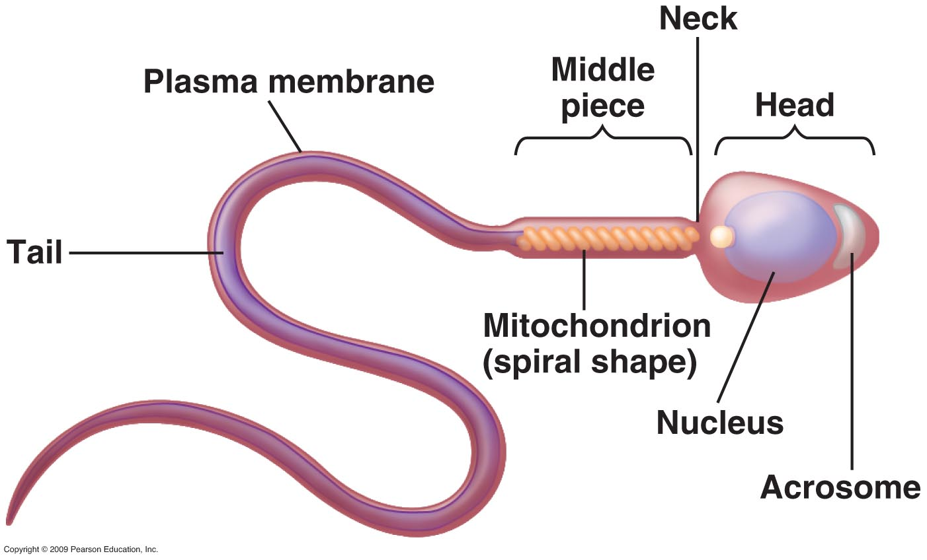
Fertilization
Fertilization
the action or process of fertilizing an egg via the fusion of the male sperm with the female egg to form a zygote.
Zygote
a diploid cell resulting from the fusion of two haploid gametes; a fertilized egg.

Slide 39
Fertilization Video

Slide 40
Cell Cycle

Slide 41
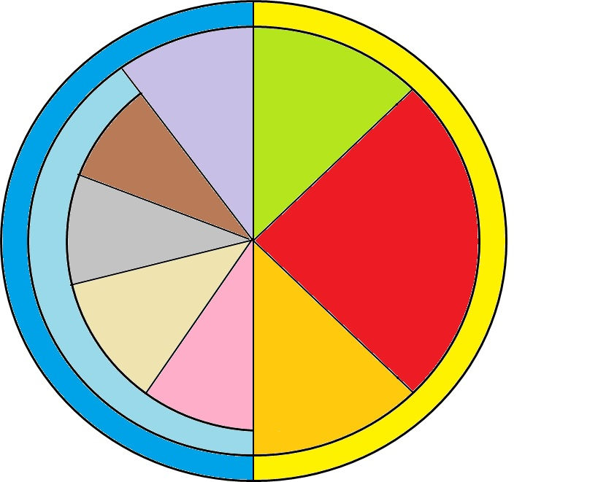
How do we know when Cell Division Occurs?
Cell Cycle
A series of events that take place in eukaryotic cells leading to their division and duplication
G1 Phase
Cytokinesis
Telophase
M-Phase
Mitosis
Interphase
Anaphase
S Phase
Metaphase
Prophase
G2 Phase

Slide 42
The Two Major Phases of the Cell Cycle
Interphase
The resting phase between mitosis or meiosis
M Phase
The phase where mitosis (or meiosis) and cytokinesis occurs.
Cytokinesis
G1 Phase
Telophase
M-Phase
Mitosis
Interphase
Anaphase
S Phase
Metaphase
Prophase
G2 Phase

Slide 43
What are the three phases of Interphase?
G1 – Gap 1 – Phase
Gap 1 phase – cell gets larger and prepares for mitosis
S Phase
Synthesis phase – DNA makes a copy of itself
G2 – Gap 2 – Phase
Gap 2 phase - final preparation for mitosis
G1 Phase
Interphase
S Phase
G2 Phase

Slide 44
S Phase and Chromosomes
Centromere: Center Part that binds two sister chromatids together.
Kinetechore: an area on a chromosome where spindle fibers attach to help move the sister chromatids apart.
Sister Chromatid (original)
Sister Chromatid (copy)
Chromosome
Chromosome

Slide 45
S Phase and Chromosomes
After S Phase
Before S Phase
Centromere
Centromere
Kinetochore
Kinetochore
Sister Chromatid (original)
Sister Chromatid (copy)
Chromosome
Chromosome

Slide 46
Chromosome Vocabulary
Centromere
The part on the chromosome that connects the two chromatids together
Original Chromatid
Copied Chromatid
Chromosome

Slide 47
Chromosome Vocabulary
Kinetechore
Attachment point for spindle fibers
Original Chromatid
Copied Chromatid
Chromosome

Slide 48
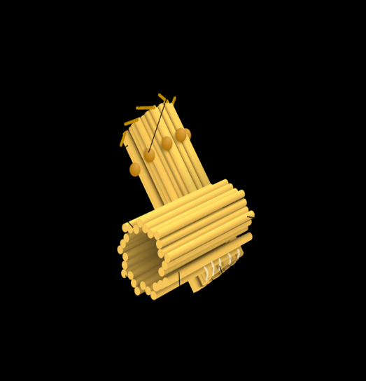
Mitosis Organelles Vocabulary
Centriole
An organelle that organizes the spindle fibers that assist in mitosis and cytokinesis.
Spindle Fibers
Filaments that attach to a kinetechore and pulls the two chromatids apart.

Slide 49
Chromosome Structure
Spindle Fibers
Spindle Fibers
Centromeres
Centriole
Centriole
Kinetechore
Kinetechore
Original Chromatid
Copied Chromatid
Chromosome

Slide 50
What are the two phases of M-Phase?
Mitosis
The process wherein the nucleus divides into two nuclei
Cytokinesis
The process wherein a cell divides into two daughter cells
Cytokinesis
G1 Phase
Telophase
M-Phase
Mitosis
Interphase
Anaphase
S Phase
Metaphase
Prophase
G2 Phase

Slide 51
What are the Four Phases of Mitosis?
PMAT
Prophase
Metaphase
Anaphase
Telophase
Cytokinesis
G1 Phase
Telophase
M-Phase
Mitosis
Interphase
Anaphase
S Phase
Metaphase
Prophase
G2 Phase

Slide 52
M-Phase: Mitosis and Cytokinesis
2N → 2N

Slide 53
G1 - The cell is going about its daily business of making energy, protein and preparing for Mitosis.
S - The DNA is replicated
G2 - Final Preparations for M Phase are made
Interphase
Chromatin
Interphase
Father Original DNA
Mother Original DNA
G1 → S → G2
Father DNA Copy
Mother DNA Copy

Slide 54
G1
2N
Growth

Slide 55
S
2N → 4N
Copy DNA

Slide 56
G2
4N
Growth

Slide 57
Prophase
4N
Nuclear Envelope Dissolves
Chromatin winds up into chromosomes

Slide 58
The Chromatin winds itself up into chromosomes.
The nuclear envelope dissolves.
M Phase
Mitosis
Prophase

Slide 59
Metaphase
4N
Chromosomes are going to line up along the center of the cell

Slide 60
The chromosomes line up vertically along the center of the cell
M Phase
Mitosis
Metaphase

Slide 61
Anaphase
4N
Spindle Fibers from the centrioles connect to the kinetochores and pull the sister chromatids apart

Slide 62
The Centriole releases spindle fibers that attach to the Kinetochores
The spindle fibers pull the sister Chromatids apart.
The spindle fibers disappear.
M Phase
Mitosis
Anaphase

Slide 63
Telophase
4N
Two nuclear envelopes will form around the chromosomes on opposites of the cell
Chromosomes will unwind into chromatin

Slide 64
The nuclear envelope develops around the chromosomes.
The chromosomes unwind back into Chromatin
M Phase
Mitosis
Telophase

Slide 65
Cell Splits
4N
4N
Original Daughter Cell
2N
Copied Daughter Cell
2N

Slide 66
The Cell splits into two daughter cells and goes back into G₁ phase
M Phase
Cytokinesis

Slide 67
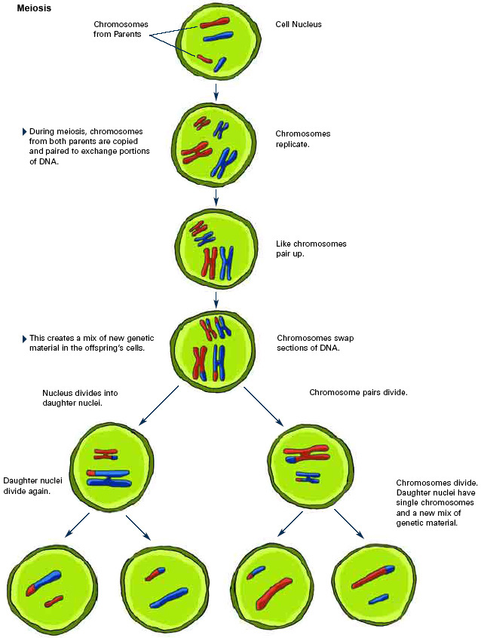
Meiosis
Meiosis
The process of taking a Diploid cell and turning it into 4 haploid cells.
1 Diploid → 4 Haploid

Slide 68
G1 - The cell is going about its daily business of making energy, protein and preparing for Mitosis.
S - The DNA is replicated
G2 - Final Preprarations for M Phase are made
Interphase
Chromatin
Interphase
G1 → S → G2

Slide 69
The Chromatin winds itself up into chromosomes.
M Phase
Meiosis
Prophase 1

Slide 70
2. Homologous Chromosomes and their copies line up to form tetrads 3. Crossing Over Occurs
M Phase
Meiosis
Prophase 1

Slide 71
Crossing Over

Slide 72
Crossing Over
This is a three dimensional representation of tetrads and crossing over. Genes can be swapped at any area of the chromosome. Which genes are swapped is completely random.

Slide 73
Crossing Over Video

Slide 74
4. The nuclear envelope dissolves
M Phase
Meiosis
Prophase 1

Slide 75
The chromosomes line up vertically along the center of the cell
M Phase
Mitosis
Metaphase

