Slide 1
Transport Between Cells
Write
Students will Be able to describe active and passive methods of transport between cells.

Slide 2
Cell Transport
Write
Movement of things in and out of the cell occurs between two solutions.
Extracellular Fluid = Solution outside of the cell
Intercellular Fluid = Solution inside of the cell
Intercellular Fluid
Intercellular Fluid
Intercellular Fluid
Intercellular Fluid
Intercellular Fluid
Cell
Cell
Cell
Cell
Cell
Extracellular Fluid

Slide 3
Listen
Extracellular Fluid
Protein Channel
Protein Channel
Aquaporin
Intracellular Fluid
(Cytoplasm)

Slide 4
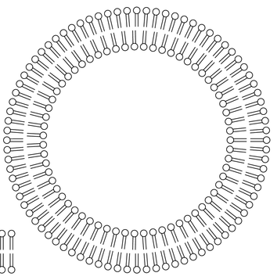
A cell in the
Listen
Extracellular
Fluid
Intercellular
Fluid
Extracellular
Fluid

Slide 5
Types of Cell Transport
Write
Cell Transport
Active
*Needs Energy
Passive
*No Energy
Endocytosis
Exocytosis
Diffusion
Movement of Solutes
Osmosis
Movement of Solvent(water)
Facilitated Diffusion

Slide 6
Active and Passive Transport
Write
Active Transport: Transport into or out of the cell that requires energy.
Passive Transport: Transport into or out of the cell that does not require energy.

Slide 7
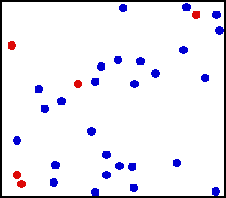
Brownian Motion
Listen
Brownian Motion
The random motion of particles suspended in a fluid

Slide 8
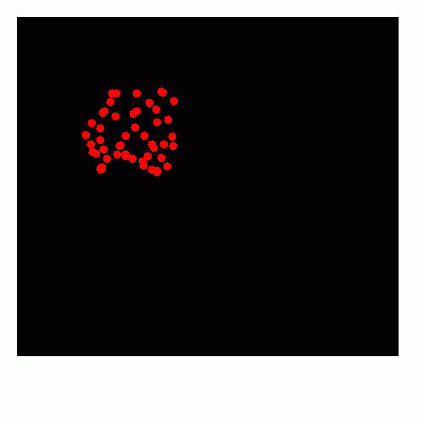
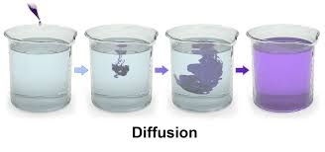
Passive Transport
Write
Diffusion
The movement of particles (solutes) from an area of high concentration to low concentration until equilibrium is met. (HYPERTONIC → HYPOTONIC)

Slide 9
Diffusion
Listen
Extracellular Fluid
Hypertonic
Isotonic
Protein Channel
Protein Channel
Aquaporin
Intracellular Fluid
(Cytoplasm)
Hypotonic
Isotonic

Slide 10
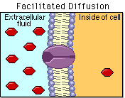
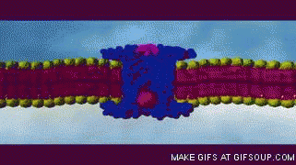
Passive Transport
Write
Facilitated Diffusion
The movement of large particles (solutes) through protein channels embedded in the membrane. (Open Gates)

Slide 11
Facilitated transport
Watch
Extracellular Fluid
Glucose
Glucose
Protein Channel
Protein Channel
Aquaporin
Intracellular Fluid
(Cytoplasm)

Slide 12
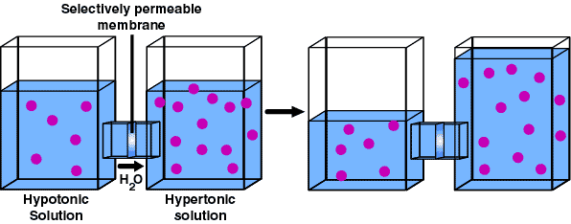
Passive Transport
Write
Osmosis
The movement of water (solvent) between two solutions until equilibrium is met. Occurs when solutes cannot pass through the cell membrane. (HYPOTONIC → HYPERTONIC

Slide 13
Hypertonic
Hypotonic
Solutes
High Solute
Diffusion
Low Solute
Low Water
High Water
Osmosis
Water

Slide 14
Osmosis and Animal Cells
Hypertonic Extracellular Fluid
Isotonic Extracellular Fluid
Hypotonic Extracellular Fluid
No water movement.
Cell stays the same.
Water moves out of the cell.
Cell Shrinks.
Water moves into the cell.
Cell expands.

Slide 15
Osmosis and Plant Cells
Hypertonic Extracellular Fluid
Isotonic Extracellular Fluid
Hypotonic Extracellular Fluid
No water movement.
Cell stays the same.
Water moves out of the cell.
Cell Shrinks.
Water moves into the cell.
Cell expands.

Slide 16
Osmosis Lab
Get out a piece of paper
Come to the front of the room and observe the set up of the Osmosis Lab
Write down what is on the board onto your piece of paper

Slide 17
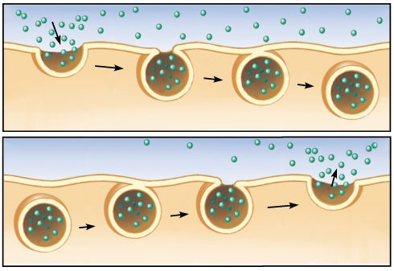
Endocytosis
Exocytosis

Slide 18
Active Transport
Endocytosis – moving things into the cell with the help of energy via vesicles or protein channels
Exocytosis – moving things out of the cell with the help of energy vesicles or protein channels

Slide 19
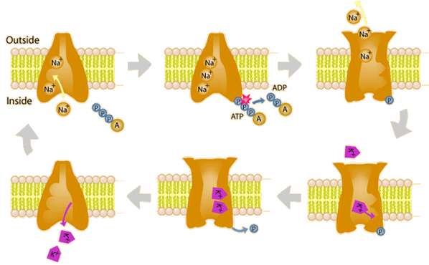
Other Active Transport Mechanisms

