Slide 1
The Cell Membrane
Write

Slide 2
Cell Membrane
Listen
The membrane of the cell has many different names. You may hear it called:
The phospholipid bilayer
The semi-permeable membrane
Fluid Mosaic Model
Plasma membrane

Slide 3
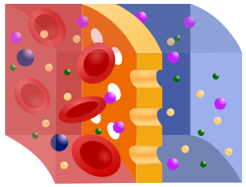
Cell Membrane Properties
Write
Semi-permeable
Some things can move in and out of the cell membrane freely, while others cannot.

Slide 4
Phospholipid Bilayers
Listen
The major component of Cell membranes are phospholipids that combine to make a phospholipid bilayer.
Phospholipid – a type of lipid
Bi – two
Layer – a sheet of material
Two layers of phospholipids

Slide 5
Phospholipid Bilayer
Draw and Label
This is a phospholipid
It has a phosphate head and two tails (fatty acid chains)
Head = Hydrophilic
(Loves water)
Tails = Hydrophobic
(Fears Water)

Slide 6
Phospholipid Bilayer
Draw and Label
This is a phospholipid Bilayer
There are two layers of phospholipids

Slide 7
Phospholipid Bilayer Formation
Listen
When put into water, phospholipids will arrange themselves so that their heads are in the water. This allows the tails to group together and stay away from the water.
https://www.youtube.com/watch?v=lm-dAvbl330
https://www.youtube.com/watch?v=04SP8Tw3htE

Slide 8
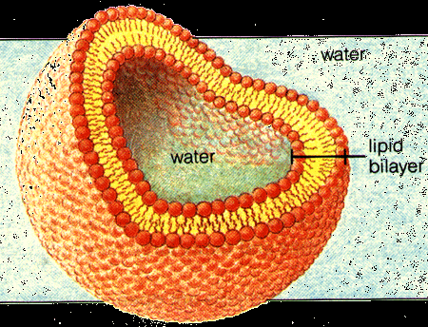
Phospholipid Bilayer
Listen
The Bilayer creates a sphere that is known as a liposome. Our cell membranes are a large liposome.

Slide 9
Things in the Phospholipid Bilayer
Write
Phospholipids
Cholesterol
Open Channel Proteins
Gated Channel Proteins
Protein/Sugar Markers

Slide 10
Phospholipids
Write
Structure: Lipids
Function: Makes up majority of the Cell membrane

Slide 11
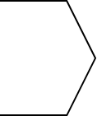
Cholesterol
Write
Structure: Lipids
Function: Stabilizes the cell membrane

Slide 12
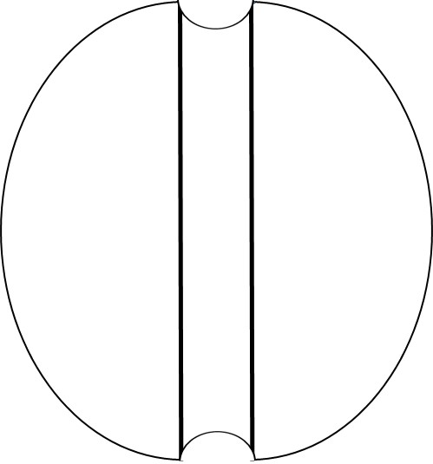
Open Channel Proteins
Write
Structure: Proteins
Function: Allow molecules that cannot pass through the phospholipid bilayer into the cell

Slide 13
Open Channel Protein Example
Listen
Example: Aquaporins
Water is a polar molecule and cannot pass through the phospholipid bilayer due to the hydrophobic tails. Instead it moves in and out of the cells through a type of open channel protein called an aquaporin.

Slide 14
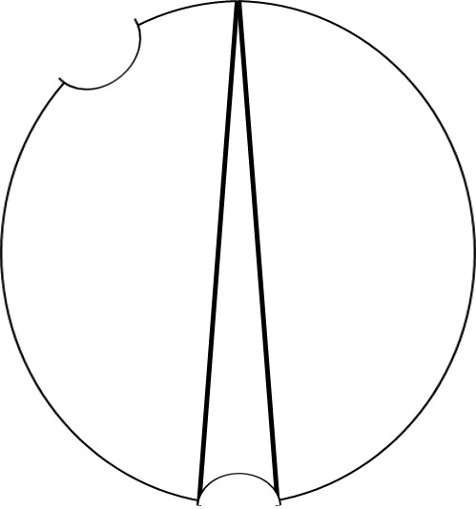
Gated Channel Proteins
Write
Structure: Proteins
Function: Allow molecules that cannot pass through the phospholipid bilayer to pass only if certain conditions are met

Slide 15
Gated Channel Protein Example
Listen
Example: Insulin and Glucose
Before Glucose can go through a gated protein channel, insulin must first signal the gated protein channel to open.

Slide 16
Markers
Write
Structure: Proteins + Carbohydrate Chains
Function: Tag and identify the cell. Important for immune system function.

Slide 17
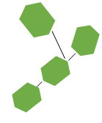
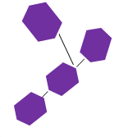
Markers
Listen
Example: Blood Types
Blood Types are determined by the type of carbohydrate chains you have on your red blood cells.
If you are Type O you have do not have A or B carbohydrate chains
Your body will attack any cell that has A or B carbohydrate Chains
If you are Type A you have A carbohydrate Chains
Your body will attack any cells that have B carbohydrate chains
If you are type B you have B carbohydrate chains
Your body will attack any cells that have A carbohydrate chains
If you are Type AB you have both A and B carbohydrate chains
Your body will not attack A or B chains
=A
=B
O
A
B
AB

Slide 18
Markers
Write
Structure: Proteins + Carbohydrate Chains
Function: Tag and identify the cell. Important for immune system function.

