Slide 1
Solutions
Listen

Slide 2
Solution
Listen
Solution
Water
Solute
Solvent

Slide 3
Solutions
Write
A solution is made of at least two parts. The solvent and one or more solutes.
Solvent: A liquid, usually water, that dissolves a solute
Solute: Something that is dissolved by a liquid

Slide 4
Concentrations
Write
Concentration: how much solute is in the solution.

Slide 5
Different Concentrations
Listen
Low Concentration
High Concentration

Slide 6
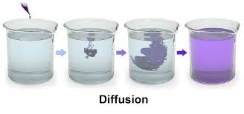
Concentration Gradients
Solution with a high concentration
Solution with a low concentration
Concentration Gradient

Slide 7
Properties of Two Interacting Solutions
Write
Concentration Gradient: Concentration is higher in one solution or part of a solution than another

Slide 8
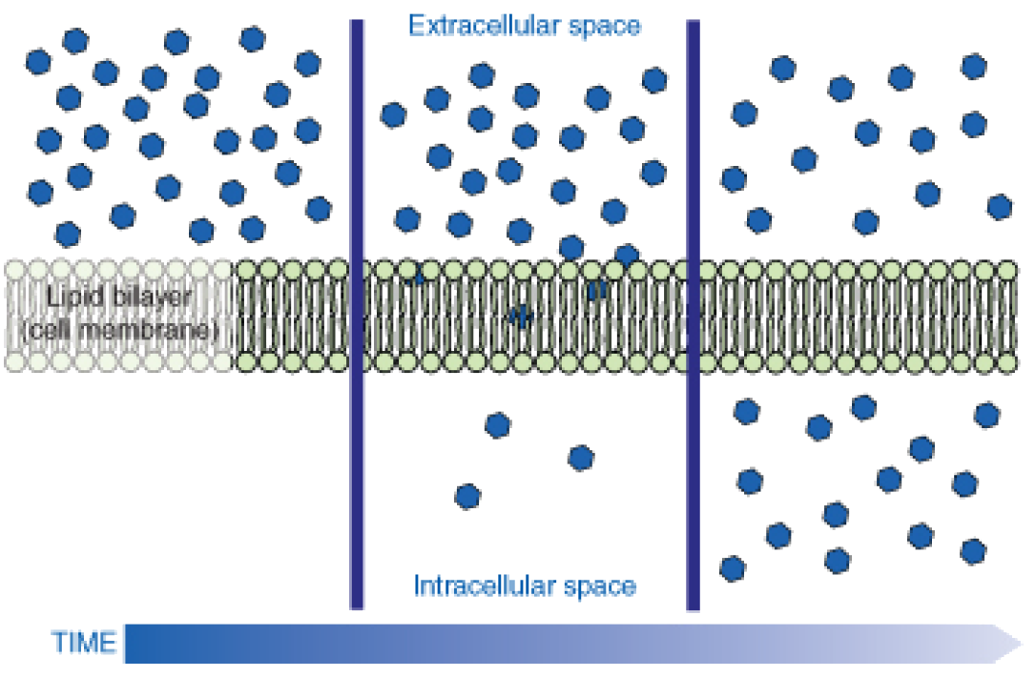
Equilibrium
Equilibrium: The concentration of particles is equal on both sides of the semi-permeable membrane.
Equal Concentrations
Equal Concentrations
Equilibrium

Slide 9
Comparing Solutions
Write
When we compare two solutions together we use three terms to describe the solutions.
Hypertonic – Solution with High Solute/Low Water
Isotonic – Solution with same amount of solute
Hypotonic – Solution with Low Solute/High Water

Slide 10
Comparing Solutions
Write
When we compare two solutions together we use three terms to describe the solutions.
Hypertonic – a solution that has a higher concentration (amount of solute)
Isotonic – a solution that has the same concentration (amount of solute)
Hypotonic – a solution that has a lower concentration (amount of solute)

Slide 11
Isotonic
A solution that has the same amount of solutes (concentration) when compared to another solution.
Isotonic
Isotonic
50% H2O
50% Solute
50% H2O
50% Solute
Have the same concentration

Slide 12
Hypotonic
A solution that has a lower amount of solutes (concentration) when compared to another solution.
Hypotonic
Hypertonic
90% H2O
10% Solute
63% H2O
37% Solute

Slide 13
Hypertonic
A solution that has a higher amount of solutes (concentration) when compared to another solution.
40% H2O
60% Solute
90% H2O
10% Solute
Hypertonic
Hypotonic

