Slide 1
Scientific Method Lecture Notes
Write

Slide 2
Lecture and Notes
Listen
Activity
Taking Notes on Teacher Directed Lecture
Conversation
No Talking
Raise Hand if you have question or comment
Help
No EDs
Integrity
Take your own notes
Effort
Listening
Writing information
Value
Transmitting information
Efficiency
Think about what we’re talking about don’t just copy the words.
Sharpen your pencils before we begin.
Keep your notes organized and bring them to class everyday.

Slide 3
Scientific Method Review
Listen
Observation or Problem
Research
Hypothesis
Experiment
Collect and Analyze Data
Conclude

Slide 4
Scientific Method Review
WRITE
Observation or Problem
A question or problem that needs to be answered or solved
See what people have already learned about the question or problem
Make a measureable prediction about the question or problem
Design and run an experiment to collect data and information.
Look at the data and determine what it means.
Did your experiment match your prediction? Why or why not? What went wrong in your experiment and what went right/
Research
Hypothesis
Experiment
Collect and Analyze Data
Conclude

Slide 5
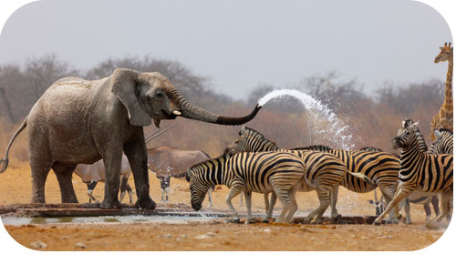

Slide 6
Observation/Inference
Write
Observation:
The act of describing the world around us with our senses

Slide 7
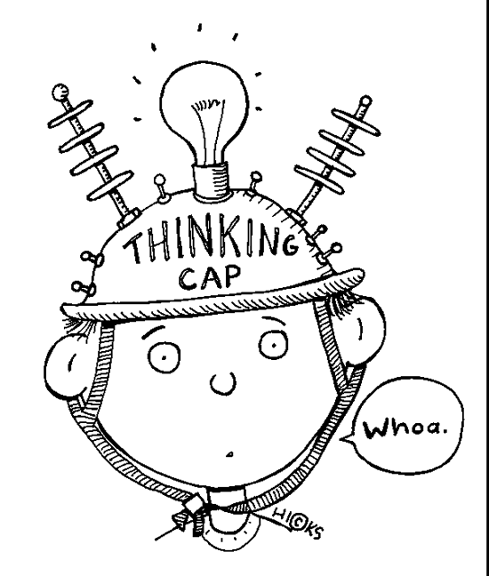
Observation/Inference
Write
Inference:
A logical interpretation based on our observations and previous knowledge.

Slide 8
Types of Observations
Listen
Qualitative Observation: Describes the quality (characteristic) of what you see.
Exp: The lady bug is red.
Quantitative Observation: Describes the quantity(number) of what you see.
Exp: The lady bug has 7 spots.

Slide 9
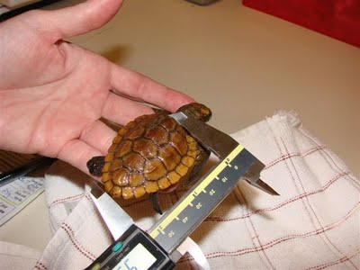
Hypothesis
Write
Hypothesis:
A prediction that is measureable

Slide 10
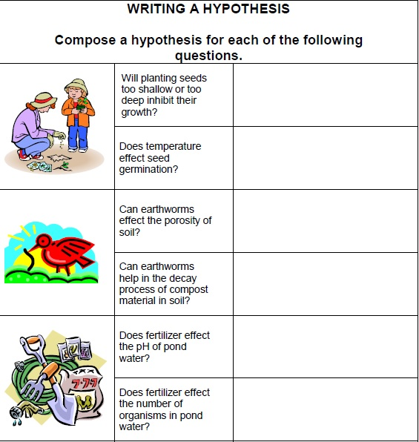
Answer
If I plant seeds deeper into the ground then their growth will decrease.
If I increase the temperature then seed germination will increase.

