Slide 1
Precision and Accuracy
Write

Slide 2
Precision and Accuracy
Write
Precision
How close multiple measurements are to each other.
Accuracy
How close a measurement is to the actual value.

Slide 3
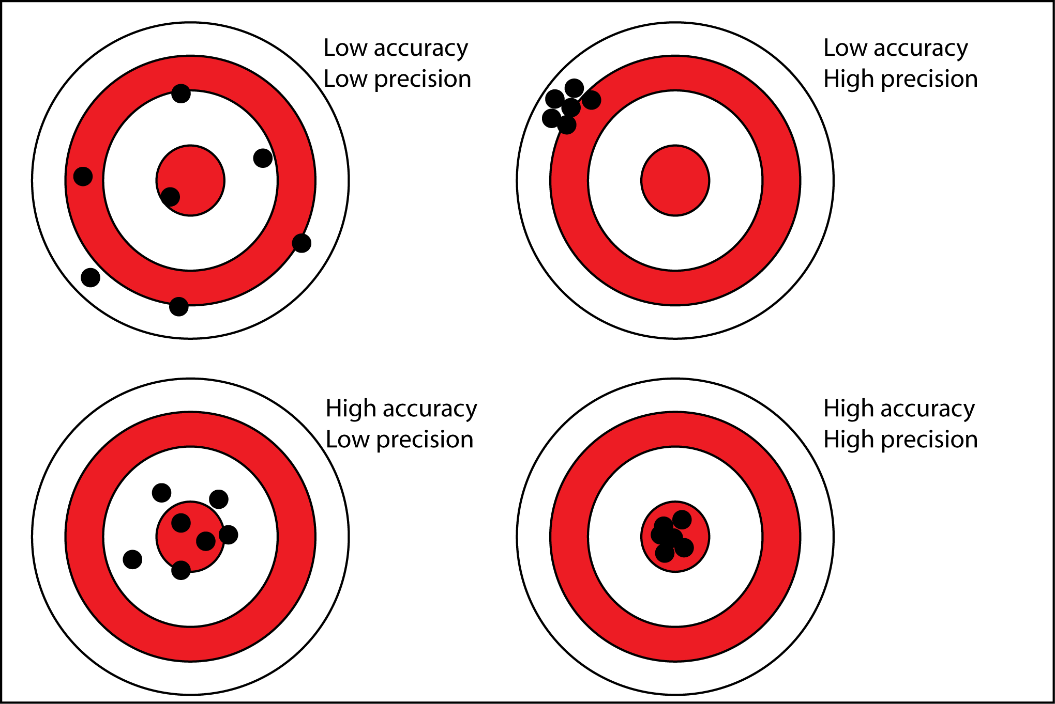
Answer

Slide 4
Accuracy or Percent Error
Write
Actual Value | Measured Value
5.55cm | 6cm
Actual Value
-
Measured Value
%Error =
X 100
Actual Value
5.55cm
-
6cm
%Error =
X 100
-8.11
5.55cm
5.55cm -6cm / 5.55cm X 100 = -8.11%

Slide 5
Skill: How to Measure Precision
Write
Team1 | Team2 | Team3 | Team4 | Team5 | Team6 | Team7
2.65g | 2.75g | 2.80g | 2.77g | 2.60g | 2.65g | 2.68g
Find the mean of all your data
Add up all the results and divide by the number of teams
2.65+2.75+2.80+2.77+2.6+2.65+2.68/7
2.72g
Find the range of your data.
Subtract the highest value from the lowest value
2.80-2.60
0.20
Precision = mean +/- range
2.72 +/- 0.20)
To be Precise you must be between: 2.52g and 2.92g
2.72 + 0.20 = 2.92
2.72 – 0.20 = 2.52

Slide 6
Listen
Precise
Not Precise
Not Precise
2.00
2.50
3.00

Slide 7
How to write really big numbers.
Listen
The number of bacteria on earth is estimated to be:
5,000,000,000,000,000,000,000,000,000,000
Is there an easier way to say and write this number?

Slide 8
Scientific Notation
Listen
Yes
You can write 5,000,000,000,000,000,000,000,000,000,000
Or
5.0 X10³⁰

Slide 9
Data Analysis
Write

Slide 10
Data Analysis
Write
Data Analysis
Using logic to interpret and visualize data.
Graph
A diagram showing relationships between data points

Slide 13
Graphing
Write
All graphs must have:
A title
A labeled X axis (Independent Variable or constant)
A labeled Y axis (Dependent Variable)

Slide 14
Skill: Graphing
Write
Title your graph
Determine your Y and X axis
Draw your Y and X axis
Label your Y and X axis
Use your Data to find your range for your Y and X axis
Number your Y and X axis
Plot your data points
Draw your line/bar

Slide 15
Practice
Graphing: When you are graphing data you must title the graph, label the axis; the dependent (y) variable goes on the vertical axis and the independent (x, most constant) variable goes on the horizontal axis. When determining the scale of your graph, make the scale as large as possible within the limits of the paper. A line graph is used when a relationship between two variables is being studied, and a bar graph is used to look at comparisons of data.
Temperature and the Breathing Rate of Freshwater Sunfish
Table 2: Breathing rate of the freshwater Sunfish
Temperature (ºC) | Breathing Rate per minute
10 | 15
15 | 25
18 | 30
20 | 38
23 | 60
25 | 57
27 | 25
60
50
Breathing Rate
40
30
20
10
5
10
15
20
25
30
Temperature

Slide 16
Dimensional Analysis
Write

Slide 17
Dimensional Analysis
Write
Dimensional Analysis
Conversion of a measurement from one unit to another.

Slide 18
Dimensional Analysis
Write
In order to do Dimensional Analysis you need:
The original measurement
The unit you want to get to
Conversion factors

Slide 19
Conversion Factor
Write
Conversion Factor
A ratio that tells you how much of one thing is in another.
Examples:
1 foot = __________inches
1inch = __________cm
1 yard = __________feet
1 kilometer = ___________meter

Slide 20
Write
Conversion Factor
What you want
Given Measurement
Answer
What you have
How many seconds are there in a class period.
60 sec
92 min
5520 sec
1 min

Slide 21
Listen
Conversion Factor
What you want
Given Measurement
Answer
What you have
How many seconds old are you?
365 days
24 hours
60 min
60 sec
473,040,000 sec
15 years
1 year
1 day
1 hour
1 min

