Slide 1
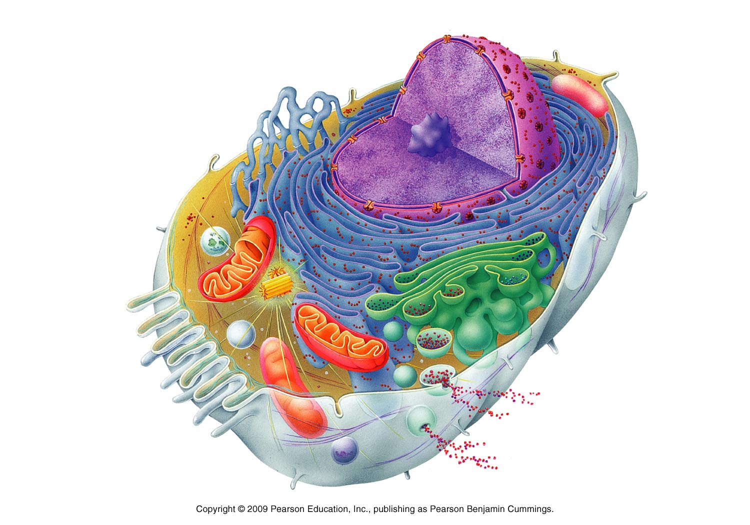
Nucleus
Stores DNA

Slide 2
Nucleolus
Makes Ribosomes

Slide 3
Smooth Endoplasmic Reticulum
Makes Lipids
Destroys Poison

Slide 4
Rough Endoplasmic Reticulum
Makes Proteins
Sends them to Golgi Body

Slide 5
Cytoskeleton
Structure Support
Help move

Slide 6
Ribosomes
Makes Proteins

Slide 7
Lysosome
Destroys and Recycles Invaders

Slide 8
Mitochondria
Makes Energy

Slide 9
Cytoplasm
Creates internal pressure
Goopy liquid

Slide 10
Vesicles
Transport Stuff
Little Vehicles

Slide 11
Golgi Bodies/
Puts proteins and lipids into a vesicle. Writes an address on the vesicle

Slide 12
Cell Membrane
Protects the Cell
Gate keeper

Slide 13
38.
37.
39.
41.
40.
42.
43.
44.
48.
47.
45.
46.

Slide 14
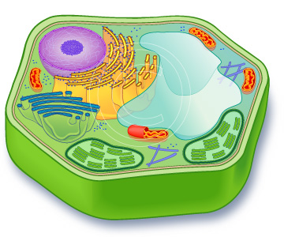
Nucleus
Stores DNA

Slide 15
Chloroplasts
Photosynthesis
Create Food/Energy

Slide 16
Rough Endoplasmic Reticulum
Makes Proteins
Sends them to Golgi Body

Slide 17
Golgi Body
Puts proteins and lipids in a vesicle, writes an address and sends them away.

Slide 18
Large Central Vacuole
Stores water and food
Creates internal pressure

Slide 19
Nucleolus
Makes Ribosomes

Slide 20
Mitochondria
Create Energy

Slide 21
Ribosomes
Make Proteins

Slide 22
Smooth Endoplasmic Reticulum
Makes Lipids
Destroys Poison

Slide 23
Cytoskeleton
Provides Structure
Helps the Cell Move

Slide 24
Cell Wall
Protects Cell
Provides Support

Slide 25
Cell Membrane
Protects the Cell
Gate keeper

Slide 26
Cytoplasm
Creates internal pressure
Goopy liquid

Slide 27
Large Central Vacuole
3.
1.
2.
Cell Wall
Chloroplast

