Slide 1
Steps of Mitosis

Slide 2
Directions:
Get into groups of 4 or 5 and grab a couple iPads
Download the Mitosis Phase Picture Analysis Power Point from my website. (www.roderickbiology.weebly.com)
Look at each phase and discuss what is happening in the cell.
For each phase write down an analysis. What do you see? What is different? What’s happening?

Slide 3
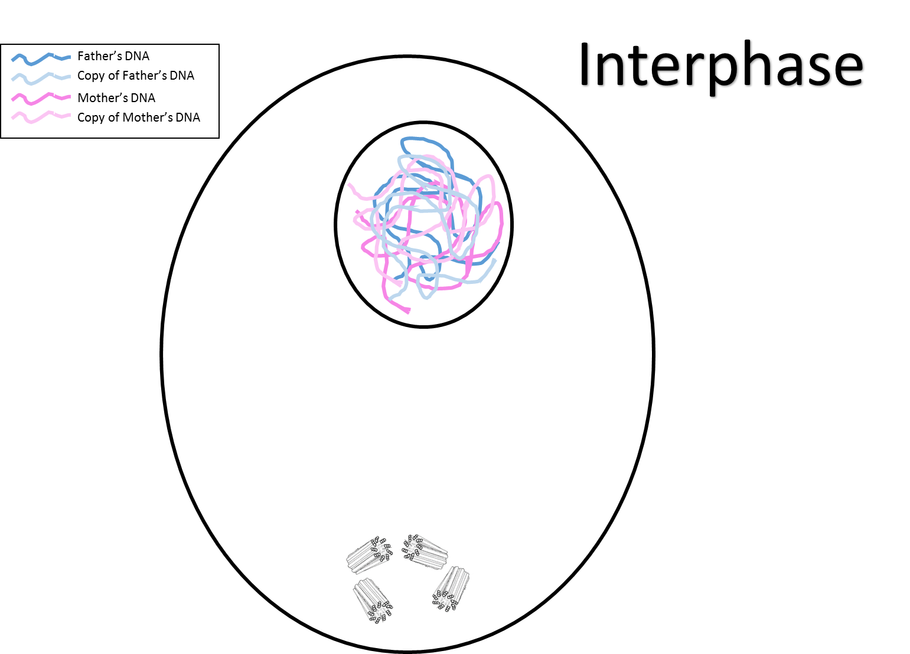

Slide 4
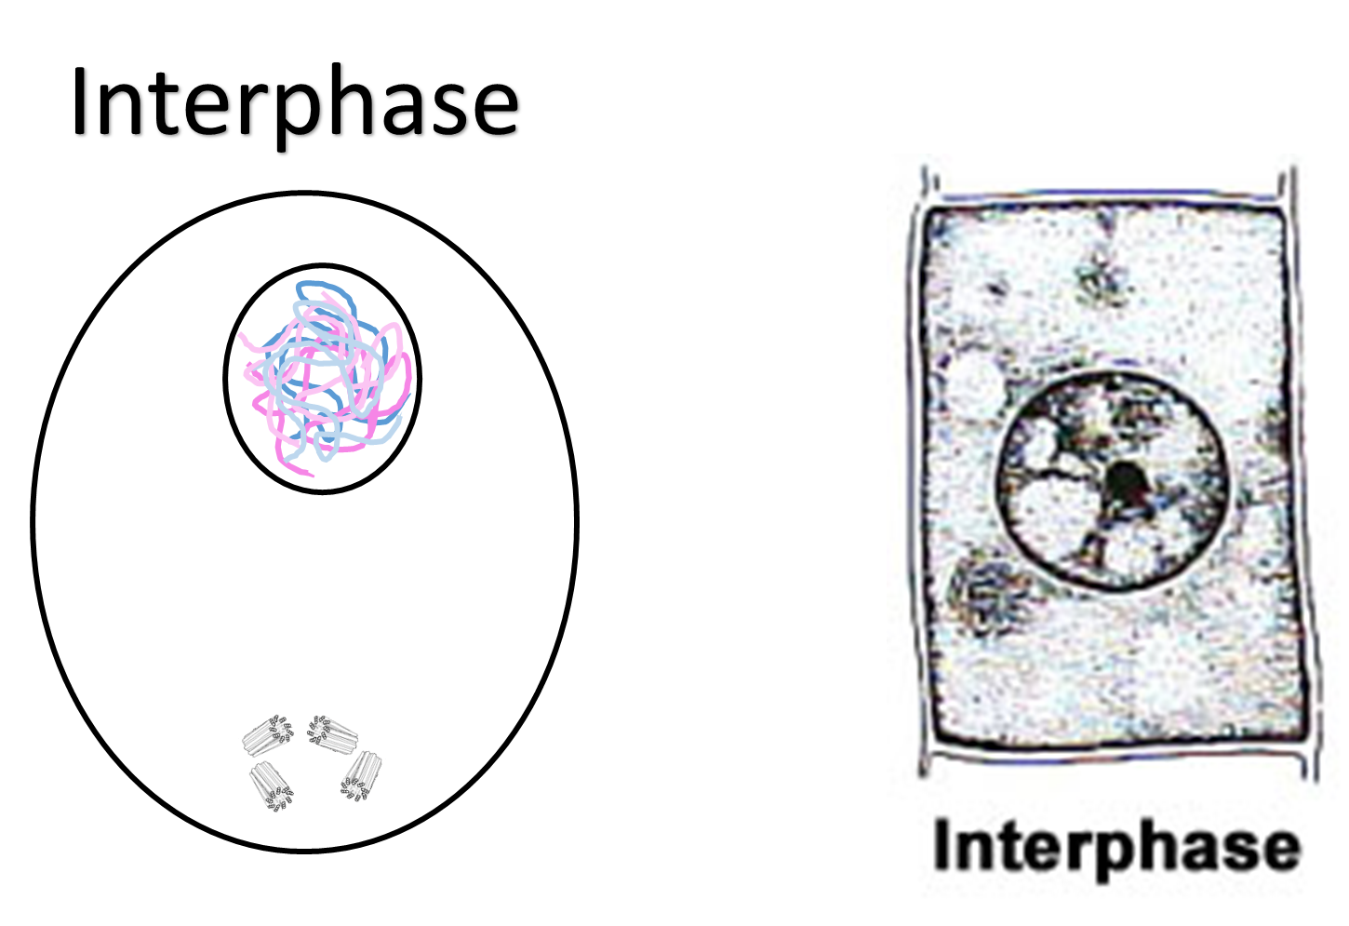

Slide 5
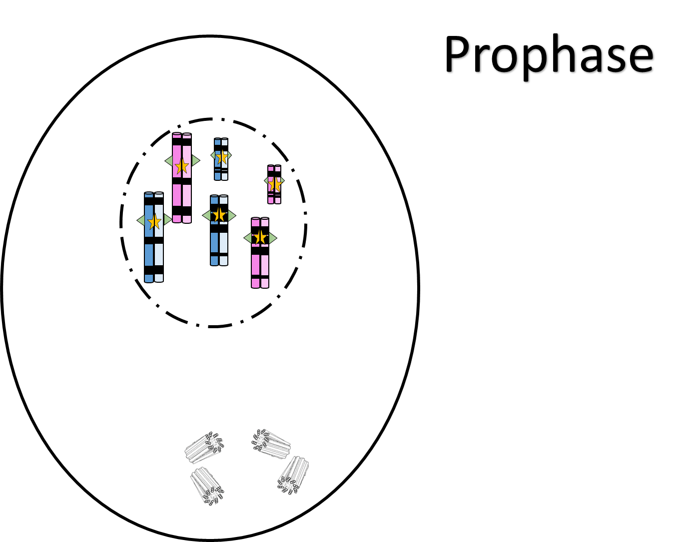

Slide 6
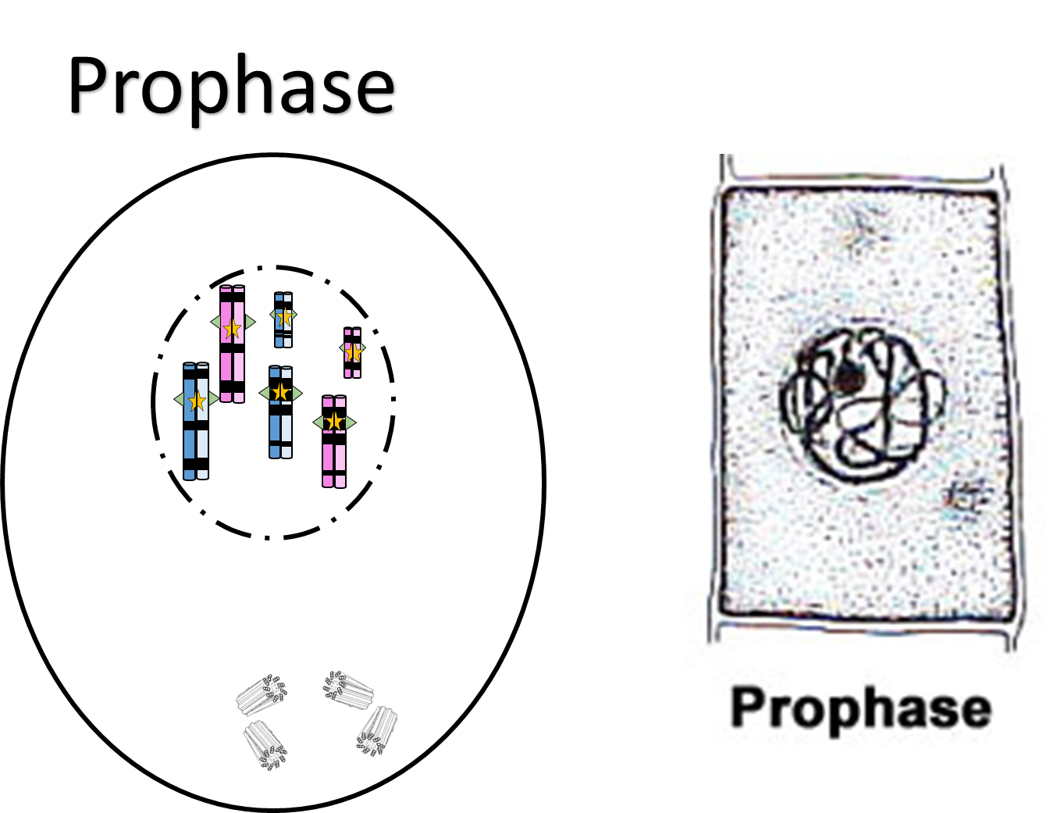

Slide 7
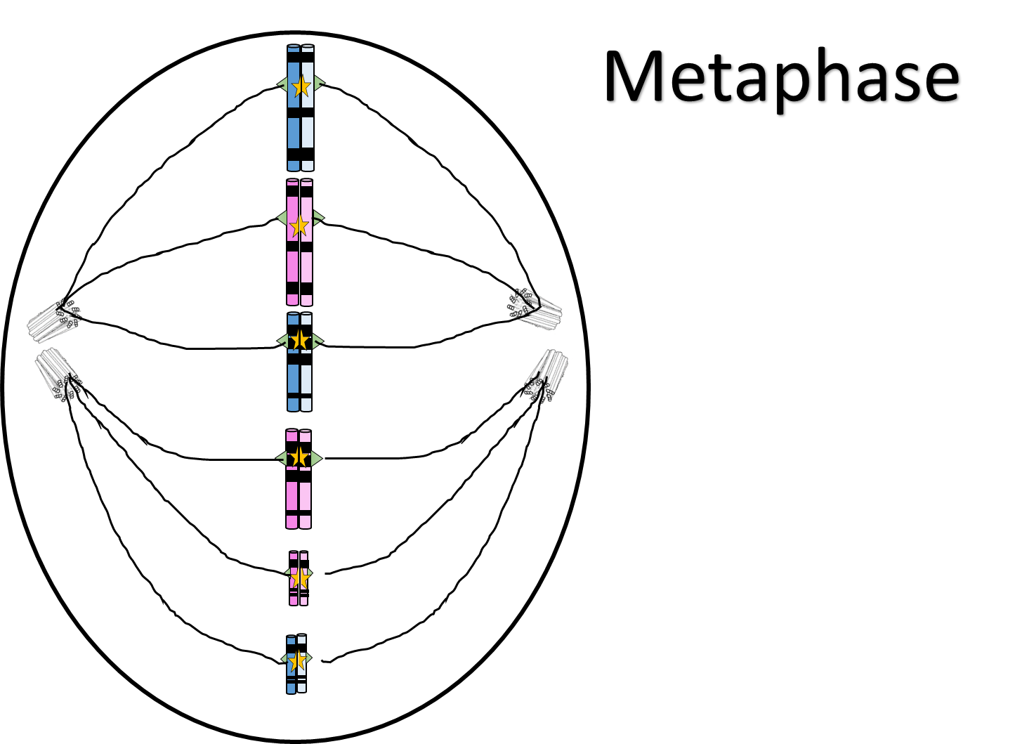

Slide 8
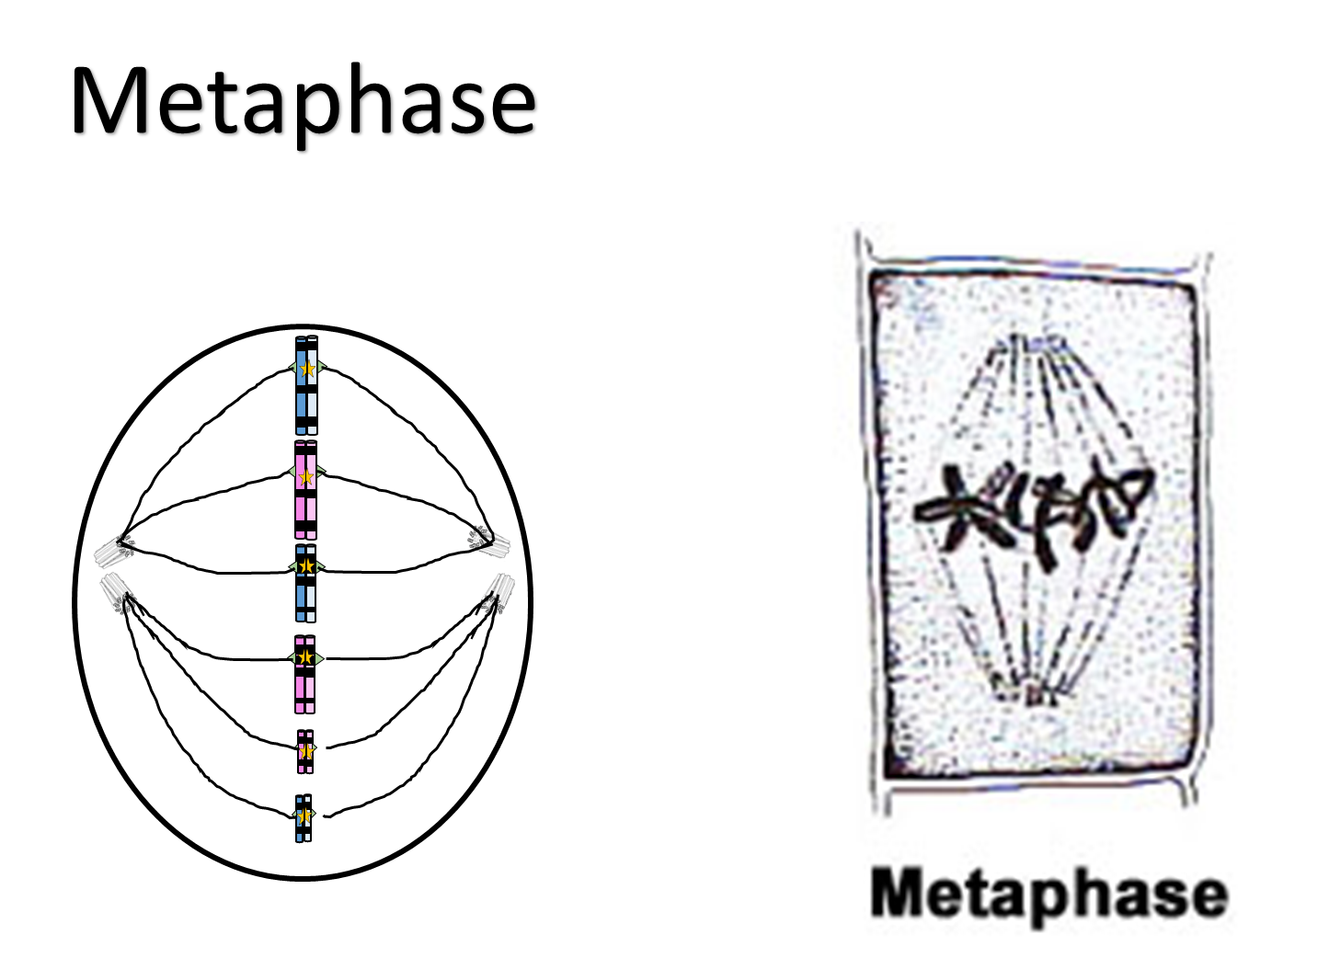

Slide 9
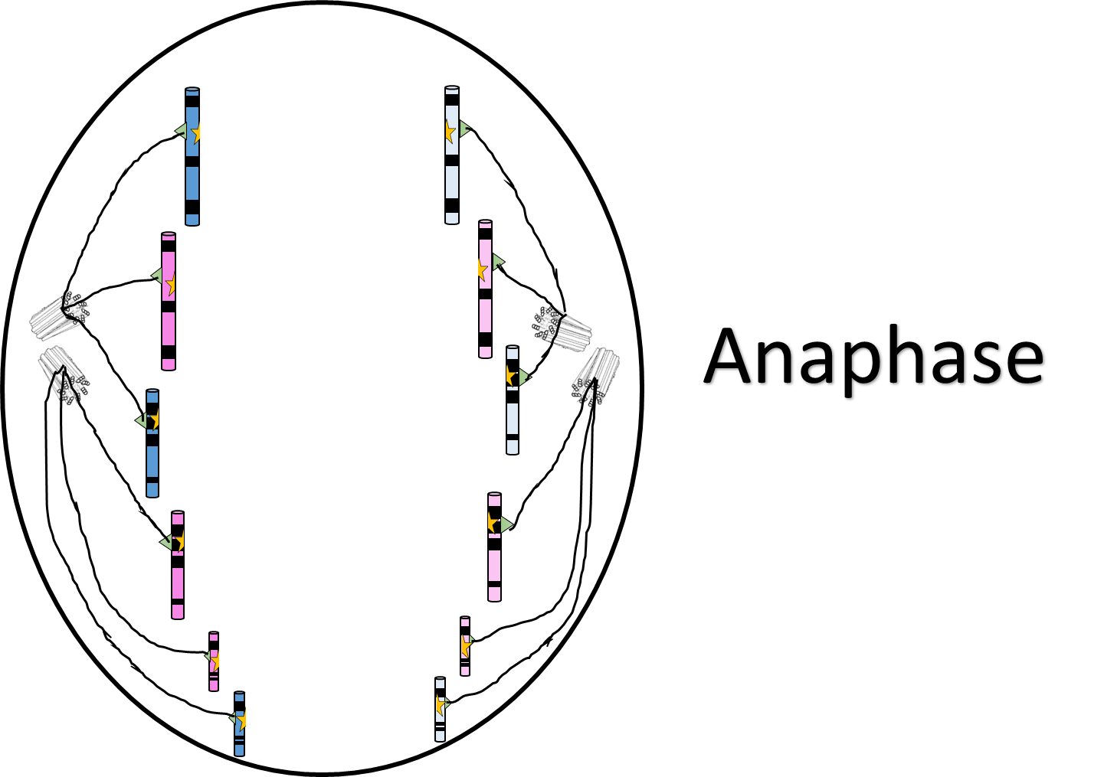

Slide 10
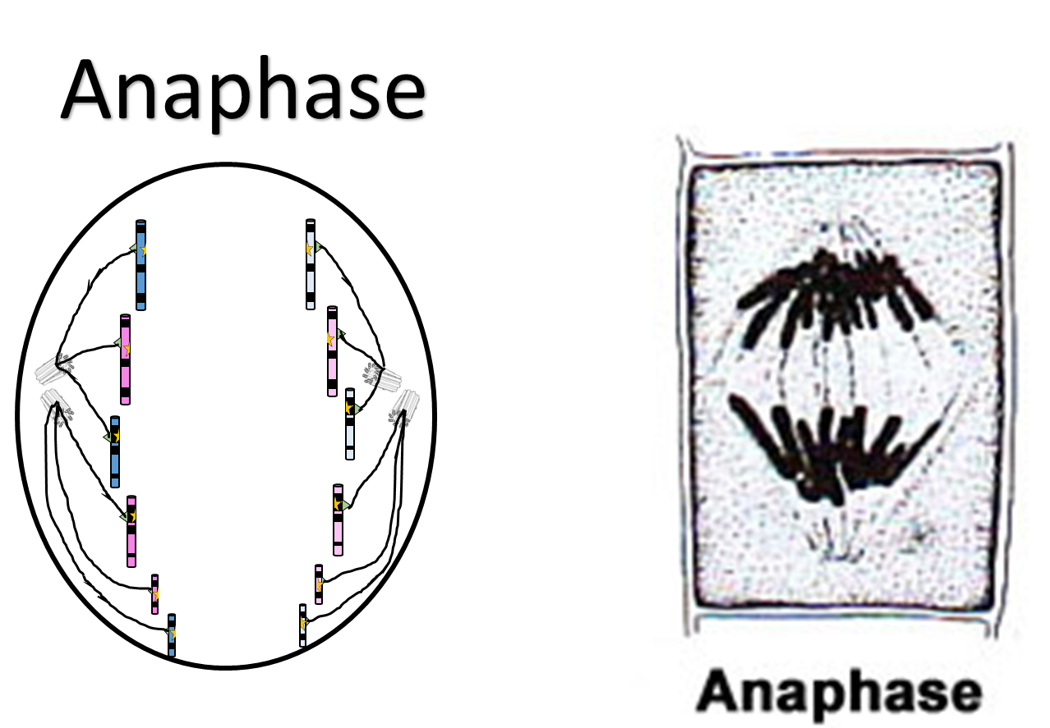

Slide 11
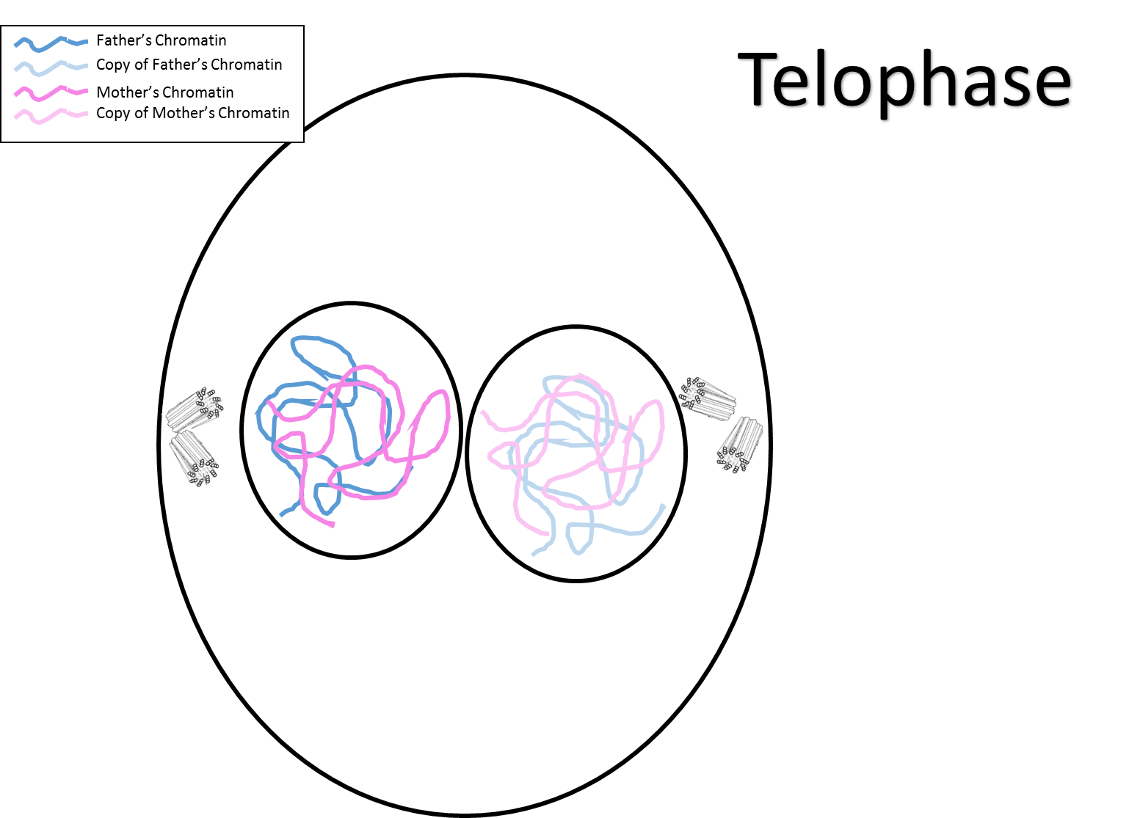

Slide 12
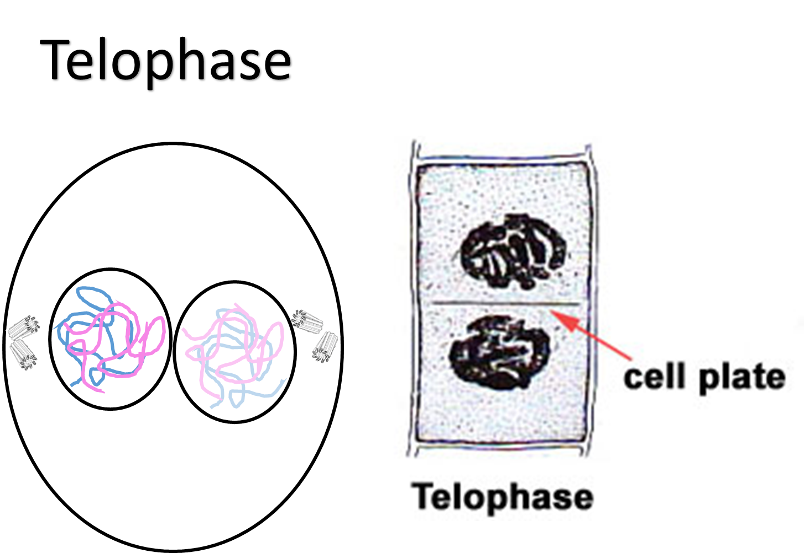

Slide 13
