Slide 1
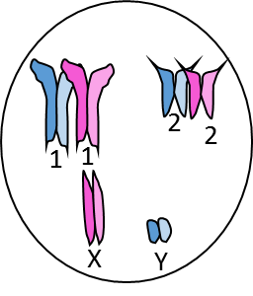
Prophase I
Before Crossing Over
Tetrad
Tetrad

Slide 2
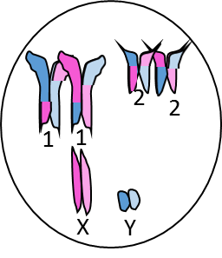
Prophase I
After Crossing Over
Tetrad
Tetrad

Slide 3
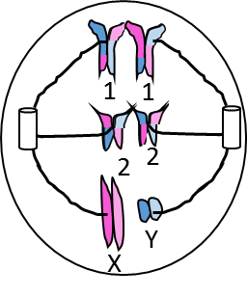
Tetrad
Metaphase I

Slide 4
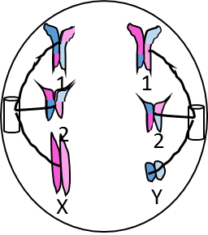
Chromosome
Anaphase I

Slide 5
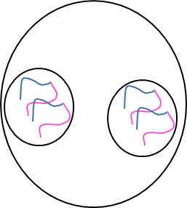
Telophase I

Slide 6
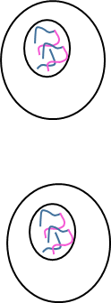
Cytokinesis I

Slide 7
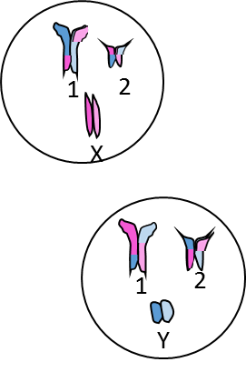
Prophase II
Chromosome
Chromosome

Slide 8
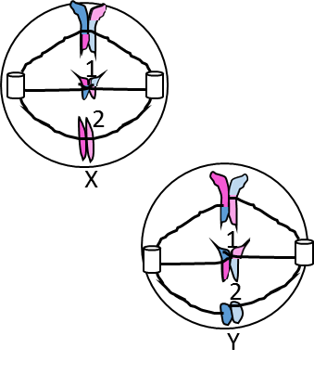
Metaphase II
Chromosome

Slide 9
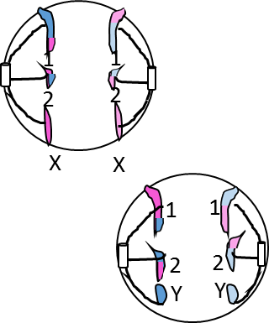
Anaphase II
Sister Chromatid
Sister Chromatid

Slide 10
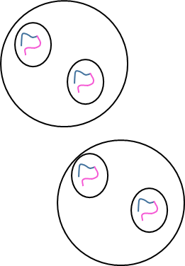
Telophase II

Slide 11
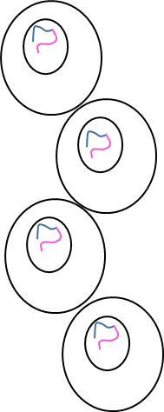
Cytokinesis II

Slide 12
Metaphase I

Slide 13
Cytokinesis I

Slide 14
Anaphase II

Slide 15
Prophase I
Before Crossing Over

Slide 16
Prophase II

Slide 17
Cytokinesis II

Slide 18
Telophase I

Slide 19
Prophase I
After Crossing Over

Slide 20
Anaphase I

Slide 21
Metaphase II

Slide 22
Telophase II

Slide 23
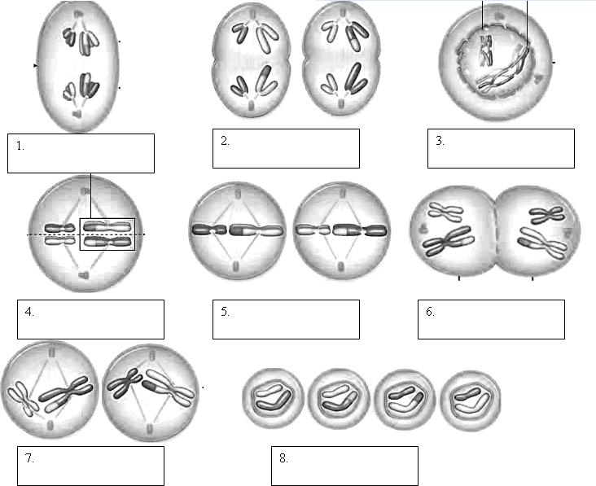
Anaphase I
Anaphase II
Prophase I
Metaphase I
Telophase I
Metaphase II
Prophase II
Cytokinesis

