Slide 1
Measurement
Write

Slide 2
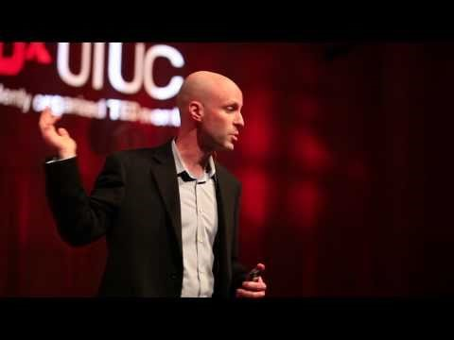
TED Talk: Seeing the World as it isn’t
Watch

Slide 3
Measurement
Write
Measurement:
a way to describe the world accurately by using numbers

Slide 4
Standards of Measurement
Write
For a measurement to make sense, it must include a number and a unit.

Slide 5
Measurement Quick Activity
Participate
Measure the length of your desk using your hand.
Your measurement should be _____ hands
Compare your measurement with the person sitting next to you.
Is it the same? Is it different?

Slide 6
Standards of measurement
Write
Measurement Standard
An exact quantity that people agree to use to compare measurements.
Examples:
Foot, inch, pound, degree
Meter, gram, second, Liter

Slide 7
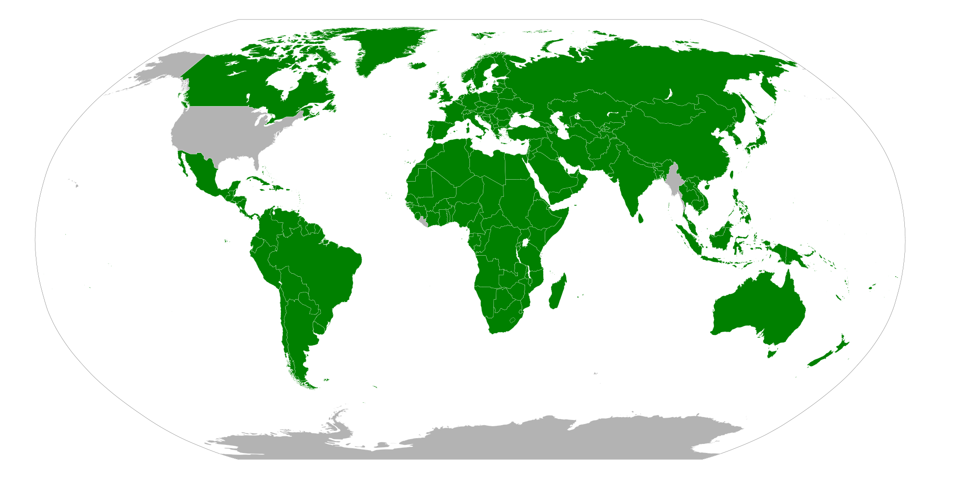
Listen
METRIC
IMPERIAL

Slide 8
Systems of Measurement
Write
Imperial
Metric
(SI) Standard International
Created by the British Empire in the 1700’s Multiple Units for each physical quantity
No Prefixes
Randomly based
Find the conversion unit
Do lots of complicated math
Created by the French in the 1700’s
One unit for each physical quantity
Prefixes
Based off the Decimal System
just move the decimal

Slide 9
Metric System
Write
What you are measuring | Unit | Abbreviation | Tool
Length | Meter | m | Meter Stick
Area | Square meter | m² | Meter Stick
Volume | Cubic meter (liter) | L | Graduated Cylinder
Mass | Gram | g | Scale
Force | Newton | N | F = m/a
Pressure | Pascal | Pa | barometer
Energy | Joule | J | calorimeter
Power | Watt | W | Electric meter
Temperature | Celsius | C | Thermometer

Slide 10
Write
Science only uses the metric system

