Slide 2
Organic and Inorganic Molecules

Slide 3
Write
Organic Compounds
Contain both Carbon and Hydrogen
Inorganic Compounds
Do not contain Carbon and Hydrogen

Slide 4
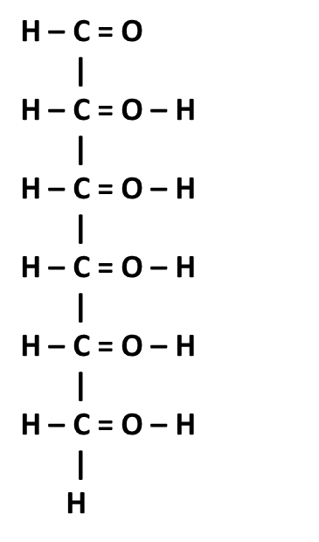
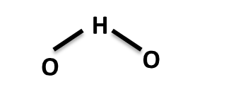

Slide 5
Write
Inorganic Substances
Water (H2O)
Solvent
Most metabolic reactions occur in water
Oxygen (O2)
Needed for cellular respiration
Carbon Dioxide (CO2)
Waste
Salts
Provide ions
Used for:
Metabolic processes
Transport
Muscle contraction
Nerve impulse conduction

Slide 6
2.1: Structure of Matter → Formulas
Write
Macromolecules
Carbohydrates
Proteins
Nucleic Acids
Lipids

Slide 7
2.1: Structure of Matter → Formulas
Write
Monomer
One thing
Polymer
Many things
A polymer is made up of many monomers.
Monomer
Polymer

Slide 8
H
H
O
C
O
C
H
H
H
H
H
O
H
O
C
C
O
C
C
O
H
H
H
H
C
H
C
H
H
C
C
H
C
C
O
H
H
O
O
H
H
O
O
O
H
H
H
H
Dehydration Synthesis

Slide 9
O
H
H
H
H
O
C
C
H
H
H
H
H
O
O
C
C
O
C
C
O
H
H
H
C
H
C
H
H
C
C
H
C
C
O
H
H
O
O
H
H
O
O
O
H
H
H
H
Hydrolysis

Slide 10
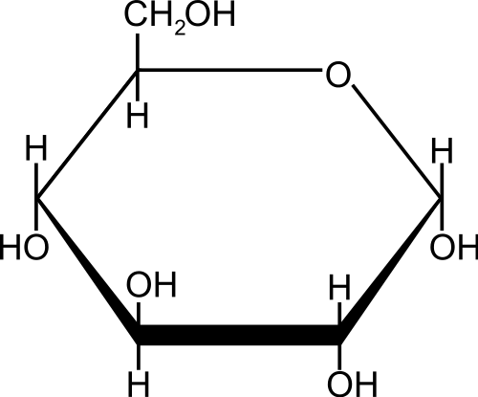
2.1: Structure of Matter → Formulas
Write
Carbohydrates
Common Name: Carbs or Sugars
Elements Present: CHO
Uses By Living Things: Energy and Structure

Slide 11
Carbohydrate: Monosaccharide
Draw this on the back of your paper.

Slide 12
2.1: Structure of Matter → Formulas
Write
Carbohydrates
Monomer: Monosaccharide
Polymer: Polysaccharide
Example
Starch
Breads
Glycogen
Energy storage in your muscles
Cellulose
Gives plants their structure
Chitin
Exoskeleton of insects
Monosaccharide
Polysaccharide

Slide 13
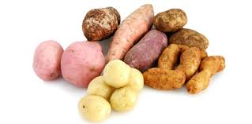
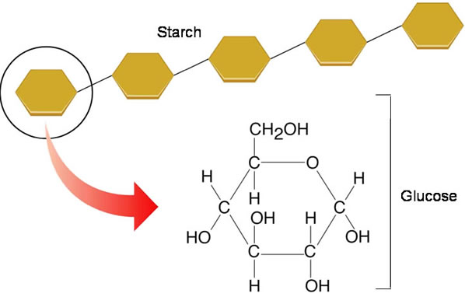
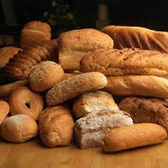
Starch

Slide 14
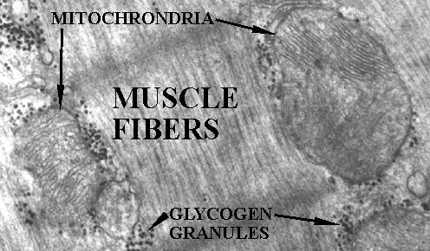
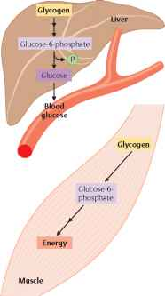
Glycogen

Slide 15
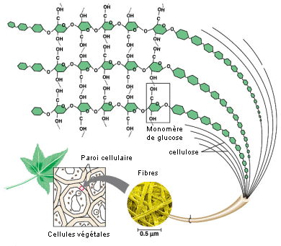
Cellulose

Slide 16
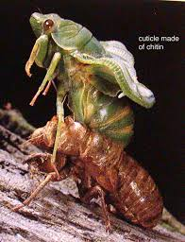
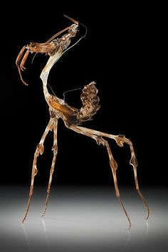
Chitin

Slide 17
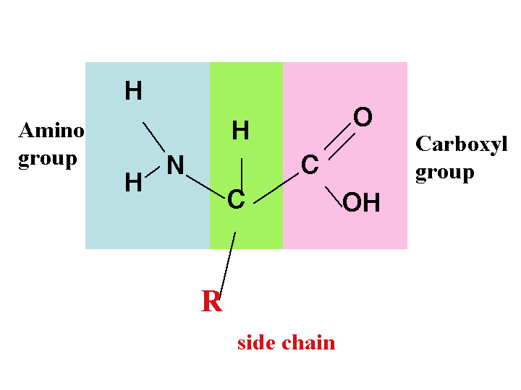
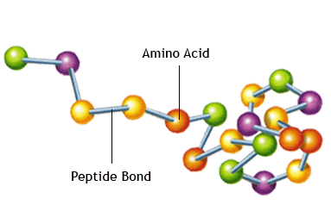
2.1: Structure of Matter → Formulas
Write
Proteins
Common Name: Protein
Elements Present: CHON
Uses By Living Things: Structure, Transport, Communication, Enzymes

Slide 18
2.1: Structure of Matter → Formulas
Write
Proteins
Monomer: Amino Acid
Polymer: Polypeptide or protein
Example
Cell Receptors
Cellular communication
Antibodies
Immune system
Enzymes
Catalyze chemical reactions
Amino Acid
Polypeptide or Protein

Slide 19
Protein: Amino Acid
Draw this on the back of your paper.

Slide 20
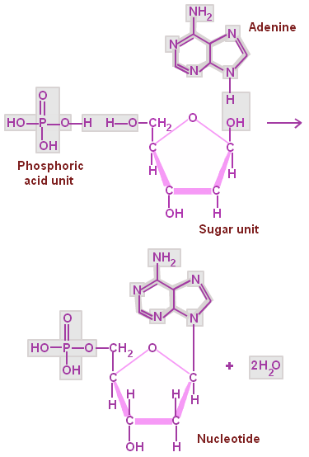
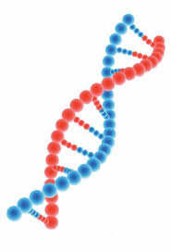
2.1: Structure of Matter → Formulas
Write
Nucleic Acid
Common Name: DNA and RNA
Elements Present: CHONP
Uses By Living Things: Information Storage and Transfer

Slide 21
2.1: Structure of Matter → Formulas
Listen
Nucleic Acid
Monomer: Nucleotide
Polymer: Nucleic Acid
Example
DNA
RNA
Polynucleotide or Nucleic Acid
Nucleotide

Slide 22
Nucleic Acid: Nucleotide
Base
Phosphate
Sugar
Draw this on the back of your paper.

Slide 23
2.1: Structure of Matter → Formulas
Write
Nucleic Acid
Monomer: Nucleotide
Polymer: Nucleic Acid
Example
DNA
RNA
Polynucleotide or Nucleic Acid
Nucleotide

Slide 24
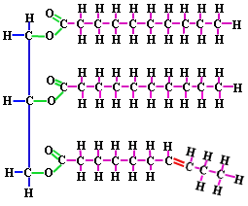
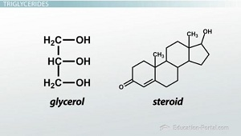
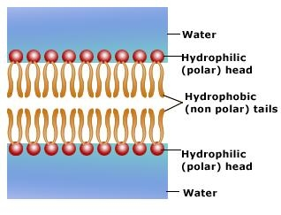
2.1: Structure of Matter → Formulas
Write
Lipids
Common Name: Fat
Elements Present: CHO
Uses By Living Things: Energy Storage and Insulation

Slide 25
2.1: Structure of Matter → Formulas
Write
Lipid
Lipids are not macromolecules
But they are still made up of parts
1. Glycerol Head
2. Fatty Acid Chains
Example
Triglycerides
Phospholipids
Steroids
Glycerol

Slide 26
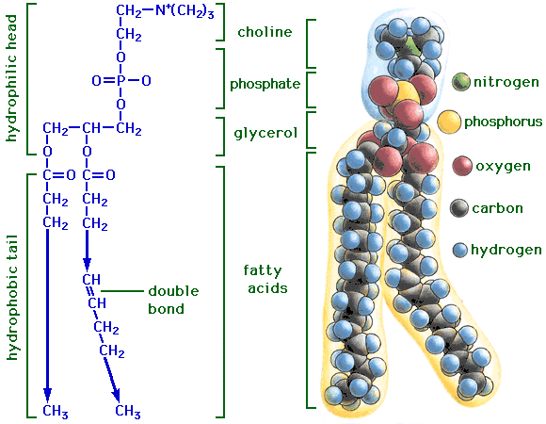
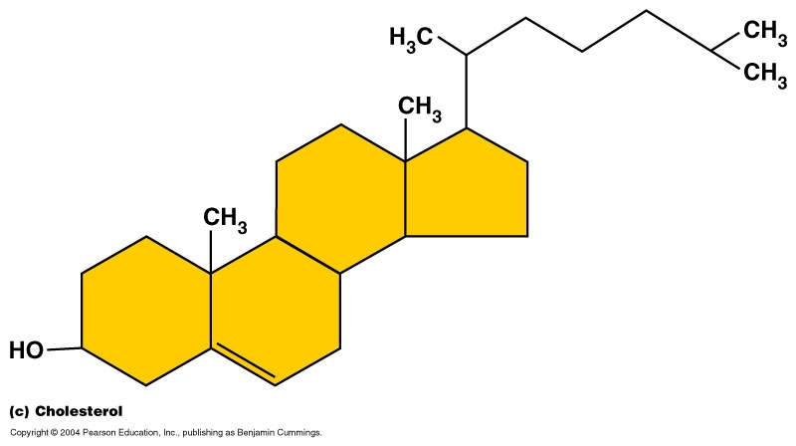
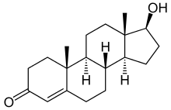
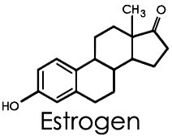
2.1: Structure of Matter → Formulas
Write
Glycerol
Triglyceride
Phospholipid
Steroids
From left to right: Cholesterol, Testosterone, and Estrogen

Slide 27
Draw this on the back of your paper.

Slide 28
