Slide 1
Linnaean Taxonomy Activity

Slide 3
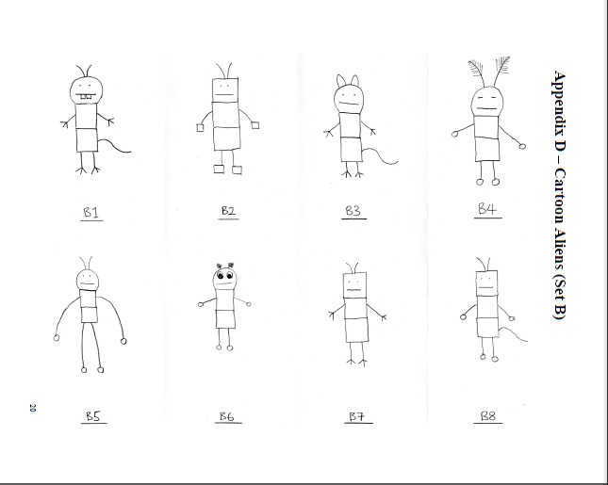
How to Classify using Linnaean taxonomy
Listen
Sort into groups with shared characteristics.

Slide 4
Listen
Characteristics:
Head Shape
Eye Type
Tail
Hand and Feet Type
Antennae Type
Arm Length
Teeth

Slide 5
Head Shape
Listen
Round
Square
Tail
Tail
Present
Absent
Present
Absent
Hands
B8
Feathery Antennae
Teeth
Present
Absent
Fingers
Blocks
B5
Antennae Size
B3
B1
B7
B2
B4
B6

Slide 6
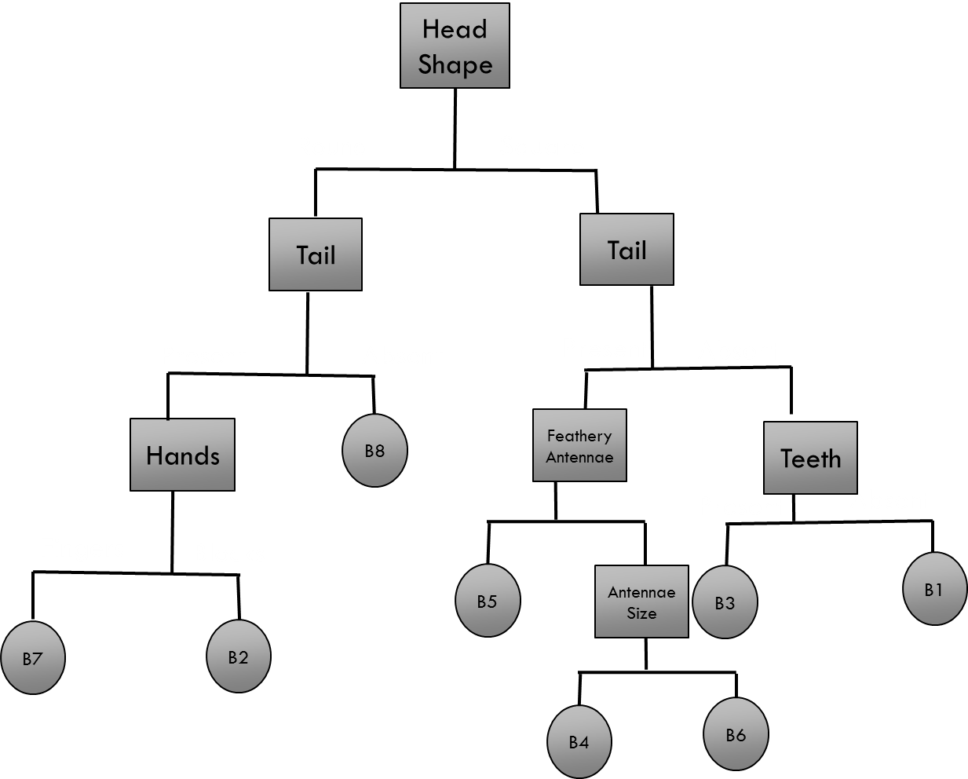
Classification Activity
Classify your cartoon animals (See next slide) using Linnaean Taxonomy
Create a flow chart showing the characteristics you used to classify.
Put you and your partner’s name on the flowchart paper and turn in when you are done.

Slide 7
