Slide 1
Introduction to Course
Listen

Slide 2
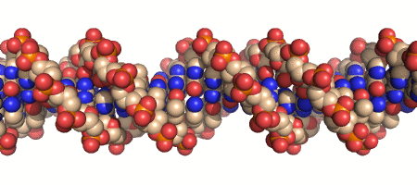
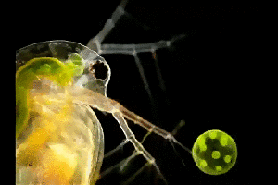
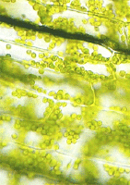
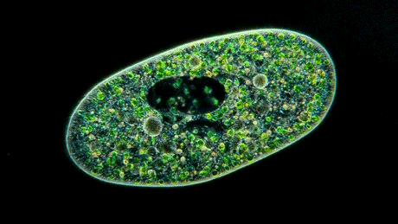
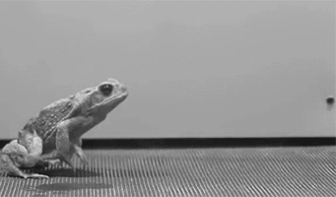
What is Biology?
Listen
The Study of Life.

Slide 3
What can I do with Biology
Listen
Required for almost all science and health related majors
Understand yourself and the world around you.

Slide 4
Course Objectives
Listen

Slide 5
Course Objectives
Students will obtain a basic understanding 9 characteristics of life.
Students will be able to read and comprehend scientific articles from various sources.
Students will be able to think critically about scientific information given to them from non-scientific sources.
Students will be able to properly design, set up, run and clean up a biological lab.

Slide 6
Evaluation and Assessment
Listen

Slide 7
Grade Percentages
Classwork/Homework = 25%
Worksheets, quizzes, coloring sheets, activities, participation
Labs and Projects = 20%
Dissections, Labs, Reports, Presentations
Unit Tests = 40%
Tentatively 14 Unit Tests
Final = 15%
-----------
100%

Slide 8
Class Supplies
Listen

Slide 9
Class Supplies
Notebooks –
You will use this for notes and assignments every day.
Pencil or Pen, Highlighters and Colored Pencils
You will need to bring these everyday as we will use them throughout the year
Binder/Folder
You will need this to hold onto returned assignments and handouts

Slide 10
Contact

Slide 11
Resources
Email:
Nampa Email: troderick@nsd131.org
Gmail: nhsbiologytr@gmail.com
Website
www.roderickbiology.weebly.com
Bookmark this on your phones

Slide 12
Classroom Rules and Expectations
Listen

Slide 13
Classroom Policies
Listen
Absences, Truancies, and Tardiness
Leaving the Classroom/Bathroom Privileges
Electronic Devices Policy
Assignments
Expected Behaviors During Class Activities

Slide 14
Absences, Truancies and Tardiness
Absences –
You are responsible for getting caught up on any missing assignments you missed during an absence. In order to do this you may:
Check my website
Talk to me before school, during lunch or after school
Do not ask me before class starts or during class. I am busy teaching and monitoring the classroom.
Remember: There is a direct correlation between attendance and academic achievement.

Slide 15
Absences, Truancies and Tardies
Listen
Truancies –
“A truancy is defined as a student who is absent from class or school without school or parent permission. Our school views truancy as a serious concern and administrators will work with students and parents to change the behavior.” -Nampa High School Student Handbook
I will mark you truant for the following reasons:
You leave the class without permission.
Security will be called to either return you to class or escort you to the office.

Slide 16
Absences, Truancies and Tardiness
Listen
Tardy
“Students are tardy if they are not at their workstations when the tardy bell rings. Any tardy is unauthorized unless a staff member has detained the student and a note has been issued excusing the tardy. With a legitimate pass, no tardy is recorded.” -Nampa High School Student Handbook
I start taking attendance when the bell rings. If you are not in your seat, then you are tardy.
If you are struggling to get to class on time, provide me with a note from your previous class’s teacher stating that you are struggling to make it to class and I will be lenient.
No note – no excused tardy

Slide 17
Absences, Truancies and Tardiness
Listen
Tardy Sign in Sheet:
If you are tardy, you must sign in on the tardy sheet by the door. If you have a note, drop it into the little pouch.
If you do not sign in on this sheet and you are marked absent, I will not remove the absence.

Slide 18
Leaving the Classroom and Bathroom Privileges
Listen
You may not leave class without a hall pass.
You may not leave class or use the bathroom during the first and last 15 minutes of class.
Trips to the bathroom should last no longer than 10 minutes
If you are gone longer than 10 minutes I will call security.
Please be mindful of your fellow classmates who may be waiting for you to get back.

Slide 19
Electronic Devices
Listen
All electronic devices are to be turned off (or silenced) and put away unless we are using them for a class activity.
If a phone is out during class, I will take it and give it to security. You may pick up your phone from them.
If you are not using your phone correctly during a class activity, I will take your phone and give it to security. You may pick up your phone from them.

Slide 20
Assignments
Listen
Keep Track of your assignments
Check my website
Check the white board
Keep an assignment Tracker
Late or Missing assignments
I will accept missing assignments up until the day of the test.
I will not accept late or missing work after the test.
Unless…
You choose to retake a test. In which case, I will accept any late or missing work before you retake the test.

Slide 21
Test Make Up
Listen
You have Two Days to make up a test. If you fail to come in to make up your test you will no longer be able to take that est.
A written make up exam will be offered instead.

Slide 22
Expected Behaviors During Class Activities
Listen
Entering the Classroom
Achieve Expectations
Daily Warm Up
Lecture
Labs
Independent Work
Partner Work
Group Work
Class Discussion or Debate
End of Class

Slide 23
Entering the Classroom
Listen
DO:
Go to your seat
Check the Board
Get out your Notes or Binder
Sharpen any Pencils
Begin working on the Daily Warm Up
Put your phone away before the bell rings
Not after
DON’T:
Wander around the classroom
Stand in a group and socialize
(if you must talk, do so in the hall)
Ask me what we’re doing today
(it’s on the board)
Bother people who are preparing for class
Stay on your phone after the bell has rung.

Slide 24
Activity
What we are doing.
Conversation
Who you may talk to and volume levels
Help
What you may do to receive help
Integrity
Collaborating or Independent
Effort
What appropriate behavior and work looks like.
Value
Why we’re doing this.
Efficiency
Tips for getting the maximum benefit
Listen

Slide 25
Activity
What we are doing.
Conversation
Who you may talk to and volume levels
Help
What you may do to receive help
Integrity
Collaborating or Independent
Effort
What appropriate behavior and work looks like.
Value
Why we’re doing this.
Efficiency
Tips for getting the maximum benefit
Due dates and Instructions for Turning in
Activity
Taking Notes on Teacher Directed Lecture
Conversation
No Talking
Raise Hand if you have question or comment
Help
No EDs
Integrity
Take your own notes
Effort
Listening
Writing information
Value
Transmitting information
Efficiency
Think about what we’re talking about don’t just copy the words.
Sharpen your pencils before we begin.
Keep your notes organized and bring them to class everyday.
Listen

Slide 26
Daily Warm Up
Listen
Activity
Answering review questions from previous class.
Conversation
Talk quietly to your desk partner about the questions
Help
Use your Notes
Ask a friend
May use an electronic device to access my website for notes.
Integrity
Collaborate on answers. Don’t just copy what someone wrote down.
Effort
Looking through notes
Quietly discussing
Value
Recalling information from last class
Efficiency
Use this activity to refresh what we learned from the previous class.
Turn your assignment into the basket before the timer is up.
I will not accept it after the timer.

Slide 27
Lecture and Notes
Listen
Activity
Taking Notes on Teacher Directed Lecture
Conversation
No Talking
Raise Hand if you have question or comment
Help
No EDs
Integrity
Take your own notes
Effort
Listening
Writing information
Value
Transmitting information
Efficiency
Think about what we’re talking about don’t just copy the words.
Sharpen your pencils before we begin.
Keep your notes organized and bring them to class everyday.

Slide 28
Lab
Listen
Activity
Lab
Conversation
No talking during directions
Normal talking during the actual lab
Help
EDs may be used to access notes or other educational material
Raise your hand if you need help
Integrity
Collaborate – do not copy answers – if your group comes to an answer and you don’t understand ask them to explain it to you!
Distribute the work fairly – don’t be a mooch.
Effort
Checking Directions
Treating lab material carefully and respectfully involve everyone in the group
Value
Hands on learning
Learning laboratory skills
Efficiency
Read the directions – most labs can be done easily by taking your time with the directions

Slide 29
Independent Work
Listen
Activity
Working Quietly on an assignment or studying
Conversation
No Talking
Help
EDs may be used to access notes or other educational material only
No Music
Raise your hand if you need help
Integrity
Do not copy answers.
Effort
Reading Directions
Referencing your notes
Value
Focused Learning
Efficiency
Read the directions
Due Date:
Turn in instructions

Slide 30
Partner Work
Listen
Activity
Working with the person sitting next to you
Conversation
Quietly discussion pertaining to the subject
Help
EDs may be used to access notes or other educational material only
No Music
Raise your hand if you need help
Integrity
Collaborate - Do not copy answers.
Effort
Reading Directions
Referencing your notes
Discussing quietly
Value
Social Learning
Efficiency
Read the directions
Due Date:
Turn in instructions

Slide 31
Group Work
Listen
Activity
Working as a group on an assignment or project
Conversation
Normal talking
Help
EDs may be used to access notes or other educational material only
No Music
Raise your hand if you need help
Integrity
Collaborate – do not copy answers – if your group comes to an answer and you don’t understand ask them to explain it to you!
Distribute the work fairly – don’t be a mooch.
Effort
Reading Directions
Referencing your notes
Distributing the work evenly and fairly
Include all group members
Value
Social Learning
Social Skills
Efficiency
Read the directions
Due Date:
Turn in instructions

Slide 32
Class Discussion or Debate
Listen
Activity
Discussing or debating a topic as a class
Conversation
Normal Talking
Do not talk over other students – be respectful of your peers!
Help
No ED’s
If you don’t feel comfortable just speaking up, raise your hand to signal you have something to say
Integrity
Discuss ideas - if you disagree be professional and polite
Be prepared to back up your statements with sources or facts
Effort
Listening
Contributing your thoughts, opinions and feelings on the subject
Value
Social Learning
Social Skills
Efficiency
Don’t be afraid to speak or ask questions.

Slide 33
End of Class
Listen
DO:
Stay in your seat
Double Check your Assignments
Pick up any trash in your area and throw it away on your way out
Sharpen pencils for your next class
Leave when you are dismissed not when the bell rings
DON’T:
Wander around the classroom or stand by the door
Stand in a group and socialize
Put away your stuff early
Get out your phone without permission
Leave without permission

