Slide 1
Enzymes
Write

Slide 2
Write
Enzyme
Protein that speeds up chemical reactions by lowering the activation energy.
Activation Energy
The amount of energy needed to create a chemical reaction

Slide 3
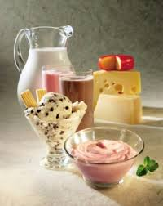
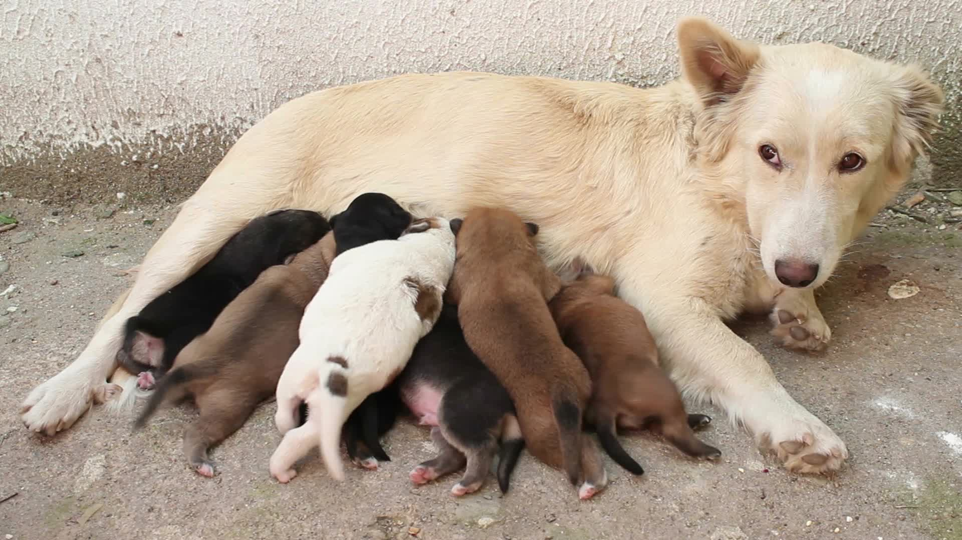
Listen
GLU
GAL
Lactose

Slide 4
Listen

Slide 5
Listen
Cramps
Diarrhea
Gas

Slide 6
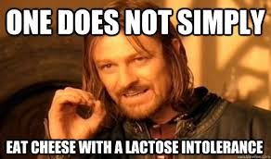
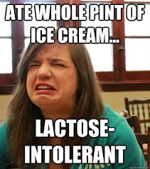
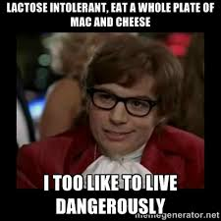
Listen

Slide 7
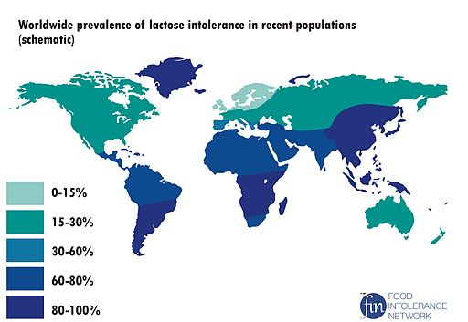
Listen

Slide 8
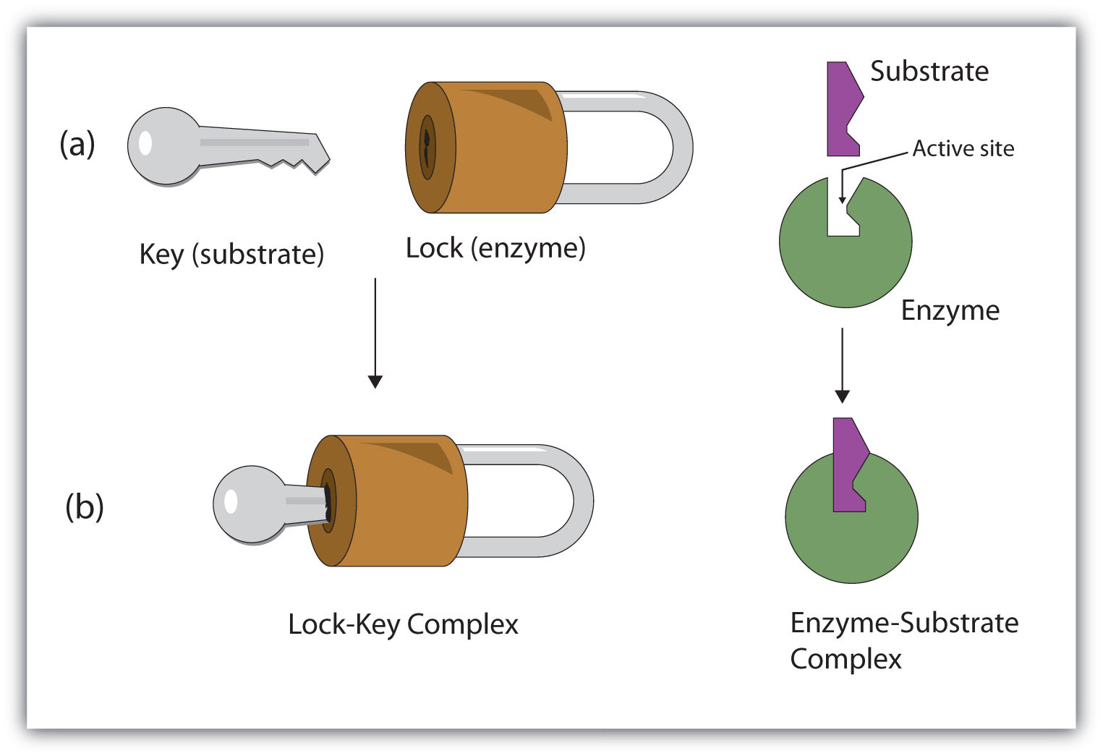
Listen

Slide 9
Write
Active Site
An area on the enzyme where the substrates are captured and changed
Substrate
A molecule that fits into an enzyme’s active site

Slide 10
Activation Energy
Listen
Lactose
GLU
GAL
Lactase
Enzyme
Energy Needed to Break bonds
Lactose
GLU
GAL
Energy

Slide 11
1. Active Sites
Listen
Areas on an enzyme where substrates are captured.
Active Site
Active Site

Slide 12
1. Specific
Listen
Each enzyme only works on 1 specific substrate (molecule)
Lock and Key – only one key shape can open a lock.
Substrate
substrate
Active Site
substrate
substrate
substrate
Active Site

Slide 13
2. Re-Usable
Listen
One enzyme can work on multiple substrates
Active Site
Active Site

Slide 14
Write
All enzymes:
1. have an Active Site
2. are specific (Lock and Key)
3. are Re-usable
Enzymes can be affected by
Temperature
pH
Enzyme amount
Substrate amounts

Slide 15
TED Talk on Enzymes
Watch
http://ed.ted.com/on/ValPoylC

