Slide 1
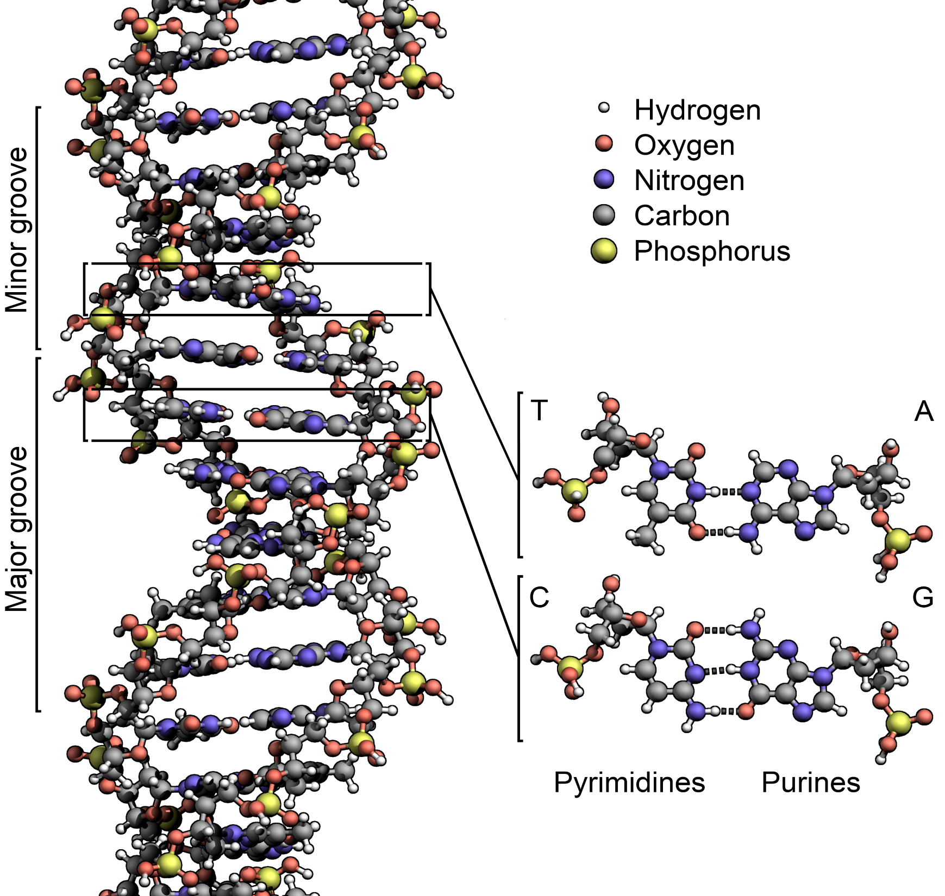
Daily Warm Up
Nucleic Acid
DNA is a ______ _______.
The monomer of a nucleic acid is called a __________.
Polymer = _______ thing(s)
Monomer = ______ thing(s)
A nucleotide is made up of a _________, ________, and a ________.
The four nucleotides of DNA are:
A
T
C
G
Nucleotide names are determined by their ___________.
How do DNA bases pair together?
________ = ________ _________ = ________
If one strand of a DNA molecule has the base sequence of ACATTAG what will the other strand base sequence be?
DNA is made up of two nucleic acid strands. What binds these two strands together?
Nucleotide
Many
One
Phosphate
Sugar
Base
denine
hymine
ytosine
uanine
bases
A
T
C
G
TGTAATC
Hydrogen Bonds

