Slide 1
DNA Replication

Slide 2
DNA Replication Brochure Directions
Take your blank piece of paper and fold it into thirds.
Copy the information on the following two slides

Slide 3
Enzymes
Helicase:
DNA Polymerase:
Processes:
Base Pairing:
Polymerization:
DNA Strands
Semiconservative:
Template Strand:
Complementary Strand:
DNA Replication W’s
What:
Where:
When:
Why:
DNA
Replication
Name

Slide 4
Step 1.
Step 2.
Step 3.

Slide 5
DNA Replication Brochure Directions
Listen to the lecture and fill in the information on your brochure.

Slide 6
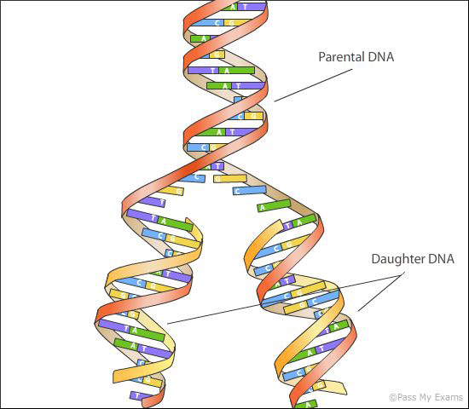
DNA replication is the process of creating a copy of your DNA

Slide 7
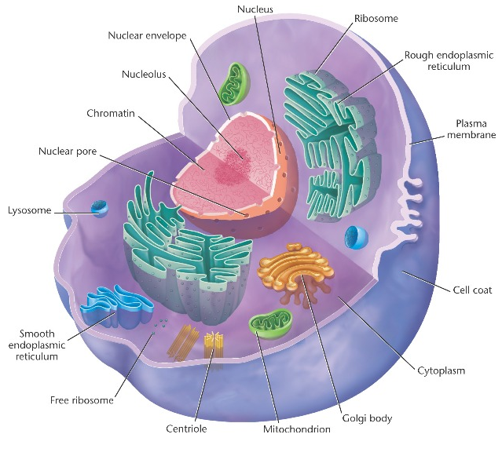
Listen
DNA can never leave the nucleus.
This means that DNA replication has to occur in the nucleus.

Slide 8
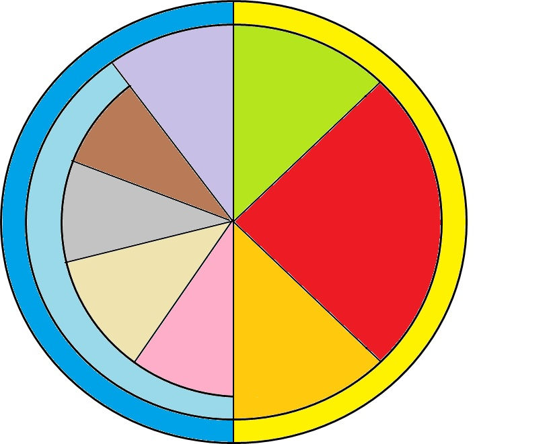
Listen
G1 Phase
Cytokinesis
Telophase
S Phase
DNA REPLICATION
M-Phase
Mitosis
Interphase
Anaphase
Metaphase
DNA replication occurs during the S phase of the Cell Cycle
G2 Phase
Prophase

Slide 9
Listen
46
Without DNA replication you would halve your chromosomes until you had no more DNA.
Every time a cell split, the new cell would only receive half of the DNA and probably lose important genes in the process.
23
23
11.5
11.5
11.5
11.5

Slide 10
Listen
46
92
By replicating your DNA before cell division, you ensure that each new cell has a COMPLETE copy of the information stored in the original cell.
46
92
46
92
46
46
46
46

Slide 11
DNA Replication W’s
Write
What: DNA replication is the process of copying your DNA
Where: DNA replication occurs in the Nucleus.
When: DNA replication occurs during the S phase of the cell cycle. (right before mitosis or meiosis)
Why: DNA replication is needed so that new cells will have a complete copy of the original cell instead of just the half.

Slide 12
H
Listen
1. Helicase breaks the hydrogen bonds holding the two strands together.

Slide 13
DNA Polymerase
2. DNA Polymerase builds the new complementary strands.
Listen
DNA Polymerase

Slide 14
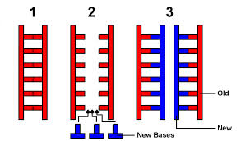
Listen

Slide 15
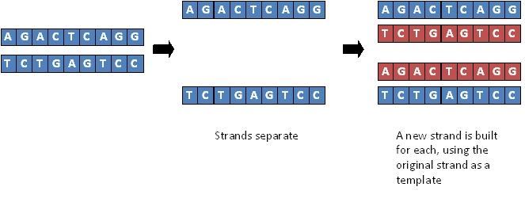
Listen

Slide 16
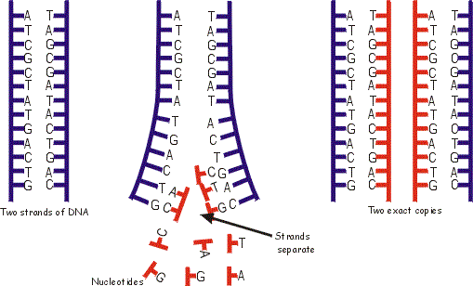
Listen
Template Strand
Template Strand
Template Strand
Complementary Strands
Template Strand

Slide 17
DNA Strands
Write
Semiconservative: Half of the DNA is an old strand (template) and the other half is new (complementary)
Template Strand: The old strand that DNA polymerase uses as a template to build a new strand.
Complementary Strand: The new strand that DNA polymerase is building.
Free Nucleotides: Nucleotides (A,T, C,G) that are found within the nucleus.

Slide 18
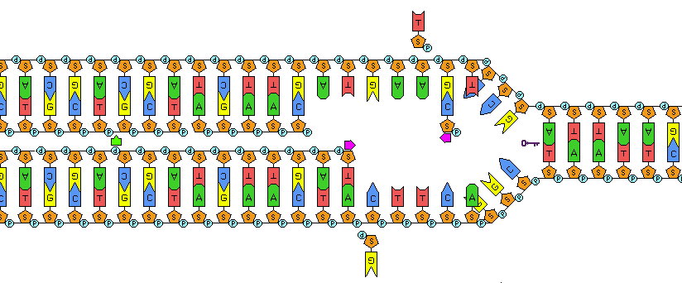

Slide 19
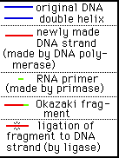

Slide 20
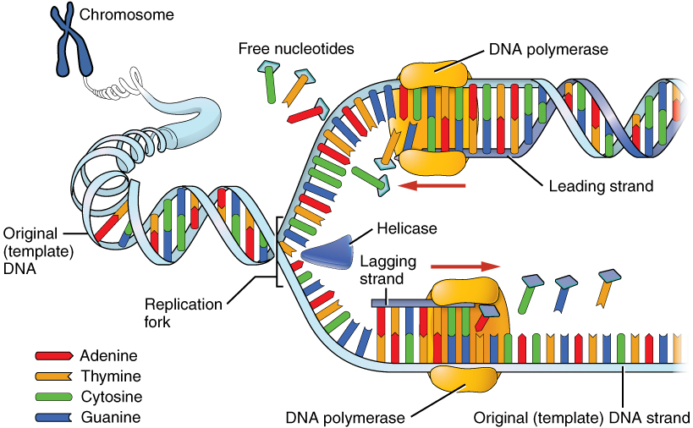
Listen

Slide 21
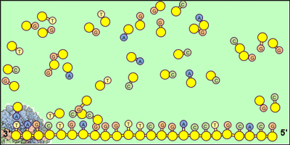
DNA Polymerase

Slide 22
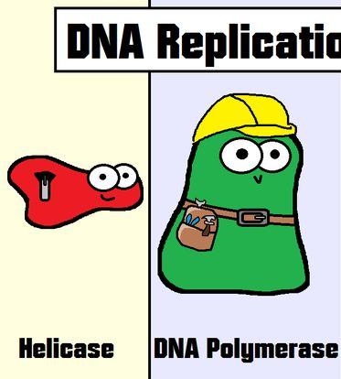
Listen
DNA REPLICATION ENZYMES

Slide 23
Enzymes
Write
Helicase: Breaks hydrogen bonds between bases.
DNA Polymerase: Builds new strands by taking free nucleotides and base pairing them with a template strand of DNA.

Slide 24
Processes
Write
Polymerization: The process of combining monomers to create polymers.
Example: Connecting Nucleotides to create Nucleic Acid or Connecting amino acids to create proteins
Base Pairing: Pairing bases together following the rule: A = T and C = G

Slide 25
Review Questions
What is DNA Replication?
When does DNA Replication occur?
Why is DNA replication necessary?
What does semi-conservative mean?
What do we call the enzyme that unzips DNA by breaking the hydrogen bonds between the bases?
What do we call the strand that is read to create a new strand?
What do we call the new strand that is being created?
What enzyme builds the complimentary strand?
How is the complimentary strand created?
What material is used to make the new complimentary strand?
Making a copy of your DNA
Template Strand
S Phase
Complementary Strand
So we can make new cells
DNA Polymerase
Half of the DNA copy is old and the other half is new
By Base pairing with the template strand
Helicase
Nucleotides found within the nucleus

Slide 26
Enzymes
Helicase: Breaks hydrogen bonds between bases.
DNA Polymerase: Builds new strands by taking free nucleotides and base pairing them with a template strand of DNA.
Processes:
Base Pairing: Pairing two nucleotides together following the rule of A = T and C = G
Polymerization: Connecting monomers to create a polymer.
DNA Strands
Semiconservative:
Template Strand: The old strand that DNA polymerase uses as a template to build a new strand.
Complementary Strand: The new strand that DNA polymerase is building.
DNA Replication W’s
What: DNA is the process of making a copy of DNA
Where: DNA replication occurs in the Nucleus
When: DNA replication occurs during the S phase of the cell cycle
Why: DNA replication is needed to create new DNA for new cells that are created during Mitosis and Meiosis.
DNA
Replication
Name

Slide 27
Helicase
G
C
A
T
C
G
T
A
G
C
G
C
A
T
C
G
1. Helicase breaks the hydrogen bonds between the bases and separates the two strands.

Slide 28
G
C
A
Helicase
T
C
G
T
A
G
C
G
C
A
T
C
G
1. Helicase breaks the hydrogen bonds between the bases and separates the two strands.

Slide 29
G
C
G
G
C
G
C
G
C
Helicase
A
T
A
A
T
A
T
A
T
C
G
C
C
G
C
G
C
G
DNA Polymerase
T
A
T
A
T
A
T
A
T
A
G
C
G
C
G
C
G
C
G
C
DNA Polymerase
G
C
G
C
C
G
C
G
C
A
T
A
T
T
A
T
A
T
C
G
C
G
C
G
C
G
C
G
C
1. Helicase breaks the hydrogen bonds between the bases and separates the two strands.
2. DNA Polymerase creates complementary strands by base pairing with the template strands
3. Two identical copies of DNA are created.

Slide 30
G
C
G
G
C
G
C
G
C
Helicase
A
T
A
A
T
A
T
A
T
C
G
C
C
G
C
G
C
G
DNA Polymerase
T
A
T
A
T
A
T
A
T
A
G
C
G
C
G
C
G
C
G
C
DNA Polymerase
G
C
G
C
C
G
C
G
C
A
T
A
T
T
A
T
A
T
C
G
C
G
C
G
C
G
C
G
C
1. Helicase breaks the hydrogen bonds between the bases and separates the two strands.
2. DNA Polymerase creates complementary strands by base pairing with the template strands
3. Two identical copies of DNA are created.

Slide 31
G
C
G
G
C
G
C
G
C
Helicase
A
T
A
A
T
A
T
A
T
C
G
C
C
G
C
G
C
G
DNA Polymerase
T
A
T
A
T
A
T
A
T
A
G
C
G
C
G
C
G
C
G
C
DNA Polymerase
G
C
G
C
C
G
C
G
C
A
T
A
T
T
A
T
A
T
C
G
C
G
C
G
C
G
C
G
C
1. Helicase breaks the hydrogen bonds between the bases and separates the two strands.
2. DNA Polymerase creates complementary strands by base pairing with the template strands
3. Two identical copies of DNA are created.

