Slide 1
Create a Dichotomous Key

Slide 2
Directions
Give the animals on the handout scientific names.
Using the animals on the handout create a flow chart that categorize them into groups using Linnaean Classification.
Using your flow chart create a dichotomous key
You will be turning in one piece of paper.
On the front you should have your scientific names and your flow chart
On the back you should have your dichotomous key

Slide 3
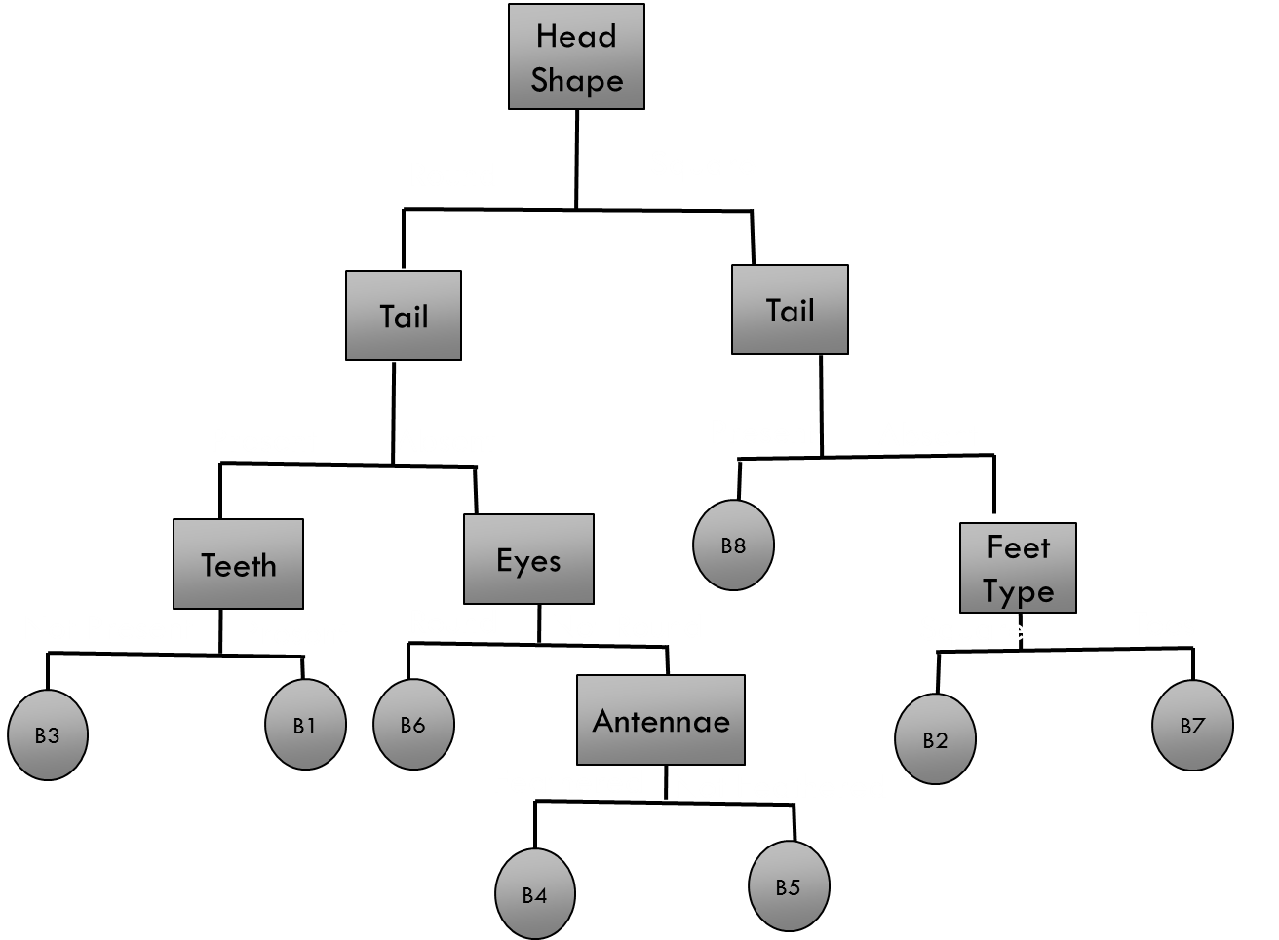
Front
Back
Dichotomous Key
1.
1a …………………………………go to 1b………………………………….go to
2.
2a …………………………………go to 2b………………………………….go to
3.
3a …………………………………go to 3b………………………………….go to
4.
4a …………………………………go to 4b………………………………….go to
5.
5a …………………………………go to 5b………………………………….go to
6.
6a …………………………………go to 6b………………………………….go to
7.
7a …………………………………go to 7b………………………………….go to
8.
8a …………………………………go to 8b………………………………….go to
9.
9a …………………………………go to 9b………………………………….go to
Scientific Names:
1.
2.
3.
4.
5.
6.
7.
8.
9.
10.

Slide 4
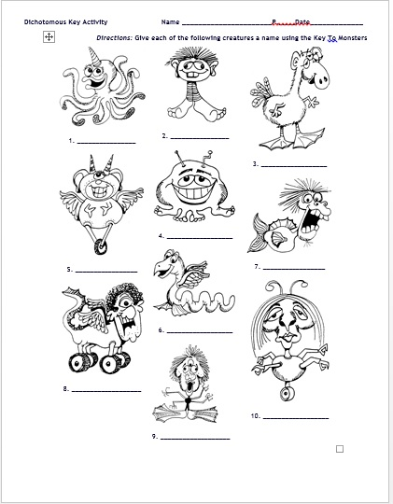
Latin Words:
Horn – Cornus
One - Uni
Two – Di, bi
Three – Tri
Four - Quadus
Feather – pluma/pinna
Teeth – Denta
Large – Maximus/Grand
Wheel – Rota
Snake – Serpere
Eye – oculus
Foor – pedus
Arm – brachium
Wing - penna
Curly – cirratus
Straight – rectus

