Slide 1
Always begins with…
Directions: Fill in the blanks with the correct answers from your notes.
Which means:
Glycolysis occurs in the __________
Creates _ ATP Molecules
If Oxygen is not present then
If Oxygen is present then
Also known as:
Occurs in: ______ ______and some ________
Creates: ______ ____ ( ___ ____)
Occurs in the ______ of the ____________
Creates _ ATP Molecules
Occurs in: _____ and other ________
Creates: ______
______
_______
___
Occurs in the _____ ________ (_______) of the ____________
Creates __ ATP Molecules
Total ATP Created: _ ATP
Total ATP Created: __ ATP

Slide 2
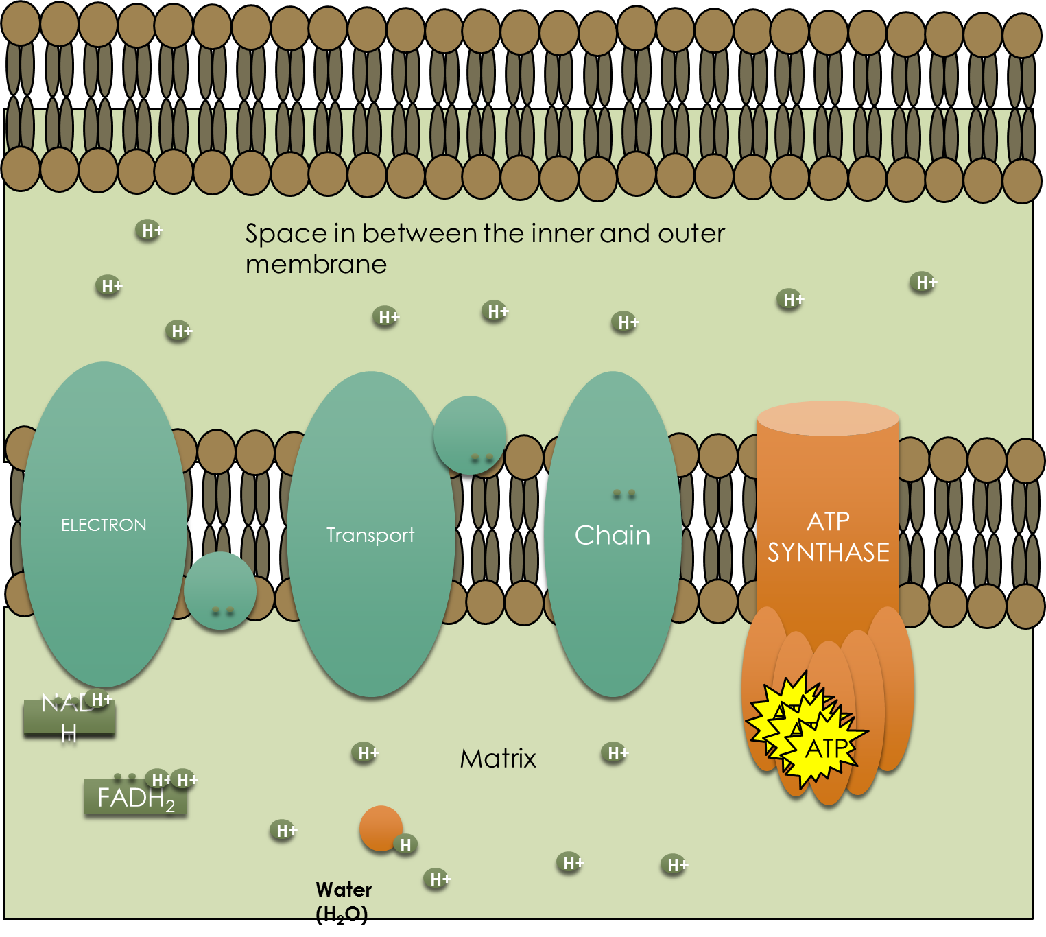
The Mitochondria consists of a _____ ________ and an _____ ________that is folded in on itself. The folds of the inner membrane are known as C _______and they contain the ________ _________ ______. Inside the inner membrane is a fluid known as the (5) ______
1
2
3
4
5
Directions: Fill in the blanks with the correct answers from your notes. Color the Mitochondria using a different color for each part.
3
1
2
5
4

