Slide 1
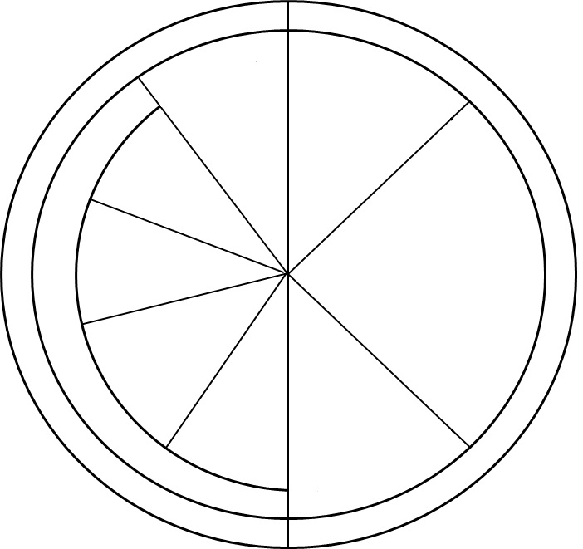
Name: _____________ Date: __________ Period: ________
Cell Cycle Coloring Sheet
Mitosis
G1
Cytokinesis
Divides Cell
Gap 1 Phase
Cell Grows
Telophase
S
Mitosis – Nucleus Divides
Synthesis Phase
M-Phase
Anaphase
DNA Copies
Interphase
Metaphase
G2
Prophase
Gap 2 Phase
Cell Grows
Interphase = resting phase
M phase = division phase

Slide 2
G1 Phase
S Phase
G2 Phase
2N → 4N
Interphase
2N
4N
Cell Grows
DNA Copies
Cell Grows
Prophase
Metaphase
4N
4N
Chromatin Wind up into Chromosomes
Nuclear envelope dissolves
Chromosomes line up along the center of the cell
Mitosis
M Phase
Anaphase
Telophase
4N
4N
Centrioles send out spindle fibers that attach to the kinetochores of the sister chromatids.
Centrioles pull back spindle fibers and separate the two sister chromatids from one another.
Chromosomes unwind into chromatin
Two nuclear envelope form around chromosomes
Cytokinesis
2N
2N
4N
4N
Cell Splits
Two Identical Daughter Cells

