Slide 1
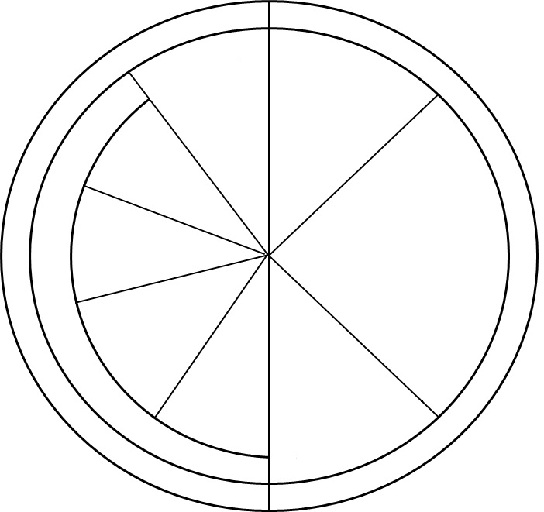
Name: _____________ Date: __________ Period: ________
Cell Cycle Coloring Sheet
Mitosis

Slide 2
Interphase
Mitosis
M Phase
Cytokinesis

