Slide 1
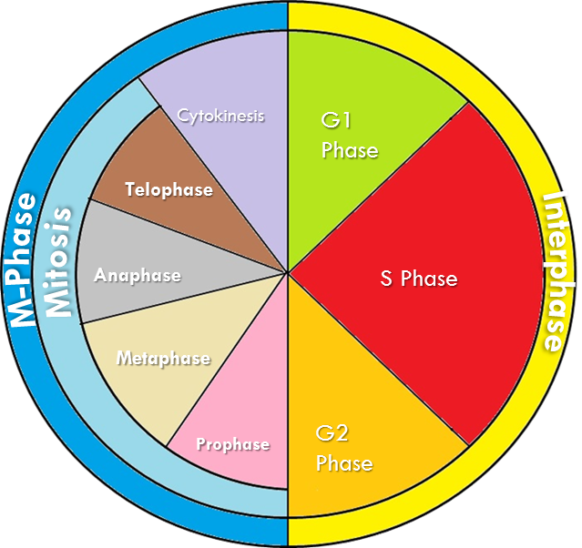
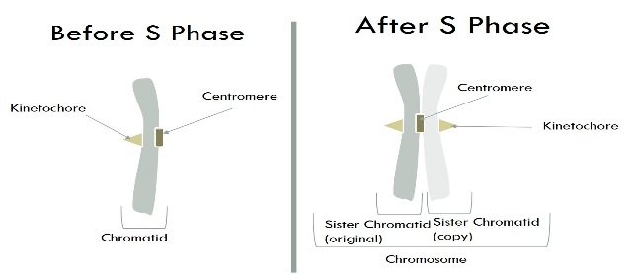
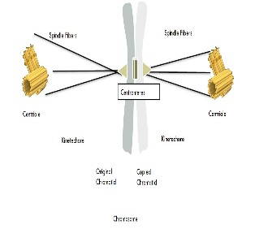
Cell Cycle:
Cell Cycle: A series of events that take place in eukaryotic cells leading to their division and duplication
Interphase: The resting phase between mitosis or meiosis
Gap 1
G1
cell grows
Synthesis Phase
S
DNA makes a copy of itself
2N → 4N
Gap 2
G2
organelles replicate
Chromatids and Chromosomes
Mitosis: Division of the Nucleus
Prophase
P
Metaphase
M
Anaphase
A
Telophase
T
1. Chromatin winds up into chromosomes
2. Nucleus dissolves
1. Chromosomes line up along the center of the cell
2. Spindle fibers attach to kinetochore
1. Spindle Fibers pull the chromatids apart to opposite sides of the cell.
1. 2 nuclei form around chromatids
2. Chromatids unwind into chromatin
Kinetochore: an area where spindle fibers attach to help move the sister chromatids apart.
Centromere: Center Part that binds two sister chromatids together.
Centriole: An organelle that organizes the spindle fibers that assist in mitosis and cytokinesis.
Cytokinesis: Division of the entire cell
Spindle Fiber: Fibers that attach to a kinetechore and pulls the two chromatids apart

Slide 2
Interphase
DNA Copies itself
Gap 1 (G1)
S Phase (S)
Gap 2 (G2)
M-Phase
Mitosis
Cytokinesis
Prophase
Metaphase
Anaphase
Telophase
2 identical daughter cells

