Slide 1
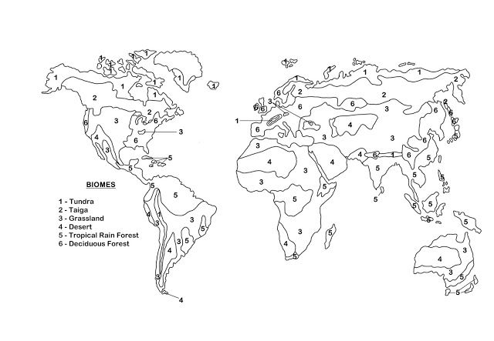

Slide 2
 | Tropical Rain Forest | Tropical Dry Forest | Tropical Savana | Desert | Temperate Grassland | Temperate woodland Shrubland | Temperate Forest | Northwestern Coniferous Forest | Boreal Forest (Taiga) | Tundra
Abiotic Factors
Dominant Plants
Dominant Wildlife
Geographic Distribution

