Slide 1
Unit 03
Cellular Structure and Function

Slide 2
Latin Root Words
Write
Objective:
Students will be able to define the Latin Root Words for this unit.

Slide 3
Latin Root Words
Write
Cyto – Cell
Scope – aim
Bi – two
Pro – before
Eu – easily formed or good
Kary – Kernal; inner part
Nucle – Kernal; inner part
Mito – Thread
Chondrion – granule
Reticulum – net
Hyper – above
Hypo – Below
Tonic - solute
Osmos – to push
Endo – Inner
Exo - outside

Slide 4
Cell Theory
Write
Students will be able to list the three components of the cell theory.

Slide 5
Cell Theory
Write
1. All living things are made of a single or multiple cells
2. Cells are the basic building block for living things.
3. All cells come from pre-existing cells.

Slide 6
Microscopes
Write
Objective:
I can identify the parts of a microscope.
I can demonstrate how to properly use a light microscope.
I can create wet slide.

Slide 7
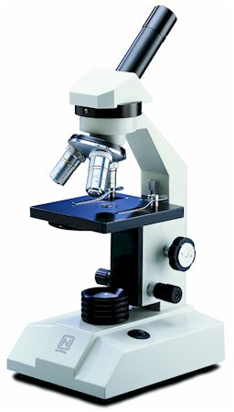
Listen
Compound
Light
Microscope
Compound = Multiply
You multiply the power of the two lenses together.
You need a light source

Slide 8
1.
Listen
Compound
Light
Microscope
There are four lenses on a compound microscope
Ocular Lens (10x) magnification
3.
2.
4.
Objectives:
2. Scanning (4x) magnification
3. Low Power (10x) magnification
4. High Power (40x) magnification

Slide 9
Write
1st lens | Magnification | 2nd lens | Magnification | Total Magnification
Ocular | 10x | Scanning (short) | 4x | 40x
Ocular | 10x | Low Power (medium) | 10x | 100x
Ocular | 10x | High Power (long) | 40x | 400x

Slide 10
Assignment
Microscope Coloring Sheet

Slide 11
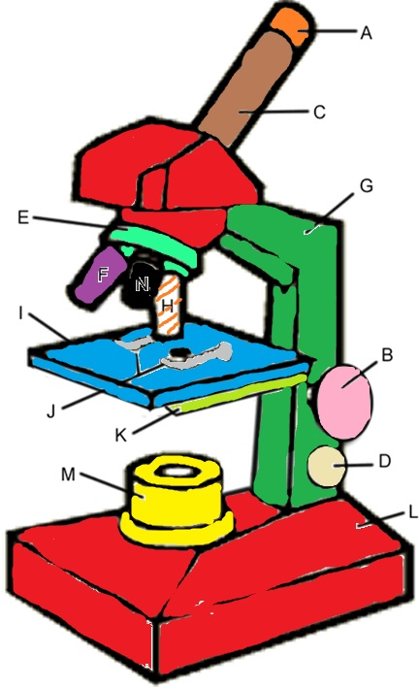
Check

Slide 12
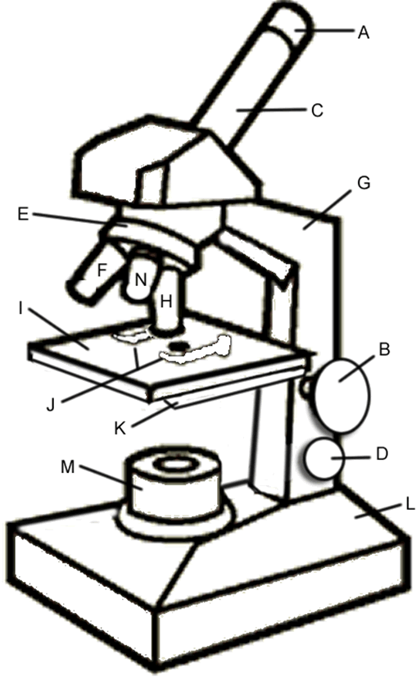
Compound Light Microscope
Ocular Lens
Quiz
Body Tube
Arm
Nose Piece
Low Power Objective (10x)
Scanning Objective (4x)
Stage
High Power Objective (40x)
Coarse Adjustment Knob
Stage Clips
Diaphragm
Light Source
Fine Adjustment Knob
Base

Slide 13
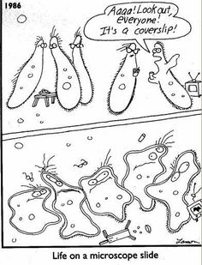
Listen

Slide 14
How to make a wet mount
Listen and Practice
1. Drop water or dye on slide
Place specimen in water
Tilt the coverslip and slowly let it down

Slide 15
Cell Basics
Write
Objective:
I know the four things that all cells have

Slide 16
Draw A Cell!
3.1: Introduction
Draw

Slide 17
Poll: How many Cells are in your body?
3.1: Introduction
Participate

Slide 18
Listen
Cell Membrane
Cytoplasm
DNA
Ribosomes

Slide 19
Write
All cells have these four things:
Cell Membrane
Skin of the cell
Cytoplasm
Fluid that fills up the cell
DNA
Stores information
Ribosomes
Makes proteins

Slide 20
Write
Organelles
A structure within a cell that performs a specific function

Slide 21
Prokaryotes and Eukaryotes
Write
Objective:
I know how to tell the difference between a Prokaryotic Cell and Eukaryotic Cell

Slide 22
Listen
The very first cells were Prokaryotic
They evolved about 3.8 billion years ago.
They had a Cell Membrane
Cytoplasm
DNA
Ribosomes
Prokaryotic Cells also had tails called flagella, hair like protrusions called cilia and a cytoskeleton to help them move.

Slide 23
Listen
Prokaryotic cells had no nucleus, and no membrane bound organelles.
Overall, Prokaryotic Cells were and still are pretty simple.

Slide 24
Over time, some prokaryotic cells evolved into a more complex type of cell called a eukaryote
Cell Wall
Chloroplasts
Plant Cells
Large
Central
Vacuole
Animal Cells
Bacteria
Centrioles
Early Eukaryotes
Developed membrane bound organelles
Endosymbiosis of mitochondria and chloroplasts
Developed nucleus
First Prokaryotic Cells

Slide 25
Prokaryote (prokaryotic cells)
Simple Cells with NO nucleus and No membrane bound organelles
Eukaryote (Eukaryotic Cells
Complex cells with a nucleus and membrane bound organelles

Slide 26
Write
Prokaryotic Cells
Eukaryotic Cells
Pro = Before
Kary= Nucleus
Eu = Good
Kary = Nucleus
All Cells have:
Cell membrane
Cytoplasm
Ribosomes
DNA
No Nucleus
No membrane bound organelles
Simple
Has a Nucleus
Has Membrane bound organelles
Complex

Slide 27
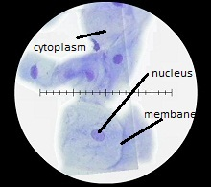

Slide 28
Let’s Look at a cell!

