Slide 1
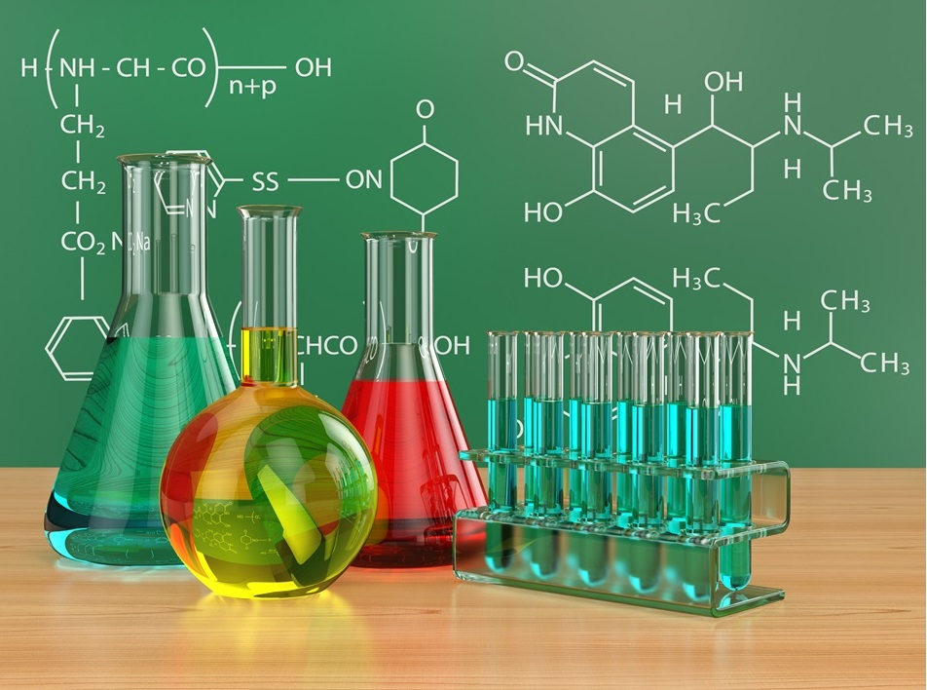
Unit 02
The Chemical Basis of Life

Slide 2
Think and Share
What do you think of when you hear the word chemistry?

Slide 3
Write
Chemistry
The composition of matter and how it changes.

Slide 4
Write
Matter
Anything that has mass and takes up space
Mass –
A measure of how much matter is in an object
Volume
The amount of space taken up by matter

Slide 5
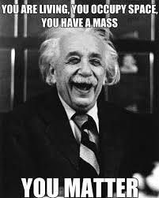

Slide 6
Write
Density
Ratio of Mass and Volume

Slide 7
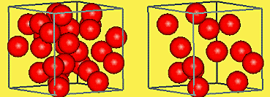
Which Cube is more dense?

Slide 8
Write
Element
Any material that can’t be broken down into a more fundamental substance

Slide 9
Remember?

Slide 10
2.1: Introduction
Read
There are 118 known elements
20 of these elements make up all living things

Slide 11
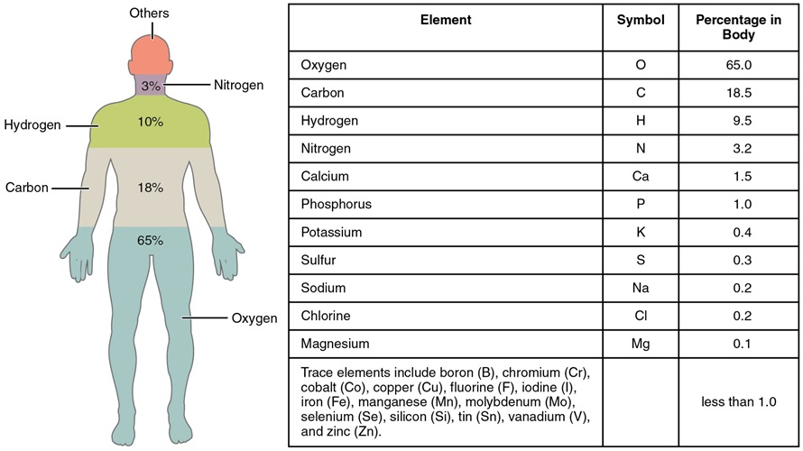
2.1: Introduction
Read
Elements in the Human Body

Slide 12
C.H.O.N
Write
Carbon
Hydrogen
Oxygen
Nitrogen

Slide 13
Living things are composed mostly of these four elements:
Answer

Slide 14
2.1: Introduction
Read
The type of element is determined by the type of atom.
Do you remember the structure of an atom?

Slide 15
Draw an Atom
Practice

Slide 16
2.1: Introduction
Write
Atom
The basic unit of matter
The type of atom determines the type of element

Slide 17
Read

Slide 18
2.1: Introduction
Read
An atom is composed of three particles
Proton (+)
Neutron (N)
Electron (e-)

Slide 19
2.1: Introduction
Write
Proton
Subatomic particle with a positive (+) charge
Neutron
Subatomic Particle with no charge (N)
Electron
Subatomic Particle with a negative charge (-)

Slide 20
2.1: Introduction
Write
Nucleus
Center of an atom
Made up of Protons and Neutrons
Contains most of the mass
N⁰
P⁺
N⁰
P⁺
Nucleus
P⁺
N⁰

Slide 21
2.1: Introduction
Write
Electron Shell
An orbit around the nucleus
Electrons can be found on electron shells
Electrons on the outermost electron shell are called valence electrons
Valence Electron
e-
Electron Shells
N⁰
P⁺
N⁰
P⁺
Normal electron
e-
e-
P⁺
N⁰

Slide 22
2.1: Introduction
Write and draw
Each electron shell can hold a certain amount of electrons
1st electron shell = 2 electrons
2nd electron shell = 8 electrons
3rd electron shell = 8 electrons
e-
e-
e-
e-
e-
e-
e-
2nd
e-
3rd
e-
e-
1st
e-
e-
e-
e-
e-
e-
e-
e-

Slide 23
Label the Atom
Draw and Label
Valence Electron
e-
Electron Shells
Proton
N⁰
P⁺
N⁰
P⁺
Electron
e-
e-
P⁺
N⁰
Neutron
Nucleus

Slide 24
2.1: Introduction
Write
Balanced Atom
Protons = Neutron = Electron
Isotope
Protons = Electrons
More or less Neutrons than protons
Ion
Protons = Neutrons
More or less electrons than protons
Creates a positive or negative charge

Slide 25
Balanced Atom, Isotope, or Ion?
Identify
Ion

Slide 26
Balanced Atom, Isotope, or Ion?
Identify
Balanced

Slide 27
Balanced Atom, Isotope, or Ion?
Identify
Ion

Slide 28
Balanced Atom, Isotope, or Ion?
Identify
Isotope

Slide 29
2.1: Introduction
Write
The type of atom is determined by the number of protons

Slide 30
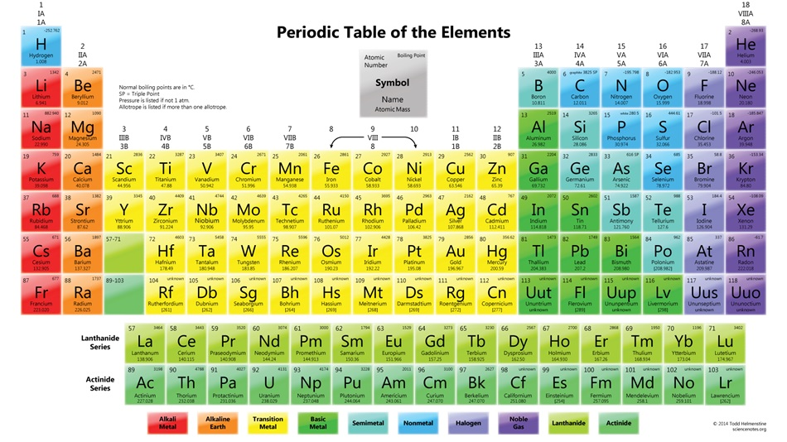

Slide 31
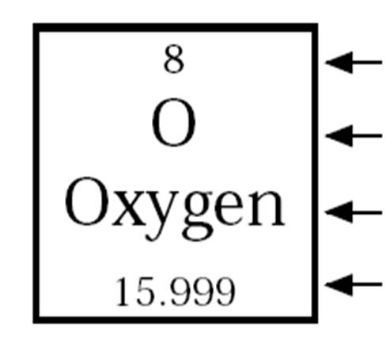
2.1: Introduction
Write
Atomic Number
Element Symbol
Element Name
Atomic Mass

Slide 32
2.1: Introduction
Write
Atomic Number
The number of protons in an atom
Atomic Number

Slide 33
Practice
Protons = 1
Neutrons = 0
Electrons = 1
P⁺
e⁻
Hydrogen
The number of protons will tell you what the element is.

Slide 34
Practice
Protons = 2
Neutrons = 2
Electrons = 2
P⁺
N⁰
e⁻
P⁺
e⁻
N⁰
Helium
The number of protons will tell you what the element is.

Slide 35
Practice
Protons = 6
Neutrons = 6
Electrons = 6
e⁻
P⁺
P⁺
N⁰
P⁺
P⁺
N⁰
e⁻
e⁻
P⁺
P⁺
N⁰
e⁻
e⁻
N⁰
N⁰
N⁰
e⁻
Carbon
The number of protons will tell you what the element is.

Slide 36
Practice
Protons = 8
Neutrons = 8
Electrons = 8
e⁻
e⁻
P⁺
N⁰
P⁺
P⁺
N⁰
e⁻
P⁺
P⁺
N⁰
e⁻
e⁻
P⁺
N⁰
N⁰
e⁻
e⁻
P⁺
N⁰
e⁻
P⁺
N⁰
N⁰
e⁻
e⁻
The number of protons will tell you what the element is.
Oxygen

Slide 38
2.1: Introduction
Review
Element Symbol
Element Symbol

Slide 39
2.1: Introduction
Review
Element Name
Element Name

Slide 40
2.1: Introduction
Write
Atomic Mass
The average weight of all atoms of an element
Atomic Mass

Slide 41
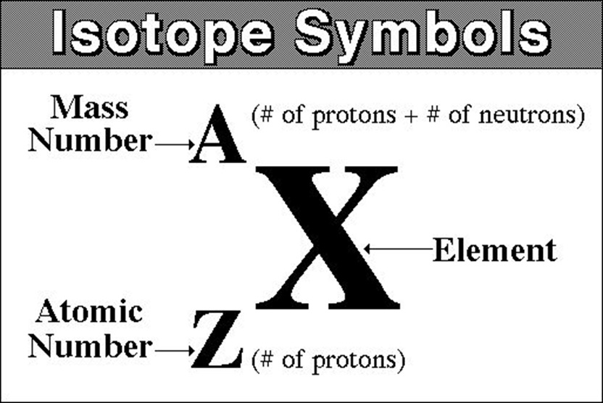
2.1: Introduction
Write
Mass Number
Weight of a single atom
P+N

Slide 42
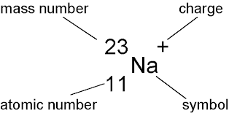
Write
(1 – 11 = -10)
12
Formulas:
To find protons → Look at the Atomic number
To find Neutrons → mass number - atomic number
To find electrons → electrons = charge - protons

Slide 43
Answer
Protons:___________
Neutrons:__________
Electrons:___________
Protons:___________
Neutrons:__________
Electrons:___________
Protons:___________
Neutrons:__________
Electrons:___________

Slide 44
2.2: Structure of Matter → Atomic Structure
Draw the Isotopic Symbol for the following
P
Atomic # = Protons
Mass # = Protons + Neutrons
Charge = Protons - Electrons
15 protons, 16 neutrons, and 18 electrons __________
56 protons, 82 neutrons, and 54 electrons _________
13 protons, 14 neutrons, and 10 electrons __________
31
-3
15
Mass # = 15 + 16 = 31
Charge = 15-18 = -3
Ba
+2
138
56
Al
+3
27
13

Slide 45
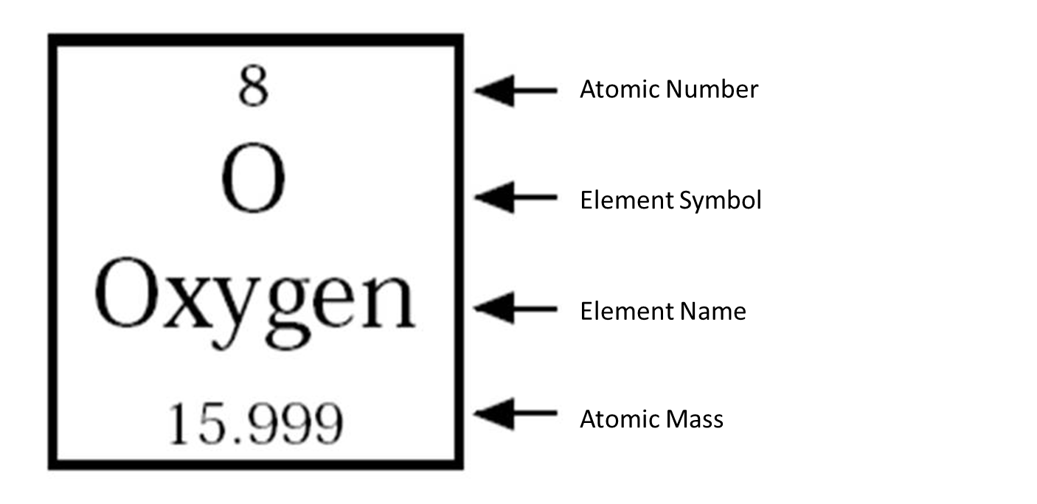
Label the Atom
Draw and Label
Valence Electron
e-
Electron Shells
Proton
N⁰
P⁺
N⁰
P⁺
Electron
e-
e-
P⁺
N⁰
Neutron
Nucleus

Slide 46
2.1: Introduction
Write
Chemical Bonding
an attraction between atoms that causes them to bind and create molecules

Slide 47
2.1: Introduction
Write
Molecule
Any time two or more atoms combine together a molecule is formed
Compound
When different atoms form together a type of molecule called a compound is formed

Slide 48
Unit 02 Vocabulary
Compounds are a type of molecule.
All compounds are molecules but not all molecules are compounds.
Molecule
Compound

Slide 49
2.1: Introduction
Write
Why does chemical bonding occur?
Every atom wants its outer electron shell full of electrons. This is why bonding between atoms occurs.
e-
e-
e-
e-
e-
e-
e-
e-
e-
e-
e-
e-
e-
e-
e-
e-
e-
e-
e-
e-
e-
e-
e-

Slide 50
2.2: Structure of Matter → Bonding of Atoms
Write
Octet Rule
atoms create chemical bonds to achieve an octet (8) of electrons in their outer most electron shell

Slide 51
Chemical Bonds
How many electrons does Hydrogen need to meet the octet rule?
1
e-
Nucleus
e-

Slide 52
Chemical Bonds
How many electrons does Helium need to meet the octet rule?
0
e-
Nucleus
e-

Slide 53
Chemical Bonds
e-
How many electrons does Carbon need to meet the octet rule?
e-
e-
e-
Nucleus
e-
4
e-

Slide 54
Chemical Bonds
e-
How many electrons does Flourine need to meet the octet rule?
e-
e-
e-
Nucleus
e-
1
e-
e-
e-
e-

Slide 55
Chemical Bonds
How many electrons does Lithium need to meet the octet rule?
e-
Nucleus
e-
7
e-

Slide 57
2.2: Structure of Matter → Bonding of Atoms
Write
Two ways to obtain an octet:
Ionization
Transfer of electrons (Ionic Bond)
Sharing (Covalent Bond)

Slide 58
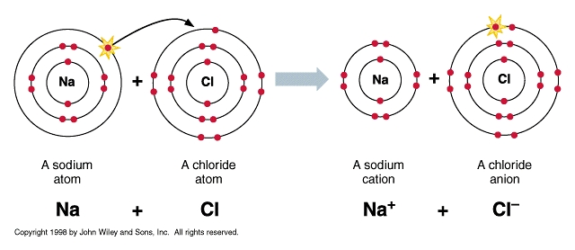
2.2: Structure of Matter → Bonding of Atoms
Write
Ionization
Occurs when an atom gives away or receives an electron causing it to turn into an ion.

Slide 59
Ionization: How atoms become Ions
Na is going to donate an electron to Cl. This fills Cl’s energy level and drops Na back to a full energy level.
Because of the number of electrons is no longer the same as the protons there is a negative and positive charge.
Cl
17
₋
₊
Na
11
Read and Watch

Slide 60
Ionic Bond
Read and Watch
Transfering electrons creates ions. Oppositely charged ions are attracted to one another (opposites attract). This attraction is an ionic bond.

Slide 61
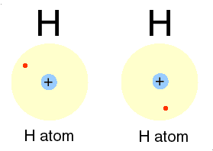
Covalent Bonds
Read and Watch
Sharing Electrons. Both atoms obtain 8 electrons in their outer electron shell.

Slide 62
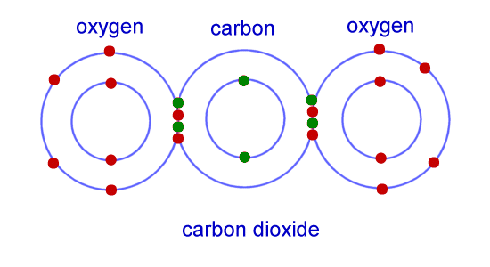
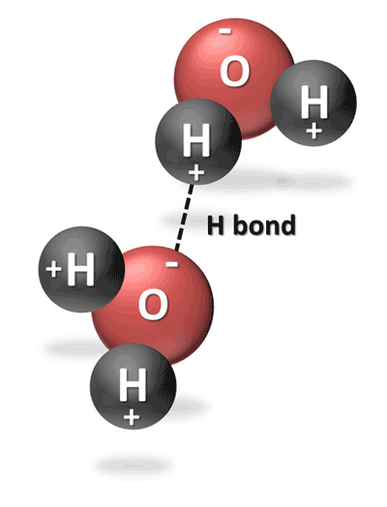
2.2: Structure of Matter → Bonding of Atoms
Write
Three Types of Chemical Bonds
Ionic Bond
Covalent Bond
Transfer of electrons
Occurs between two Ions
Attraction of +ions to –ions
strongest
Sharing electrons
Occurs between two atoms
2nd strongest
Hydrogen Bond
Occurs between two polar molecules
Attraction of +pole to –pole
Weakest

Slide 63
2.2: Structure of Matter → Bonding of Atoms
Listen
Two types of Covalent Bonds:
Non-polar Covalent Bonds
Electrons are shared equally
Results in a non-polar molecule
Molecule does not have poles
Polar Covalent Bonds
Electrons are shared unequally
Results in a polar molecule
Molecules have positive and negative poles

Slide 64
Let’s Make Water
O
H
H

Slide 65
Negative Pole
O
H
H
Positive Pole

Slide 66
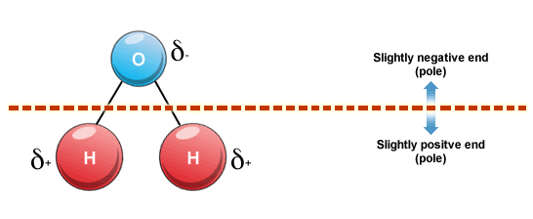
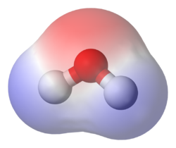

Slide 67
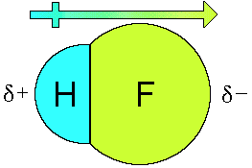
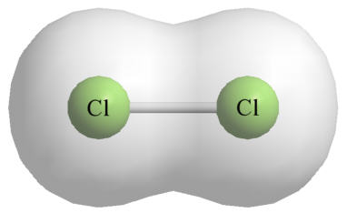
Polar Molecules
Non-Polar Molecules

Slide 68
2.1: Introduction
Write
Polar Molecule
A molecule that has positive and negative poles due to uneven sharing of electrons. Created by polar covalent bonds.
Nonpolar Molecules
A molecule that is neutral. Created by nonpolar covalent bonds.

Slide 70
Hydrogen Bond
Read and Watch
A bond formed between two polar molecules. A positive pole is attracted to a negative pole.

Slide 72
Properties of Water
Write

Slide 73
Properties of Water
Write
Cohesion
Adhesion
Surface Tension
Floating Ice
High Heat Capacity
Capillary Action
Solvent

Slide 74
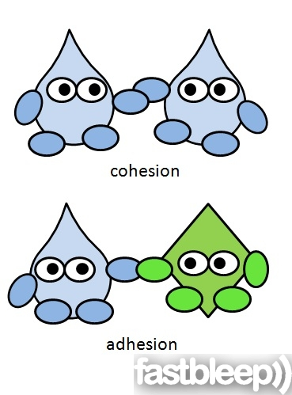
Cohesion
Write
Cohesion
Hydrogen bonds between two water molecules
co = together

Slide 75
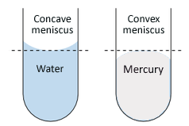
Adhesion
Write
Adhesion
Hydrogen bonds between water and other polar molecules
Ad= to other

Slide 76
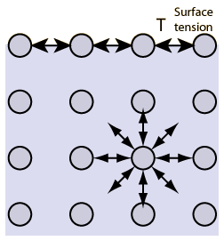
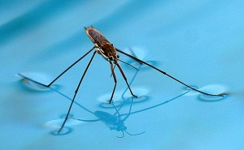
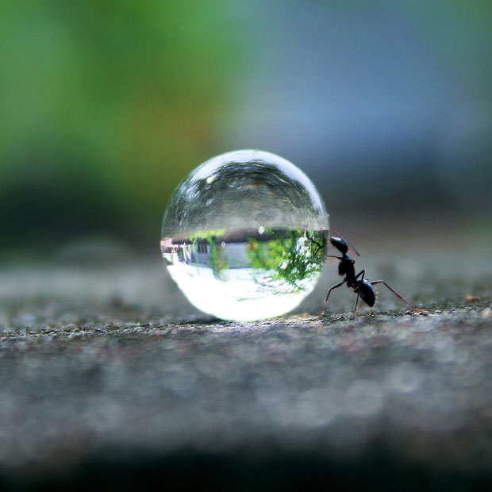
Surface Tension
Write
Surface Tension
surface film of a liquid caused by hydrogen bonds between water (cohesion)
Examples:
Insects walking on water
Droplet of water

Slide 77
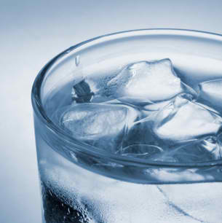
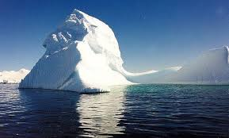
Why does Ice Float in Water?
Listen

Slide 78
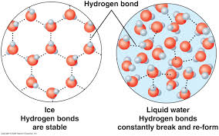
Listen

Slide 79
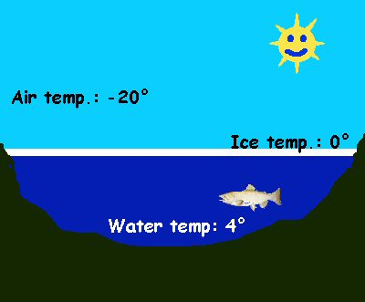
Listen

Slide 80
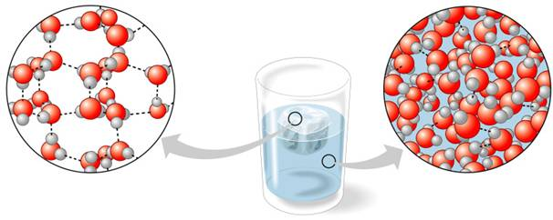
Floating Ice
Floating Ice
Solid water is less dense than liquid water due to hydrogen bonds

Slide 81
TED Ed Video on Ice
Watch
https://www.youtube.com/watch?v=UukRgqzk-KE

Slide 82
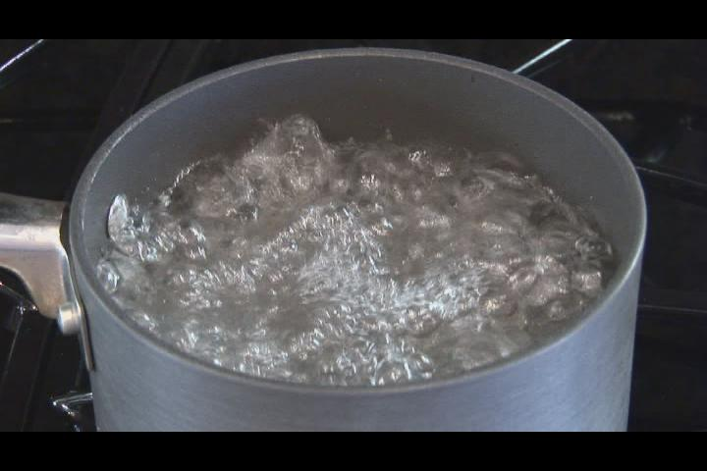
High Heat Capacity
Write
High Heat Capacity
Water takes longer to evaporate because you have to break the hydrogen bonds.

Slide 83
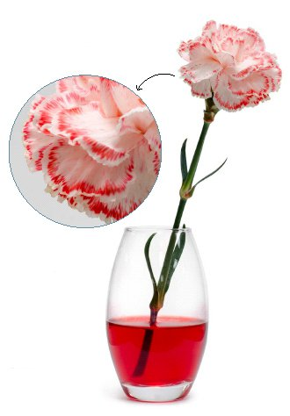
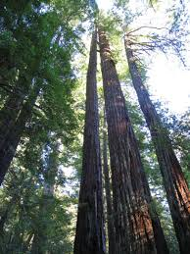
Listen

Slide 84
Capillary Action
Write
Capillary Action
Movement of water up straws or trees. Occurs due to cohesion and adhesion.

Slide 85
Capillary Action Video
https://www.youtube.com/watch?v=y9hprlmck44
https://www.youtube.com/watch?v=0IzcZ_UWuB0

Slide 86
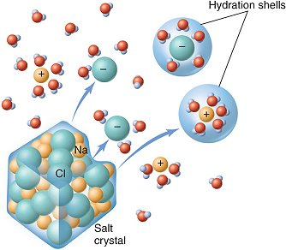
Listen

Slide 87
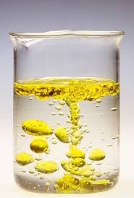
Universal Solvent
Write
Universal Solvent
Water dissolves polar molecules or charged molecules.
Water can’t dissolve oil because it is nonpolar

Slide 88
Review
https://www.youtube.com/watch?v=aVmU3CLxvgU

Slide 89
2.2 Structure of Matter
Formula

Slide 90
2.1: Structure of Matter → Formulas
Write
Molecular Formula
Represents the numbers and types of atoms in a molecule as well as any charges.
Mg⁺²
K⁺
CO₃⁻²
ion
ion
CO₂
Ca⁺²
Cl⁻
Polyatomic Ion
Molecular Compound
ion
ion
H₂O
SO₄⁻²
Diatomic Molecule
Na⁺
Polyatomic Ion
O₂
ion
Diatomic Molecule
C₆H₁₂O₆
HCO₃⁻
Molecular Compound
Polyatomic Ion

Slide 91
2.1: Structure of Matter → Formulas
Write
Ion
Single element with a positive or negative charge
Polyatomic Ion
More than one elements bonded covalently into a molecule with a positive or negative charge.
Diatomic Molecule
Two atoms (same or different) bonded covalently.
O2, CO, H2, NO
Molecular Compound
Two or more atoms of different elements bonded together covalently.
Polar Molecule
Molecules with positive and negative sides due to uneven sharing of electrons.

Slide 92
2.1: Structure of Matter → Formulas
Write
CO₃⁻²
Overall Charge
Number of Elements

Slide 93
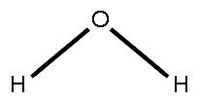
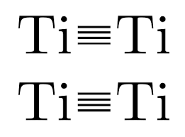
2.1: Structure of Matter → Formulas
Write
Structural Formulas
Represents how the atoms are bonded together
1 bond 2 bonds
3 Bonds 4 Bonds
N N

Slide 94
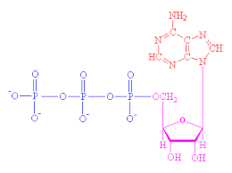
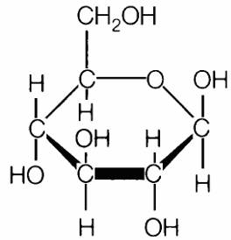
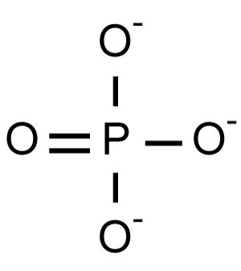
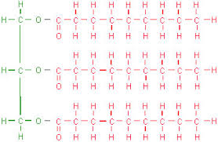
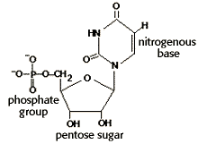
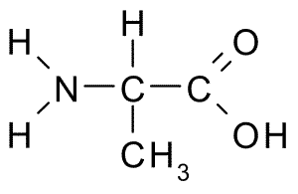
2.1: Structure of Matter → Formulas
Write

