Slide 1
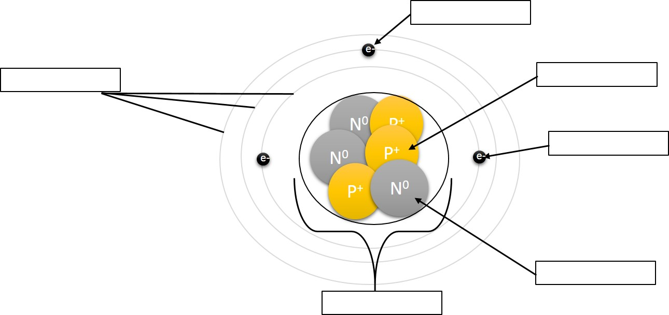
Daily Warm Up 09/10/2015 -09/11/2015
Label the parts of an atom:
2.
1.
3.
4.
Decipher the isotopic symbol:
5.
¹³C⁻⁴
⁶
6.
Protons: ___________
Neutrons: _________
Electrons: __________
This atom is both an _________ and an _____.

Slide 2
Daily Warm Up 09/10/2015 -09/11/2015
Label the parts of an atom:
2.
Valence Electron
1.
3.
Electron Shells
Proton
4.
Electron
Decipher the isotopic symbol:
5.
^{-4 – 6 = -10 electrons}
6.
Neutron
¹³C⁻⁴
⁶
Nucleus
6
Protons: ___________
Neutrons: _________
Electrons: __________
This atom is both an _________ and an _____.
7
-10
Ion
^{7 Neutrons}
Isotope

Slide 3
2.2: Structure of Matter → Atomic Structure
Draw the Isotopic Symbol for the following
P
Atomic # = Protons
Mass # = Protons + Neutrons
Charge = Protons - Electrons
15 protons, 16 neutrons, and 18 electrons __________
56 protons, 82 neutrons, and 54 electrons _________
13 protons, 14 neutrons, and 10 electrons __________
31
-3
15
Mass # = 15 + 16 = 31
Charge = 15-18 = -3
Ba
+2
138
56
Al
+3
27
13

