Slide 1
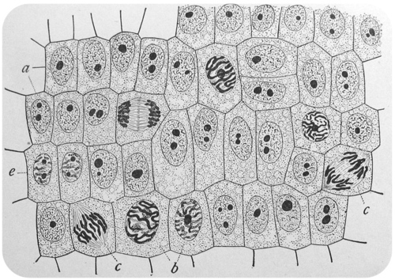
Daily Warm Up FRI 01/23/2015 - MON 01/26/2015
Label the phases of Mitosis as seen under this microscope.
1.
2.
3.
4.
6.
7.
5.

