Slide 1
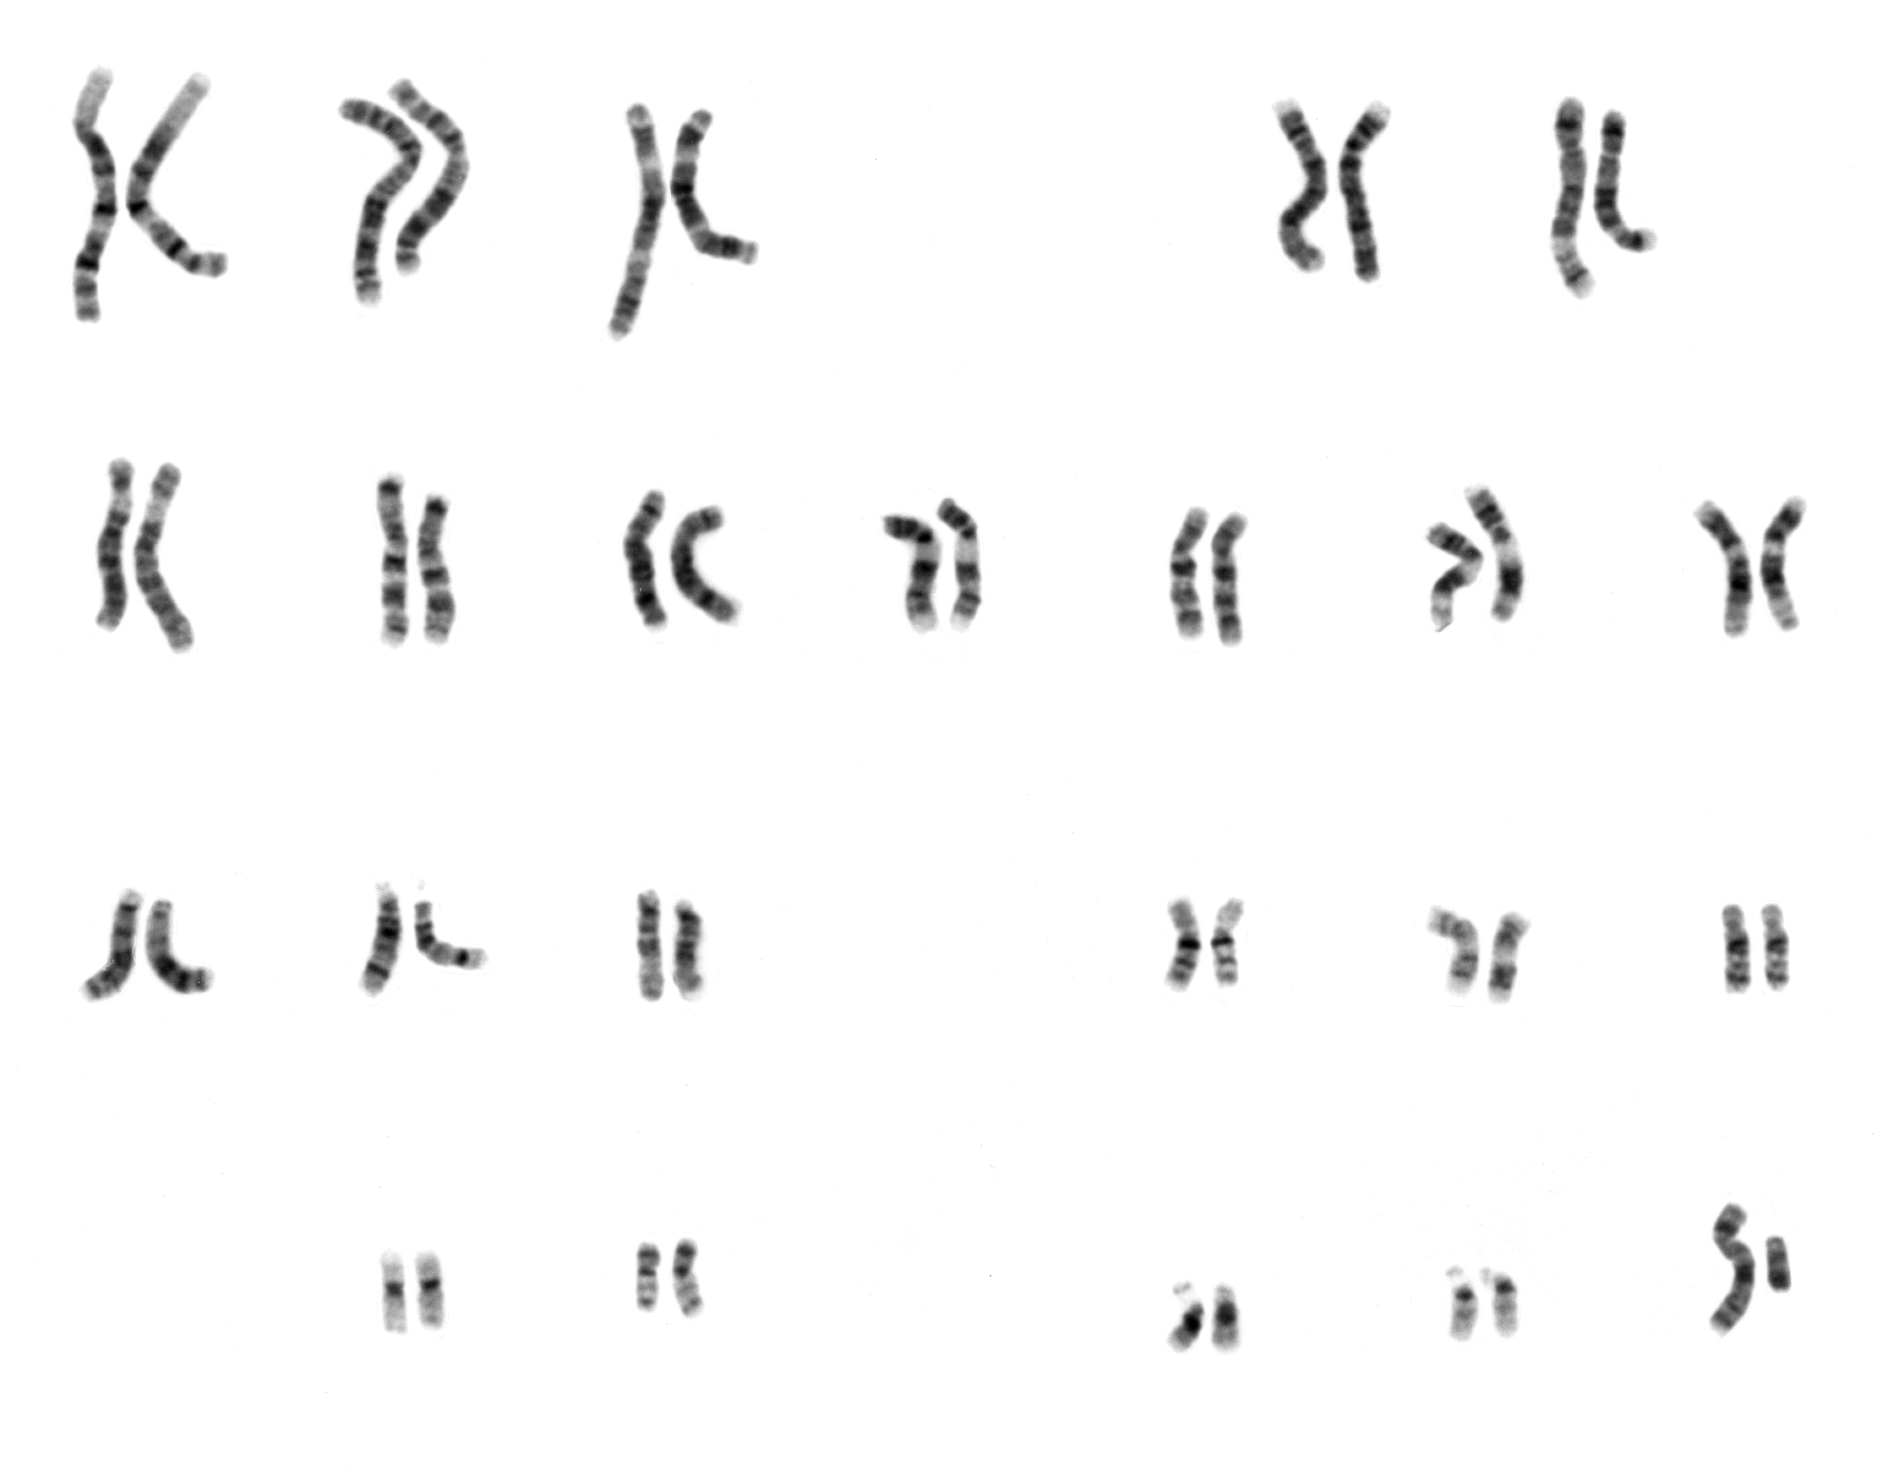
Daily Warm Up FRI 01/16/2015 – TUE 01/20/2015
What is are homologous chromosomes?
In order for there to be homologous chromosomes a cell must have ______ set of chromosomes.
What is this? →
What are the two types of reproduction?
During a process called _______________, a sperm and egg cell fuse together to create a unique diploid cell known as a ____________.

